Slide 1
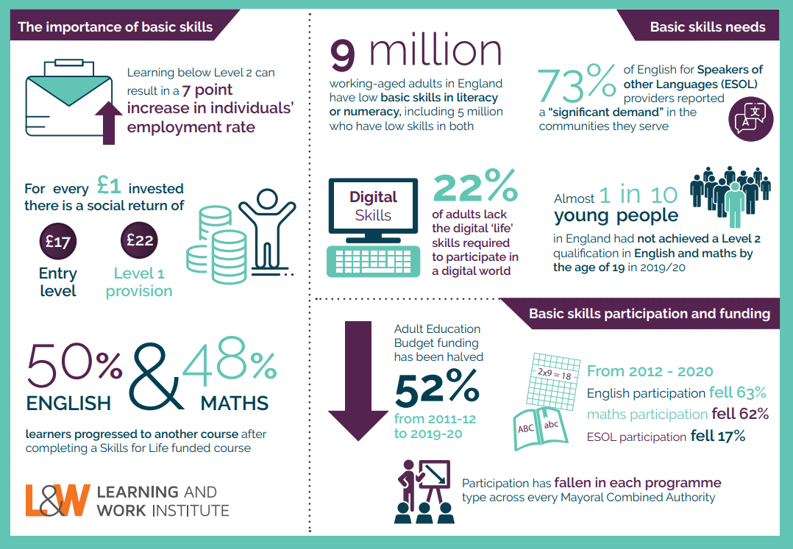
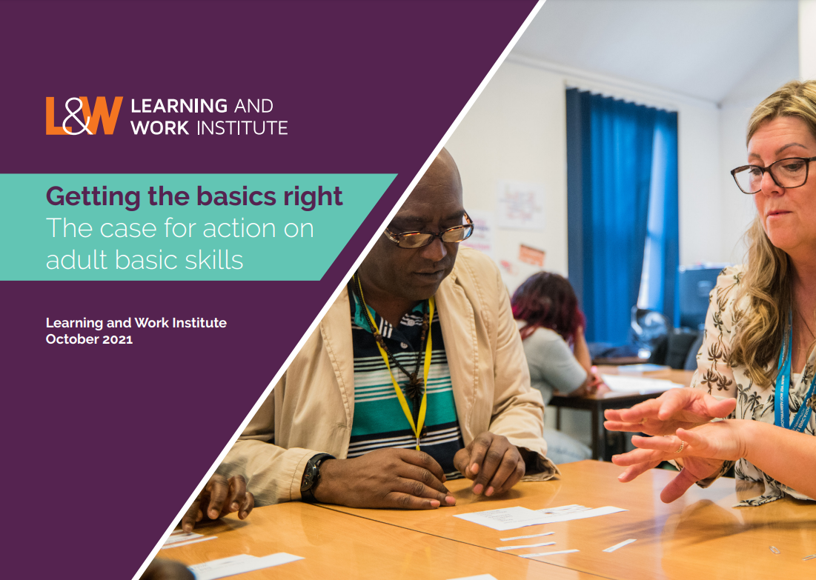
Getting the Basics Right: The Case for Action on Adult Basic Skills
Notes:
Key points
- Good basic skills have huge benefits – increased employment, progression to further learning and wider social outcomes.
- 9 million adults have low basic skills in literacy and/or numeracy
- participation is down 63% in English and 62% in maths – and in all MCA areas.
- AEB funding has more than halved between 2011 – 12 and 2019 – 20

Slide 2
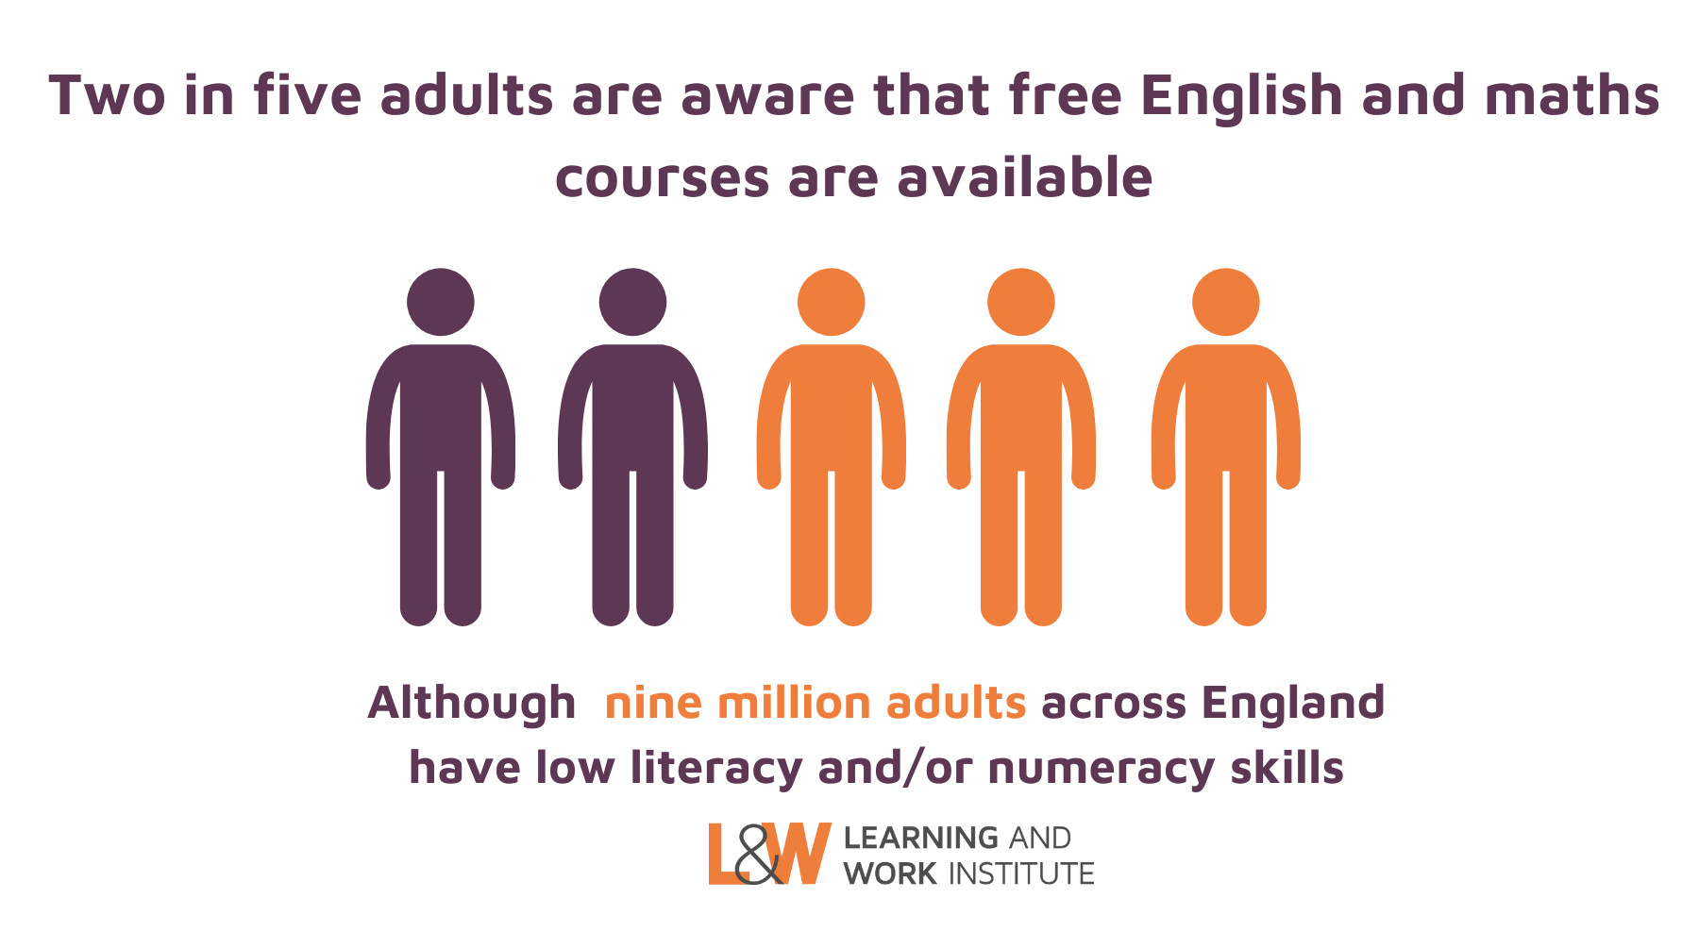
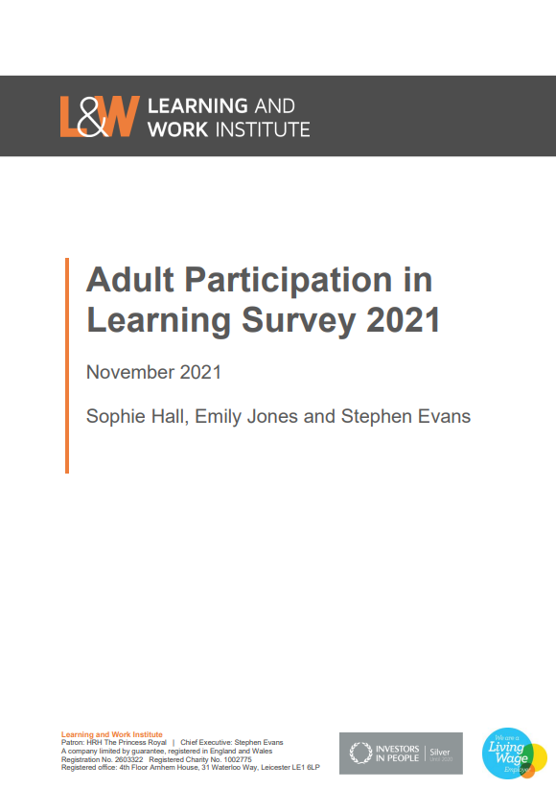
Adult Participation in Learning Survey 2021: Basic Skills Learning
Notes:
Twenty years on from the government’s original Skills for Life strategy for improving adult literacy and numeracy skills, one in five adults across England have low literacy and/or numeracy, equating to nine million people.
At the same time, participation in English, maths, and ESOL learning has fallen 60 per cent over the last decade.
Within this context, the 2021 survey included two questions exploring adults’ awareness of free English and maths courses in England and factors that would encourage take up of these courses.
Just over two in five respondents (43 per cent) are aware of the availability of these courses.

Slide 3
Notes:
Adults who are least likely to be aware of the availability of free English and maths courses include:
Adults who left full-time education earlier,
Adults with lower-level qualifications,
Adults who have not engaged in learning recently,
These findings suggest that those who may benefit most from free English and maths provision – that is, those furthest away from learning and with no formal qualifications – are the least likely to be aware that such provision is available.

Slide 4
Engaging Adults in Basic Skills Learning
Option to take the course entirely online
19%
Flexible course times to fit around work or family
19%
A course location close to home or work
16%
Understanding how the course would benefit me personally
15%
Notes:
Respondents were asked what would encourage them to take up a free course to improve their English and maths skills.
Flexibility to fit learning around other commitments emerges as a key motivating factor – with around one in five adults saying that they would be encouraged to take up a course if it were delivered entirely online or if course times were flexible to fit around work or family commitments.
Other factors commonly cited include a course location close to their home or work (16 per cent) and understanding how the course would benefit them personally (15 per cent).
Two in five respondents (40 per cent) indicated that none of the options listed would encourage them to take up a free English or maths course. Respondents who left full-time education aged 16 or below, who left school without GCSEs/O Levels, and who have not engaged in learning in the last three years are all more likely than the sample average to indicate that nothing would encourage them to take up a free English or maths course.
This suggests that there is a need to proactively promote the benefits of English and maths learning – and to take a targeted approach to reach those who are least likely to seek opportunities themselves.

