Slide 1
The missing million: the labour market in 2022
Chair: Stephen Evans, Chief Executive, Learning and Work Institute
Richard Clifton, Managing Director – Employability, Shaw Trust;
Shazia Ejaz, Director of Campaigns, REC; Kim Chaplain, Associate Director for Work, Centre for Ageing Better

Slide 2
Overcoming shortages:
How to create a sustainable labour market
17 November 2022

Slide 3
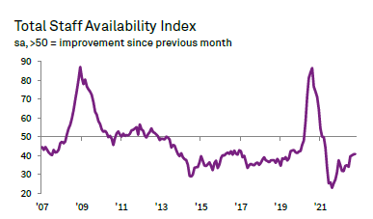
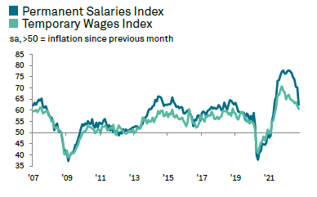
Staff demand continues to rise, permanent placements decline for first time since February 2021
According to our monthly survey of recruiters (Report on Jobs):
Permanent placements saw a fresh fall in October. While candidate shortages dampened hiring, heightened economic uncertainty had also led some businesses to reassess their recruitment plans.
Permanent staff demand continued to rise across all ten monitored job categories in October. Nursing/Medical/Care topped the rankings, while Retail was placed at the bottom of the league table.
Temporary staff demand continued to rise across all ten monitored job categories. Nursing/Medical/Care, Hotel & Catering and Retail registered the strongest increases in temporary vacancies, while Executive/Professional saw the slowest.
The candidate availability of permanent staff across the UK fell for the twenty-first month running in October. The rate of reduction was sharp overall and much quicker than the series trend, despite easing fractionally to the least severe in 18 months. As has been the case since March 2021, the availability of temporary workers also continued to decline during October.
Report on Jobs, November 2022

Slide 4
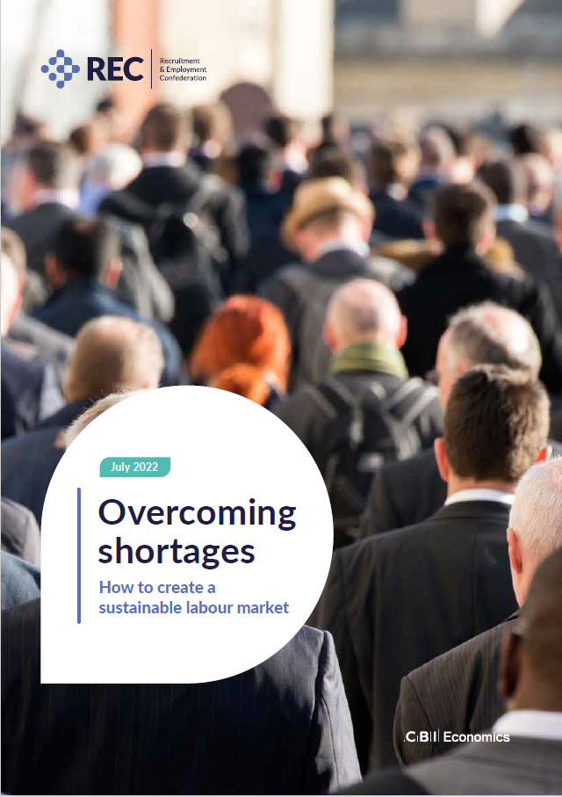
Overcoming Shortages
For the past two years, labour and skills shortages have continued to dominate headlines.
But in 2022, the REC wanted to demonstrate why we needed action. We examined the economic impact of shortages and came up with recommendations for governments and businesses that would genuinely address them for the long-term.
In our report, we demonstrated the:
The economic impact of labour and skills shortages in the UK
How the UK labour market and government policies compare to other G7 countries also facing labour shortages
The difficulties UK businesses have when hiring, and what businesses, government and other stakeholders can do to build a longer-term view of the workforce.​​
Conclusion that business and government have a shared duty to overcome shortages.
Overcoming shortages, 2022

Slide 5
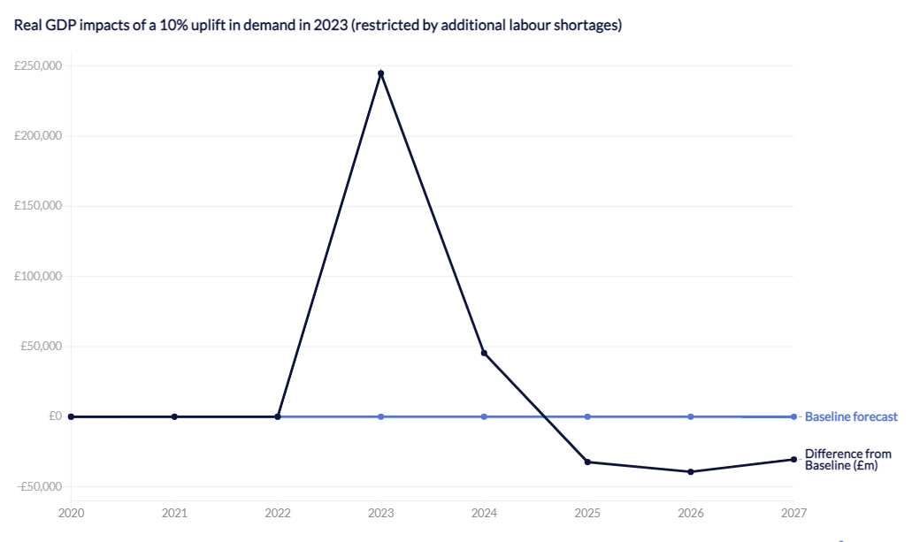
Not addressing labour shortages could cost UK economy up to £39 billion every year
Our forecasts for the next five years point to anaemic growth and stagnant productivity – a situation that could be exacerbated if we do nothing to fix labour and skills shortages.
With a hypothetical but not inconceivable 10% uplift in demand in the economy, we would need 1.7 million new jobs.
Without this employment increase, real UK GDP would fall by between £30 billion and £39 billion every year from 2024 through to the end of 2027.
This is equivalent to 1.2% to 1.6% of GDP per year and around the size of the UK recruitment sector in 2019.
Modelling analysis also shows that a demand boost in the face of shortages leads to higher earnings and inflation, and an overall fall in real disposable income, which in turn means restricted growth in public sector receipts.
Source: REC Overcoming Shortages report, 18 July 2022
Overcoming Shortages, 2022

Slide 6
Business recommendations
– In summary
Unless workforce planning is pushed up the agenda at leadership level, businesses will be stifled in their own attempts to grow and innovate. Many companies say their staff are their greatest asset and their top priority – it is time that was followed with action. Put the “people stuff” first.
Businesses are the key actors in delivering growth.
Firms must play their part on skills and behave as if people are their greatest asset – not just say that they are.
Increasing investment in skills isn’t effective unless it is targeted and integrated with the overall commercial growth plan.
Any commercial long-term strategy should include a people plan which treats skills spending as investment rather than costs.
Most businesses know that achieving an equal, diverse and inclusive workplace is essential for commercial and ethical reasons, but few are acting. Equality, diversity and inclusion should be at the core of your people plan; work closely with recruitment agencies and EDI specialists to review your policies.
Employers need to deploy good employment relations skills. For a sustainable hiring strategy, businesses should improve staff engagement, particularly when considering benefits and working conditions.
Overcoming shortages, 2022

Slide 7
Key recommendations for government
Commission a cohesive, future workforce strategy for how the UK will put people planning at the heart of its growth strategy. This must go well beyond just skills and have a home in with a government department eg Cabinet Office or with an independent commission. The government also needs to work closely with businesses and others on developing the strategy and monitoring the progress.
Skills policies that catalyse private sector investment – by reforming the apprenticeship levy
Expand Local Skills Improvement Plans (LSIPs) across England with a view to supporting the model across the entire UK, in ways which are appropriate for each devolved system.
Create a tax credit scheme for employers who invest in training, and specifically, a ‘green tax credit’ for businesses investing in green skills, and green jobs.
Extending work visas and updating the shortage occupation list more frequently. The report shows how Canada is doing this.
Making local labour markets work – by improving local transport, addressing childcare needs
Mandate ethnicity and disability pay gap reporting for large businesses to further diversify the labour market and retain talent.

Slide 8
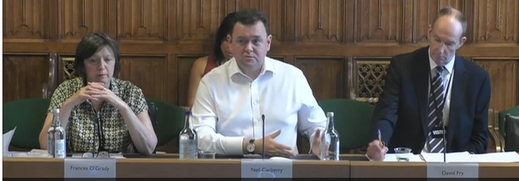
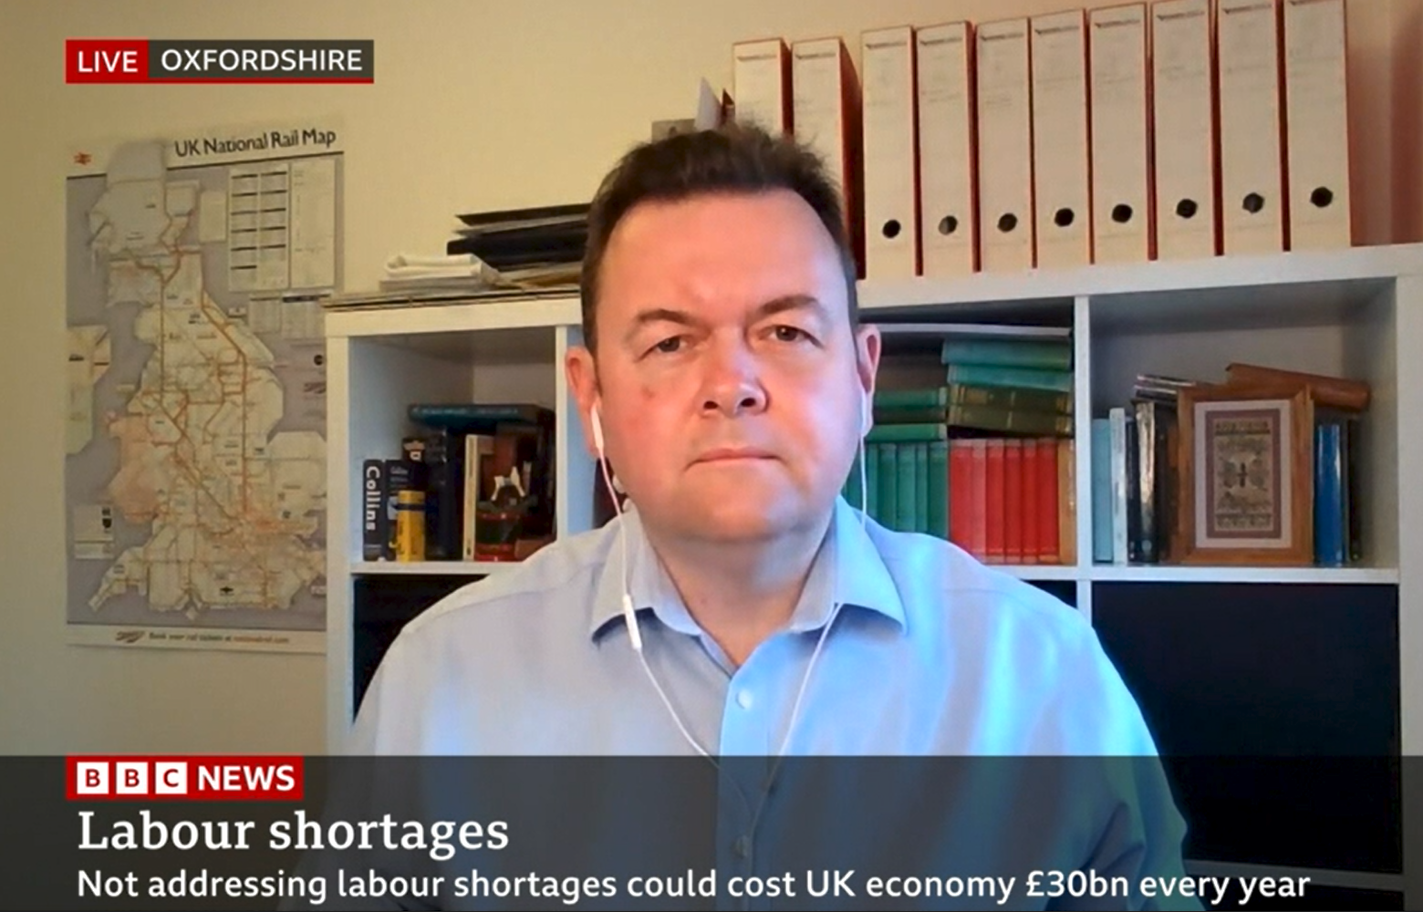
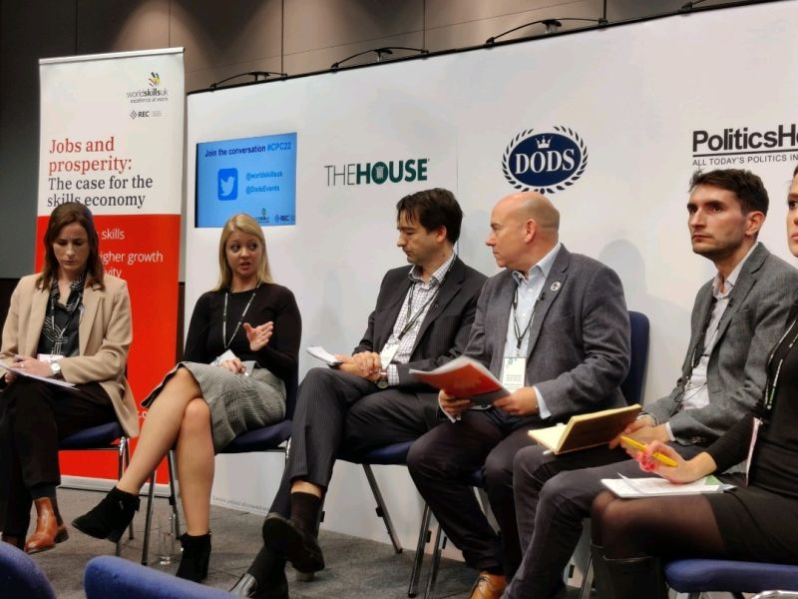
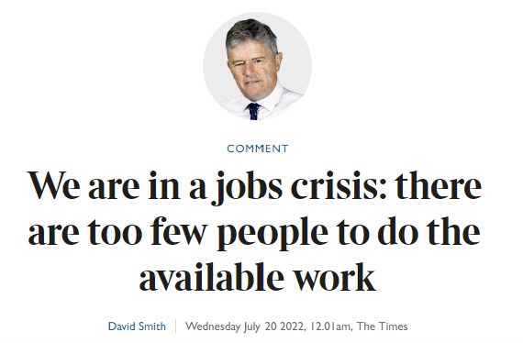
Recent campaigns activities
Recent engagement & industry news

Slide 9
The missing million: the labour market in 2022
Chair: Stephen Evans, Chief Executive, Learning and Work Institute
Richard Clifton, Managing Director – Employability, Shaw Trust;
Shazia Ejaz, Director of Campaigns, REC; Kim Chaplain, Associate Director for Work, Centre for Ageing Better

Slide 10
How can we make sure no-one is shut out of work because of their age?
Kim Chaplain
Special Adviser (Work)
Centre for Ageing Better

Slide 11
The problem:
People in their 50s and 60s do not have equitable access to work – because of structural barriers and ageist attitudes.

Slide 12
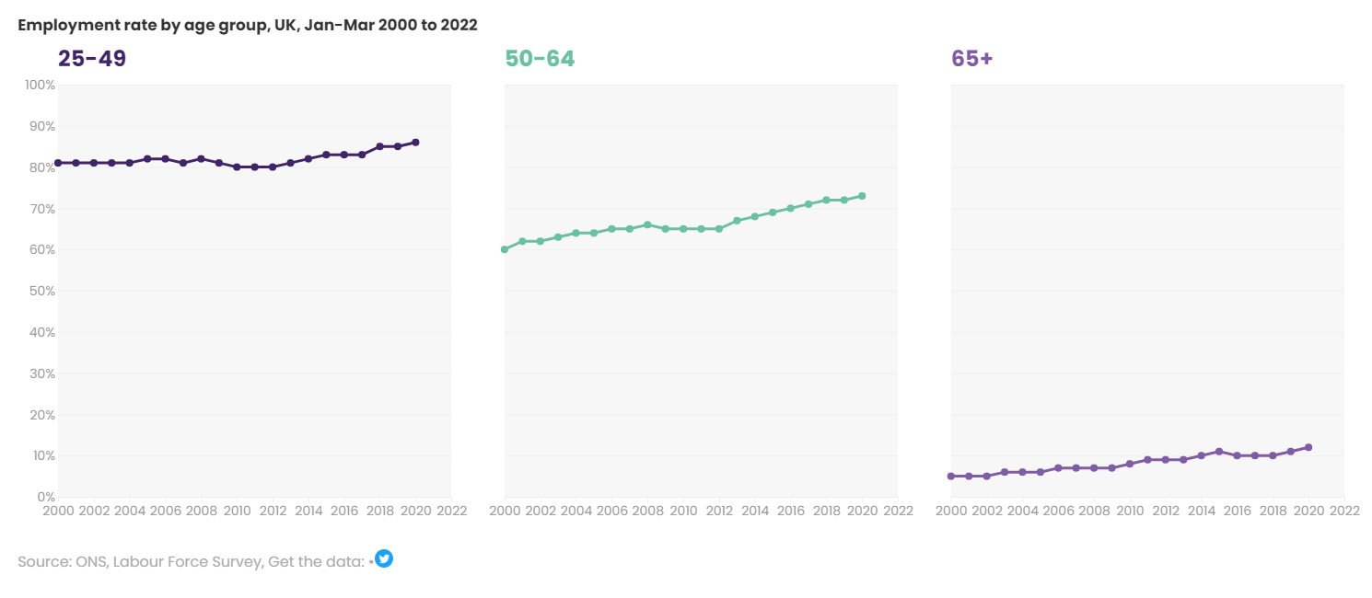
The employment rate of 50-64s rose by 12 percentage points between 2000 and the start of the pandemic…

Slide 13
…but there remained a 13 percentage point gap between the 25-49s and 50-64s…
13ppt

Slide 14
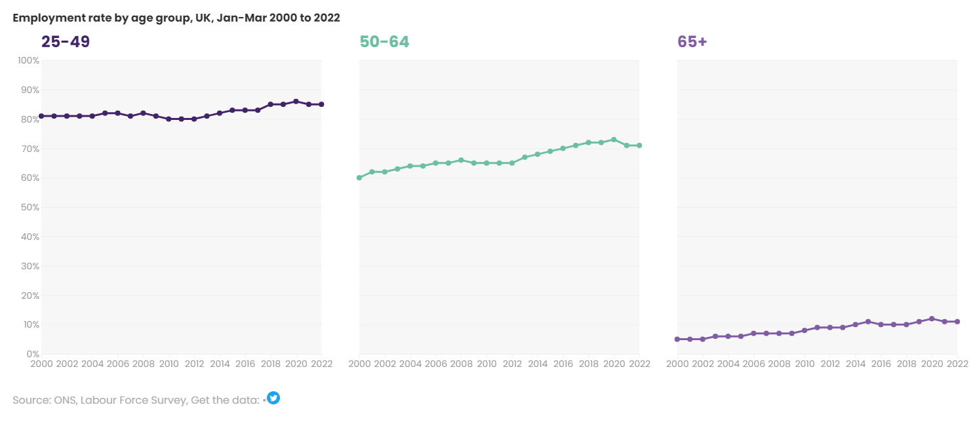
…which has widened to 14 percentage points over the course of the pandemic.
14ppt

Slide 15
People with some characteristics are more likely to fall in this gap than others.
women
People from BAME backgrounds
14ppt
People with long-term health conditions

Slide 16
These are the main reasons people age 50-64 give for being out of work.
Unemployed and actively jobseeking
Sick, injured or disabled
Looking after family/home
Retired
1 in 9
1 in 3
1 in 8
1 in 3
Retirement can be a positive choice.
But overconfidence about financial security is a problem.
And retirees may have stayed in the workplace if it was more welcoming to older workers…
People who fall out of work in their 50s and 60s are more likely than younger people to become long-term unemployed. And, when they access employment support, their outcomes are worse.
Caring responsibilities and long-term health conditions create structural barriers which prevent many people in their 50s and 60s from accessing work.

Slide 17
The state pension age;
66 yrs
67 yrs 2026
68 yrs 2044

Slide 18
Accept and normalise working lives extending into 60s and 70s
Not sufficient to extend the SPA without supporting policies
Stronger messaging and support for employers
Different welfare support for 50 plus to SPA, particularly for those with health conditions
Appropriate delivery of upskilling and reskilling, making lifelong learning a reality for more

Slide 19
The missing million: the labour market in 2022
Chair: Stephen Evans, Chief Executive, Learning and Work Institute
Richard Clifton, Managing Director – Employability, Shaw Trust;
Shazia Ejaz, Director of Campaigns, REC; Kim Chaplain, Associate Director for Work, Centre for Ageing Better

