Slide 1
Growing a high skill, high wage economy
Chair: Naomi Clayton, Deputy Director, Learning and Work Institute
Patrick Craven, Director of Policy, City and Guilds; Anthony Painter, Director of Policy and External Affairs, Chartered Management Institute;
Cath Sleeman, Head of Data Discovery, Nesta

Slide 3
Improving Labour Market Information
Employment and skills convention
Genna Barnett Elizabeth Gallagher
Karlis Kanders India Kerle
Adeola Otubusen George Richardson Isabel Steward Jack Vines
Cath Sleeman, Head of Data Discovery

Slide 6
Growing a high skill, high wage economy
Chair: Naomi Clayton, Deputy Director, Learning and Work Institute
Patrick Craven, Director of Policy, City and Guilds; Anthony Painter, Director of Policy and External Affairs, Chartered Management Institute;
Cath Sleeman, Head of Data Discovery, Nesta

Slide 7
Improving Labour Market Information
Employment and skills convention
Genna Barnett Elizabeth Gallagher
Karlis Kanders India Kerle
Adeola Otubusen George Richardson Isabel Steward Jack Vines
Cath Sleeman, Head of Data Discovery

Slide 8
What Labour Market Information is missing and why?
Very little data on the
transitions between jobs
No timely or granular data on skill demands or supply
Potential causes that we’ve noticed
Some LMI is expensive or not open
Some variables are not collected
There’s no single accepted framework / taxonomy
No single group owns the challenge of improving LMI
….but there are many groups who are trying to fill the gaps!
No granular data on
green jobs or green skills
Not much data on job quality and its determinants

Slide 9
Why is missing Labour Market Information important?
Job seekers may not realise that their skills are transferable to another industry
Employers may not realise that a candidate would be under/over qualified for the job
Educators may not realise that they are teaching skills that are becoming redundant
Dampened skill levels
Slower rates of knowledge diffusion
Skill mismatches
Reduced job quality
Slowed growth in productivity
Slower transition to Net Zero Workers may not know which skills will help them to find a ‘green job’
Imposing barriers to diversity Employers may ask for a degree rather than specific skills
Other potential side effects of poor LMI

Slide 10
What are we doing to improve LMI?
We’re creating an Open Jobs Observatory (OJO)
Collection
We began collecting adverts in January 2021 and we now have millions of deduplicated postings.
Collect online job adverts, with permission
Extraction
Job titles
Descriptions
Salaries
Locations
Deduplication
Enrichment
Annualize salaries
Standardize locations
Extract skills
Aggregation
Composition of skills demands
Skill demands by region
Value of skills
Keywords in adverts

Slide 11
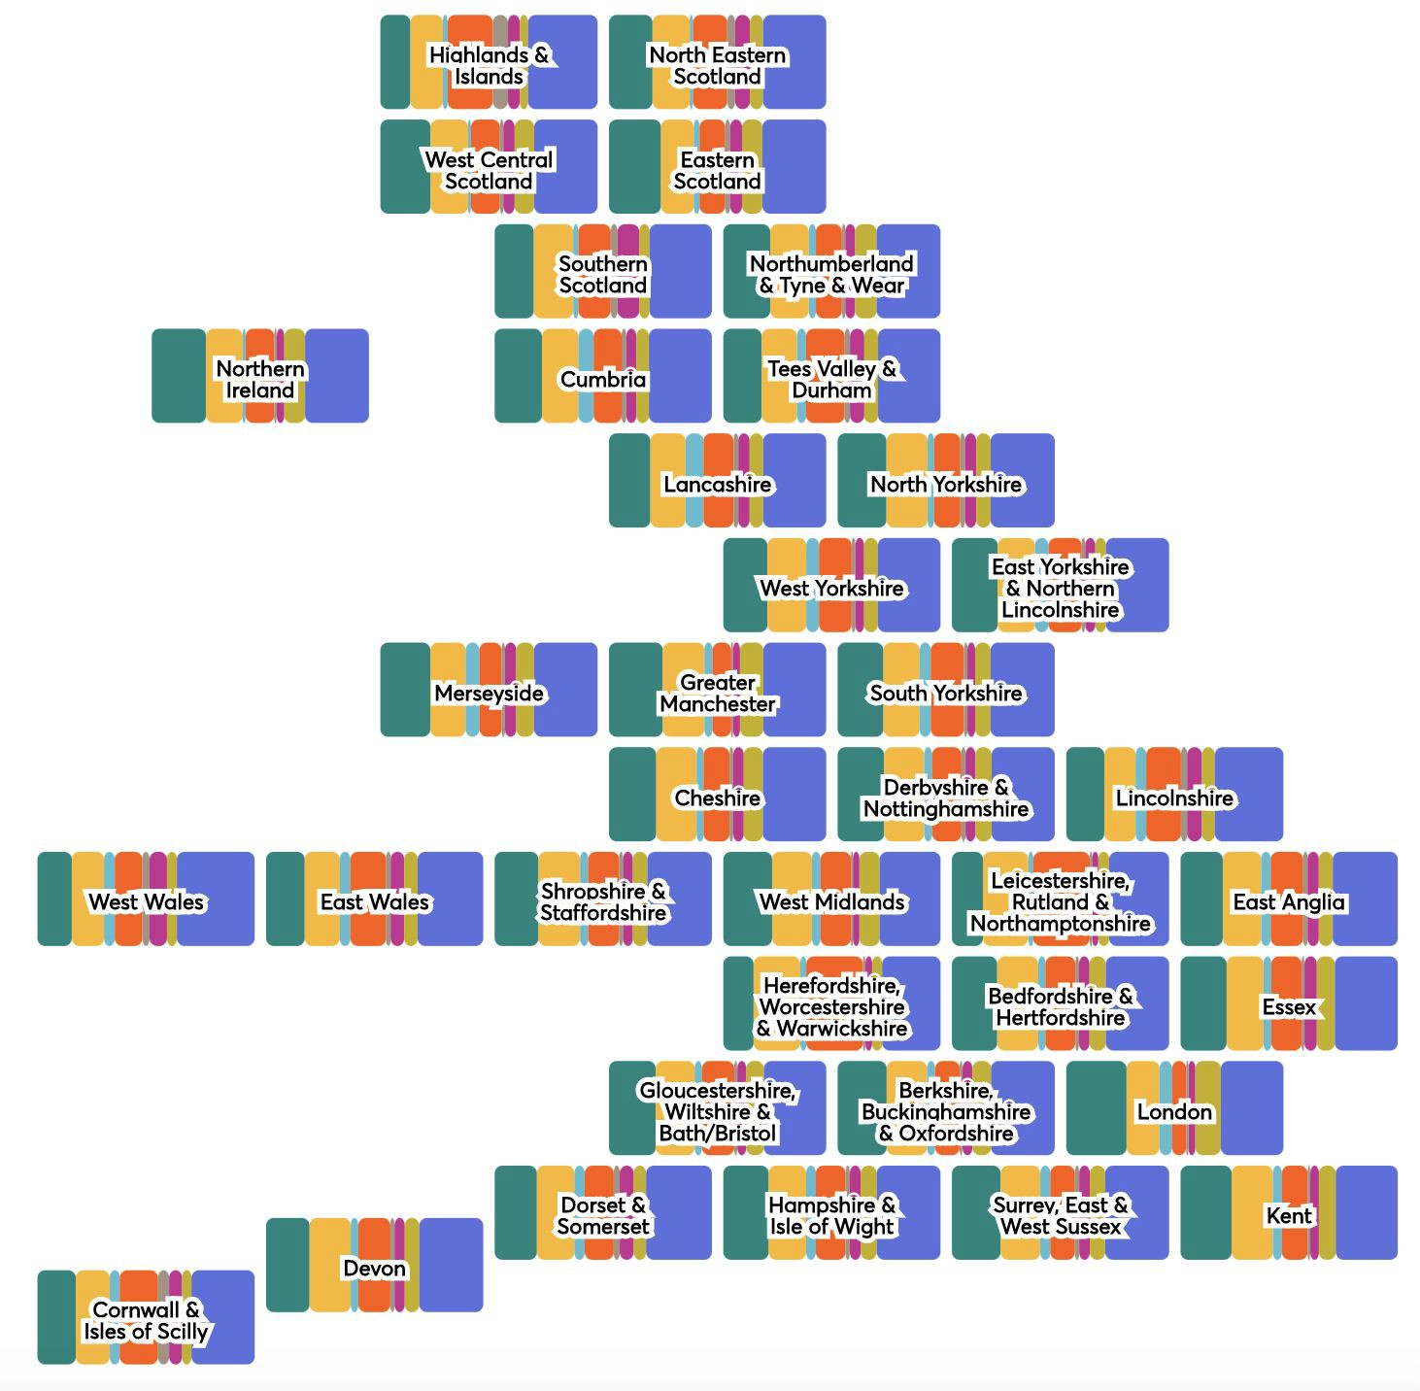
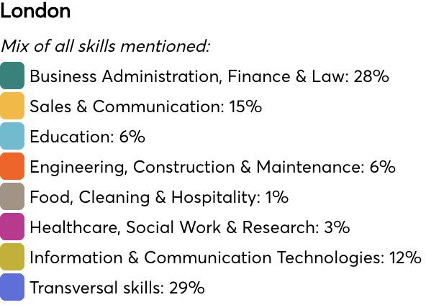
An example of preliminary insights from the Observatory
How do skill demands vary across the UK?
OJO can also provide insights on:
Skills required for a particular job
Transversal skills
Most highly paid skills
Changes in skill demand over time
NUTS 2 regions; London has been merged

Slide 12
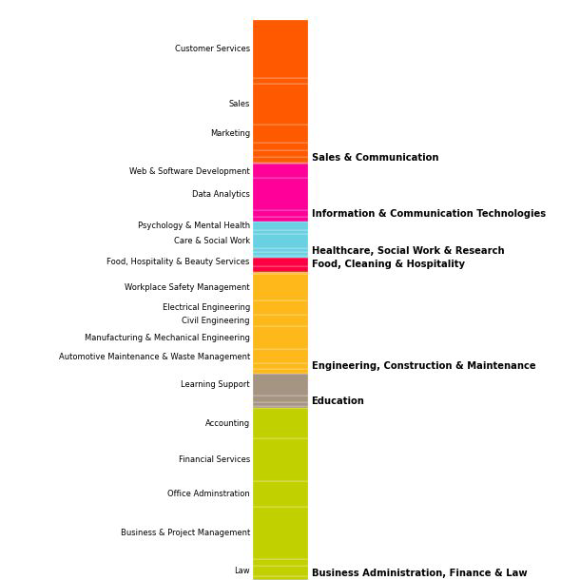
Application One: Measuring skill demands in Sussex
Which skills are demanded in Sussex?
Commissioned by the Sussex Chamber of Commerce to analyse skill demands
We identified absolute and relative skill specialties
We conducted deep dives on jobs in green industries, transversal skills and digital skills
Examples of findings:
The higher paying transversal skills require
foresight or working closely with others
(compromise / negotiation / cooperation)
The higher paying digital skills typically require coding. Demand for several languages, such as SQL, now stretch far beyond the ICT industry.

Slide 13
Green Industries
Application Two: Finding jobs in green industries
Green jobs
The Govt has pledged to support the creation of 2 million green jobs by 2030
There’s no standard list of UK green jobs
So we developed the first open algorithm
for tagging jobs in green industries.
It’s a trained model that uses words within the text of adverts to identify these jobs.
Around 3% of job adverts were for positions in green industries
Examples of ‘green jobs’ in green industries
Sustainability consultants
Senior ecologists
Heating engineers
Recycling operatives
Climate change specialists
Examples of ‘non-green jobs’ in green industries
QC analysts
Project managers
Data analysts
Operations managers
Software developers

Slide 14
Where could the field focus next?
A few other projects
Developed a data-driven skills taxonomy
Using millions of employee reviews to learn about the drivers of job quality
About to revisit our green jobs algorithm
Creating timely measures of skill supply
Identifying different types of ‘green jobs’
Developing mixed method approaches
for monitoring the labour market
Creating standards for algorithm-based career advice tools
Exploring the theoretical similarity between jobs

