Slide 1
Expanding opportunity, meeting demand
@LearnWorkUK
#EmpSkills22

Slide 2
Workshop 2 | Devolution of employment and skills: Joining up support locally
Chair: Kathryn Jellings, Head of Employment, 3CS
Deep Khanna, Director of Operations, Twin Training; Seb Barker, Co-Founder & COO, BEAM;
Clare Boden-Hatton, Director of Operations –
Employment and Skills, West Midlands Combined Authority

Slide 3
Devolution of Employment and Skills: A Great Opportunity to Embrace
A Frontline Perspective from Twin Employment & Training

Slide 4
A few words about us
We support jobseekers, individual learners and international students to achieve career success…
…through education, training, travel, and work experience
We work with DWP, DfE, MoJ, MCAs, local authorities, universities, colleges and third sector organisations
With the acquisition of 3SC and an apprenticeship provider, Twin will further develop devolved opportunities

Slide 5
Realising opportunities in the new devolution landscape
Localised employer engagement = more job outcomes and skills enhancement
Increased engagement with SMEs and 3rd Sector
More inclusive provision in line with metro mayor priorities
Growth in upskilling with short courses to quickly meet employer and learner demand
Closer working with commissioners (MCAs and LAs) offers flexibility and innovation in delivery
Greater scope for join-up of employment & skills delivery

Slide 6
It’s only just begun
Expanding skills bootcamp delivery to 5 regions West Midlands, East Midlands, London, South East & East England
Ready to be part of Multiply and UKSPF
Turing Scheme Benefits not yet fully recognised by all
More scope for programme join-up e.g. Neurodiversity Strategy Coaching, for more learner progression and meeting employer needs
Responding to Mayors’ Employment & Skills Strategies and LSIPs
County deals and levelling-up help drive local economic development while staying inclusive

Slide 7
Workshop 2 | Devolution of employment and skills: Joining up support locally
Chair: Kathryn Jellings, Head of Employment, 3CS
Deep Khanna, Director of Operations, Twin Training; Seb Barker, Co-Founder & COO, BEAM;
Clare Boden-Hatton, Director of Operations –
Employment and Skills, West Midlands Combined Authority

Slide 8
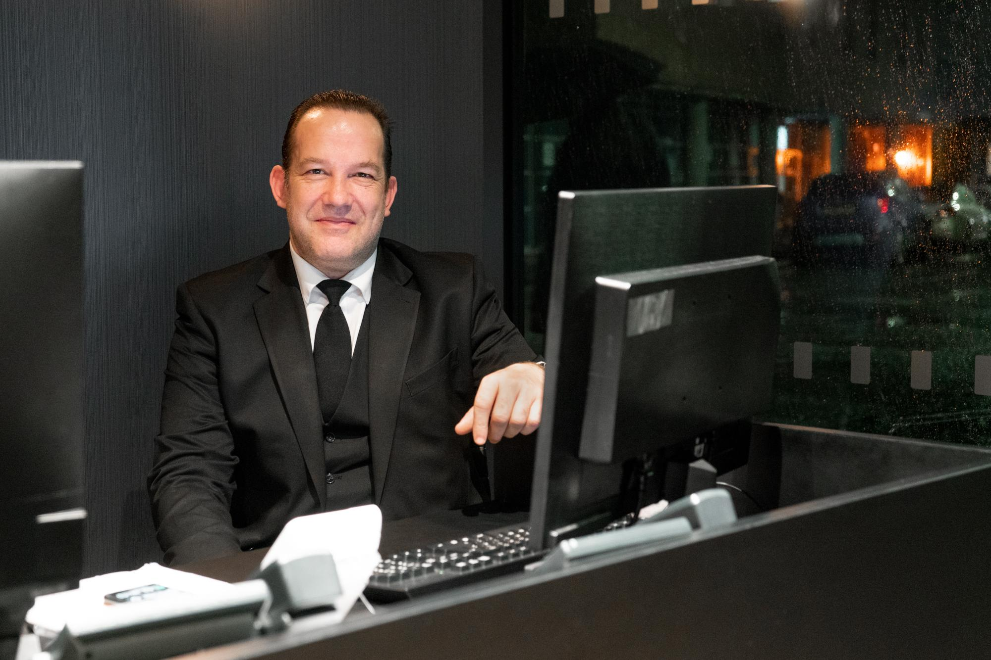
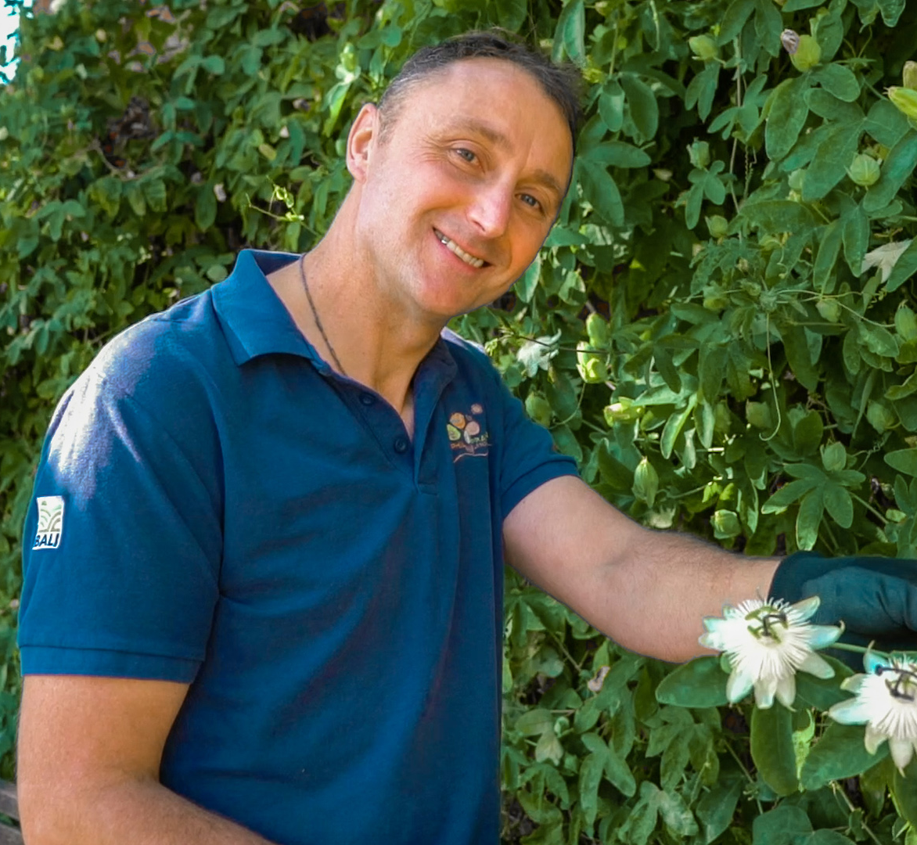
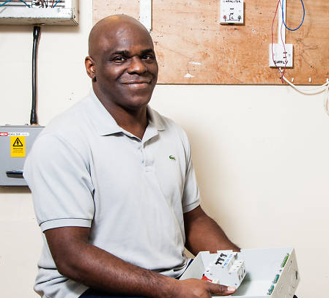
Devolution Breakout
November 2022

Slide 9
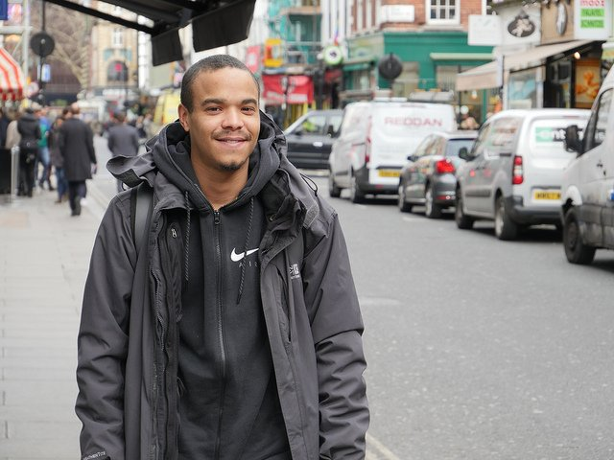
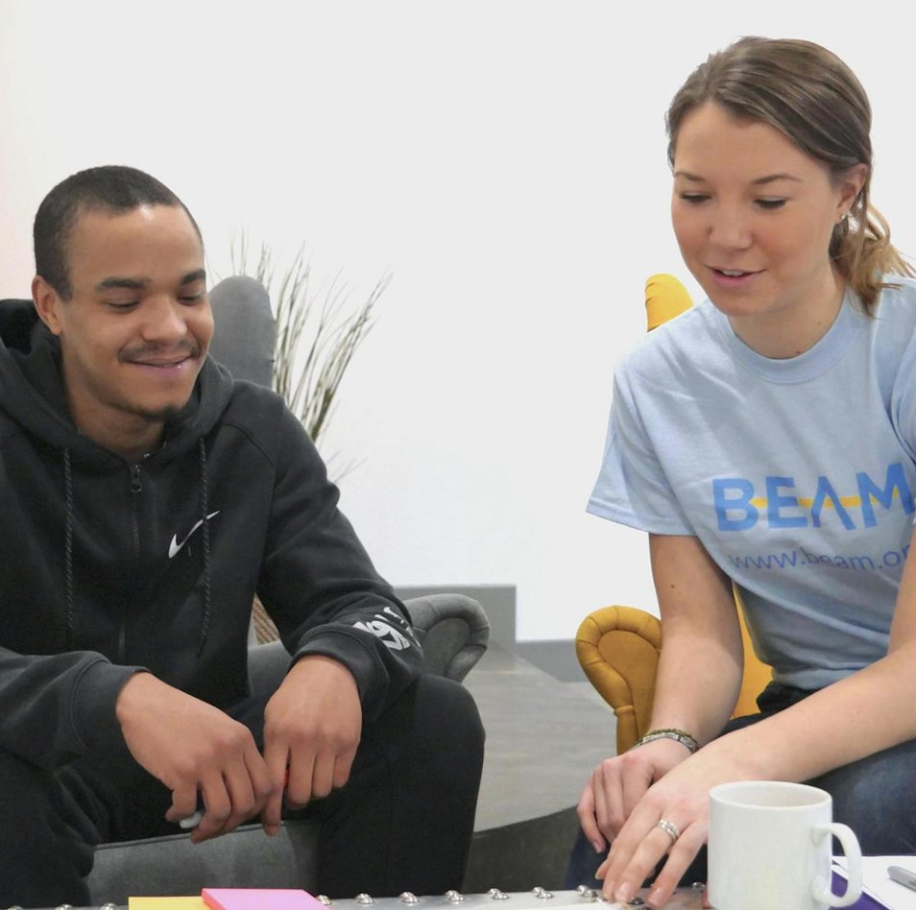
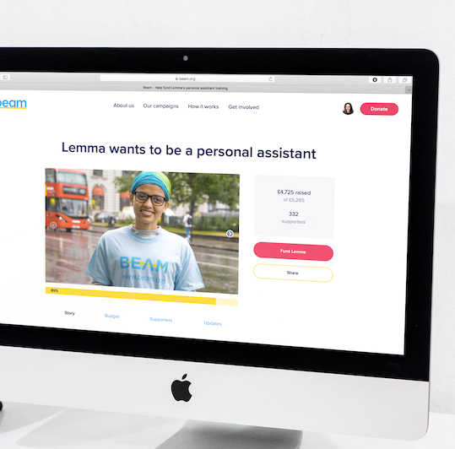
HOW IT WORKS
A collaborative approach
Partners
refer
Beam
supports
Communities engage
Training
upskills
Companies hire
01
02
03
04
05
Notes:
Joining dots between different partners
Govt & charities refer to Beam - simple online referral form
Employers - EPs are really brought into hiring Beam Members and ringfence roles e.g. Pret have experience hiring rough sleepers, Bupa created midday shifts for our single parents
Sustainment - Provide 3 months of support when the M first starts with an EP so that if there are any issues, the caseworker can help the M

Slide 10
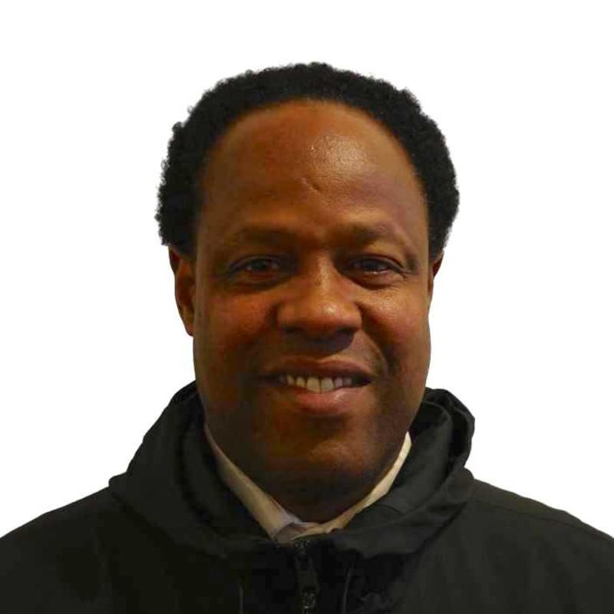
Meet Joseval

Slide 11
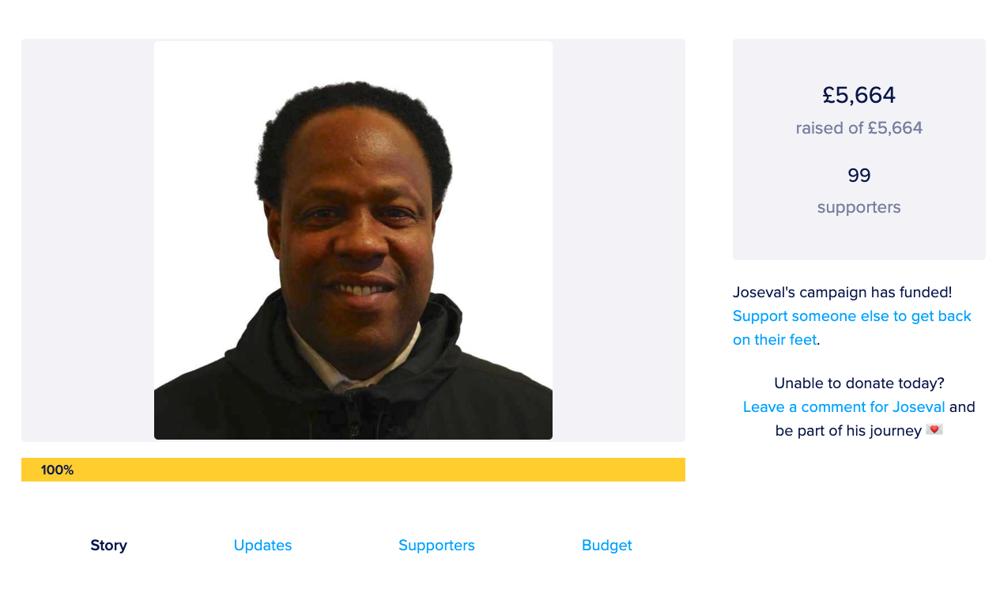

Slide 12
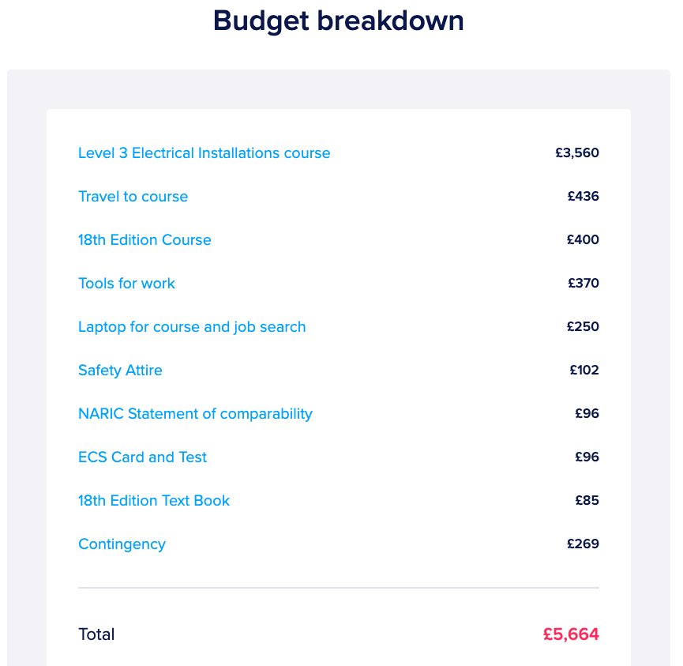

Slide 13
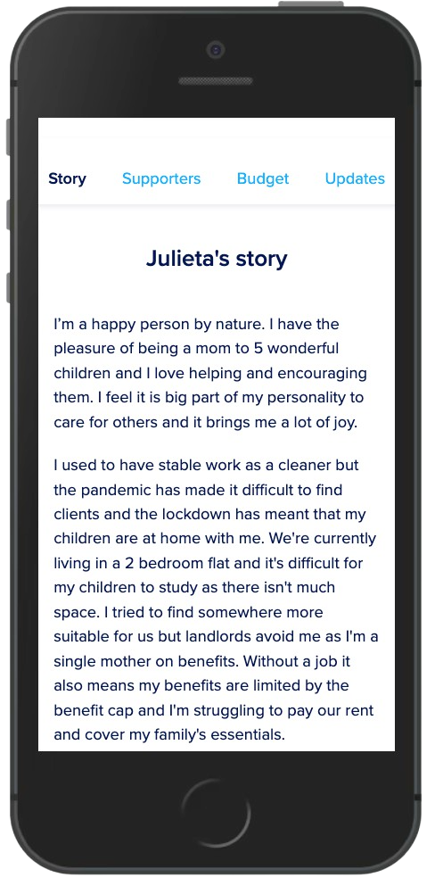
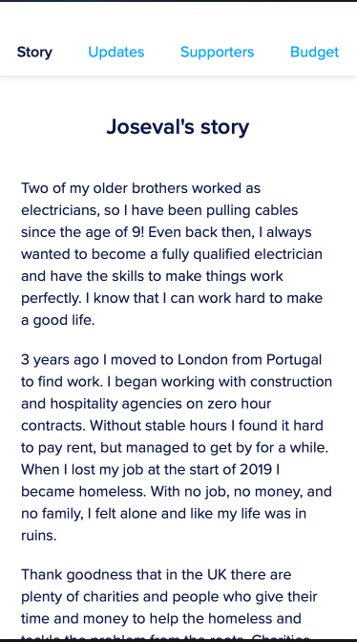

Slide 14
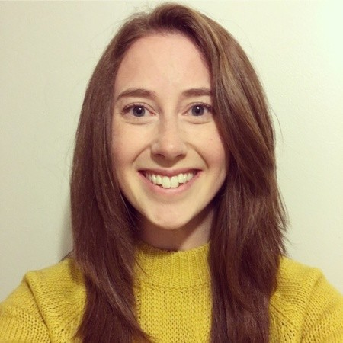
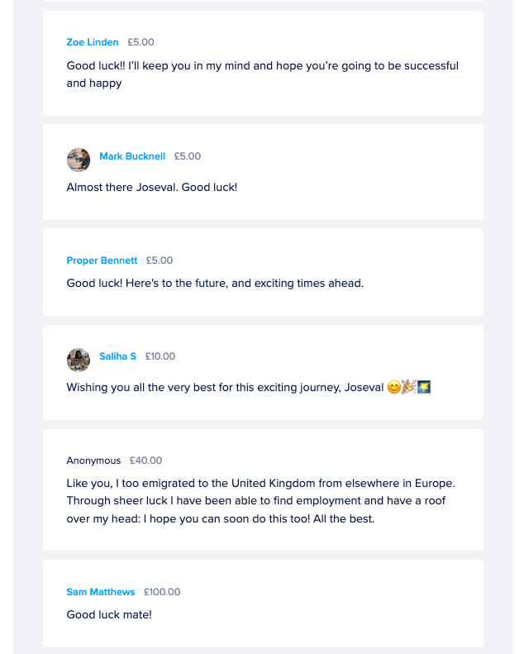
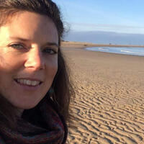

Slide 15
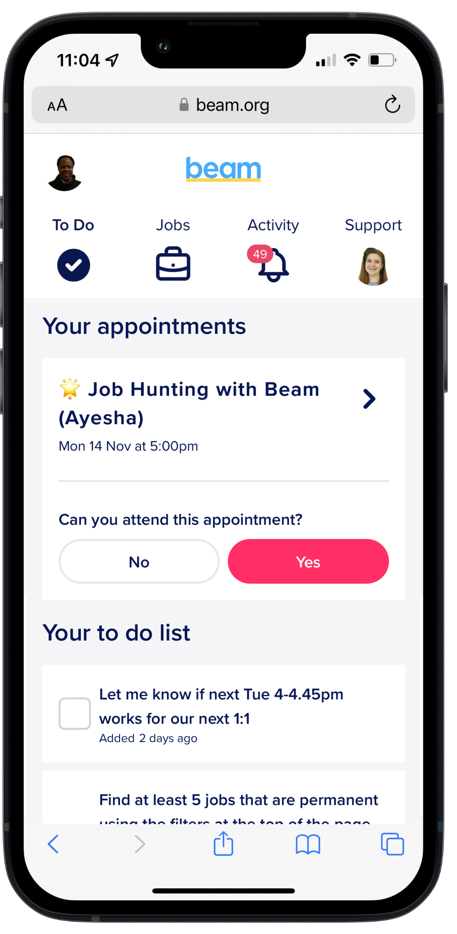
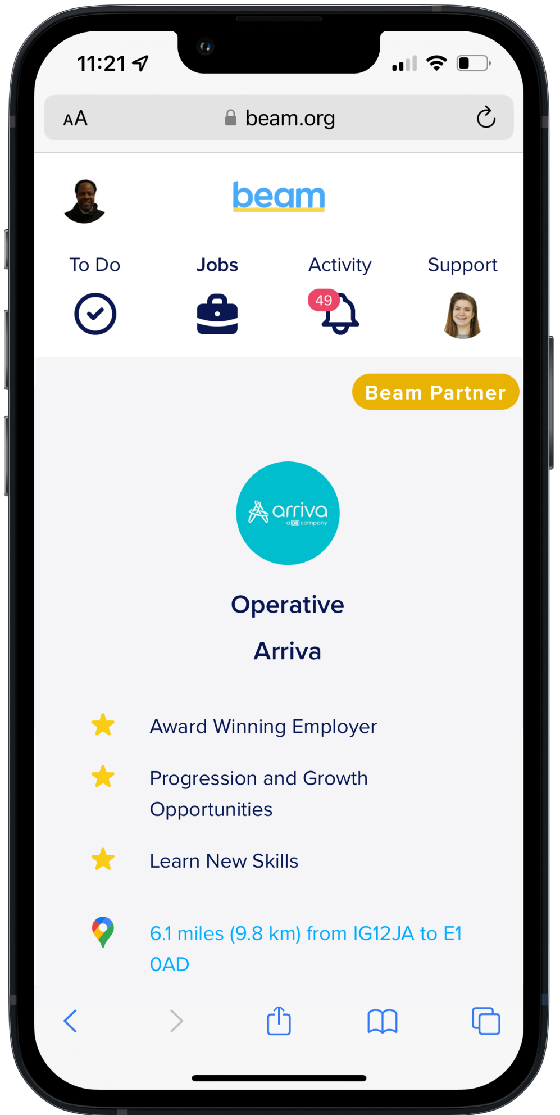
FOR SERVICE USERS A personal hub

Slide 16
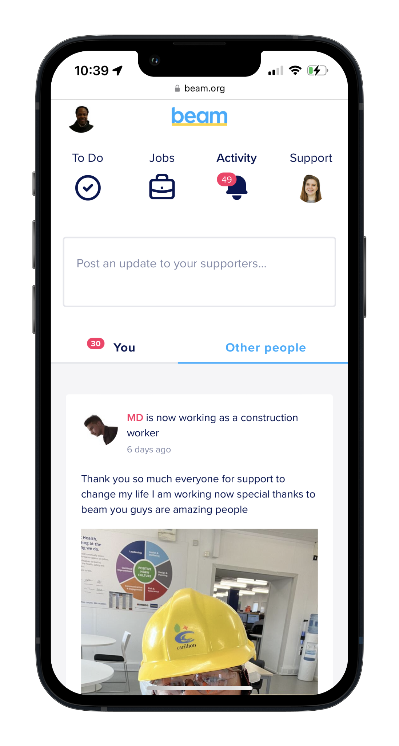
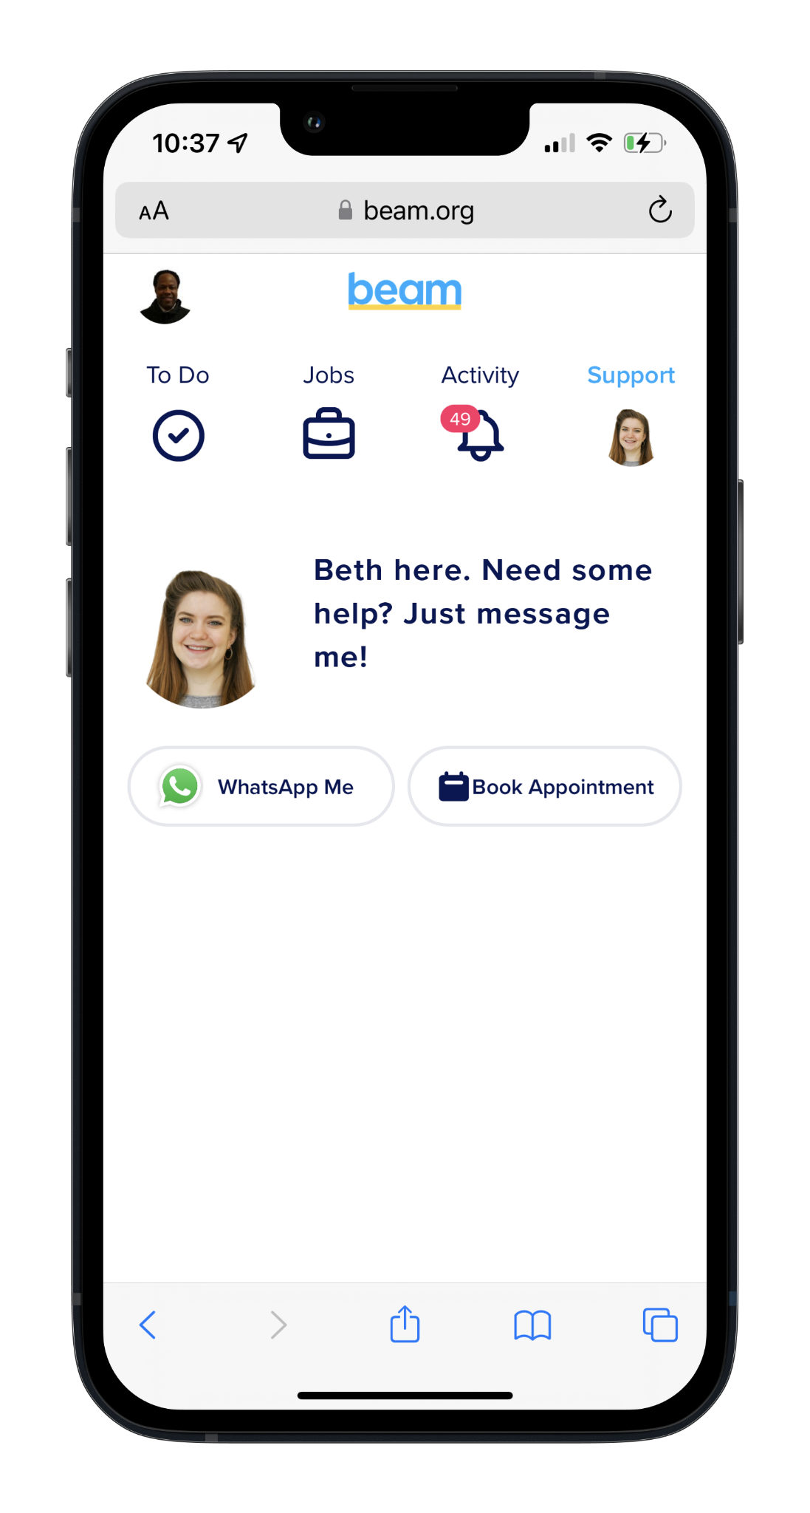
FOR SERVICE USERS A personal hub

Slide 17
IMPACT 1,200+ lives changed to-date
81%
start
a job
83%
sustain employment
£26k
average salary achieved for
Beam candidates
5 years
average time out of work before Beam

Slide 18
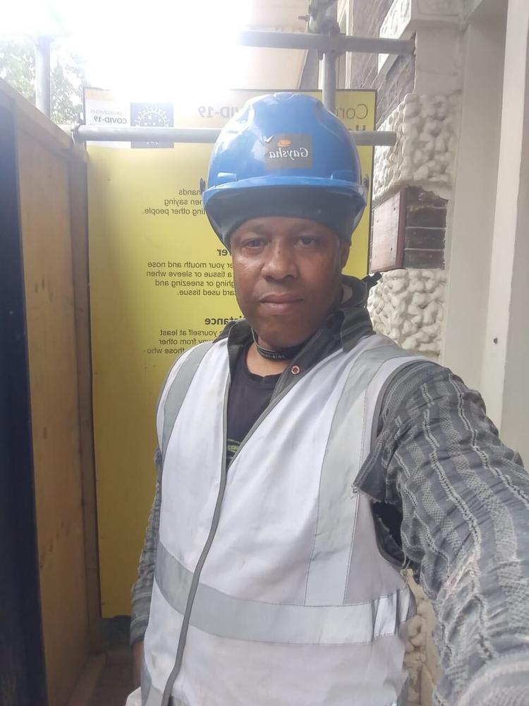
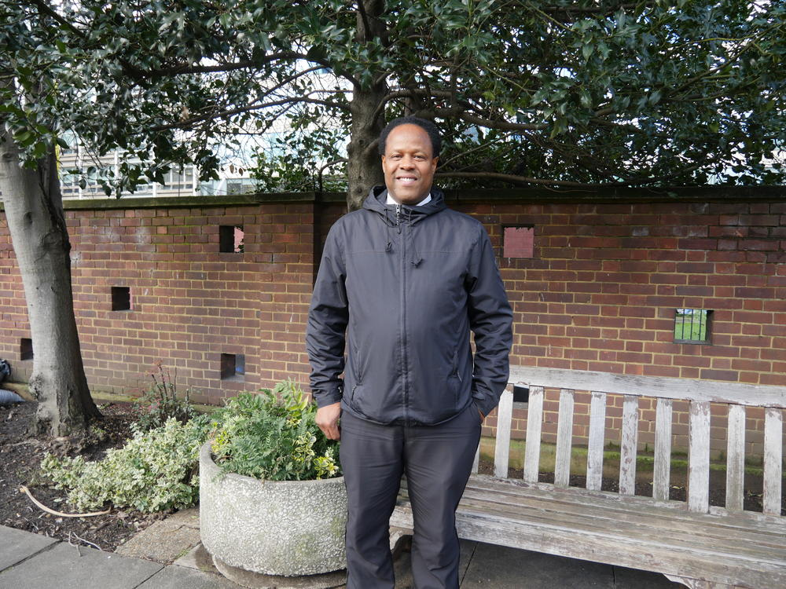
“I wanted to thank all my supporters for giving me the funds to do the course and to study something I’ve wanted to do my whole life.”

Slide 19
Workshop 2 | Devolution of employment and skills: Joining up support locally
Chair: Kathryn Jellings, Head of Employment, 3CS
Deep Khanna, Director of Operations, Twin Training; Seb Barker, Co-Founder & COO, BEAM;
Clare Boden-Hatton, Director of Operations –
Employment and Skills, West Midlands Combined Authority

Slide 20
learningandwork.org.uk
@LearnWorkUK
#EmpSkills22

