Slide 1
Expanding opportunity, meeting demand
@LearnWorkUK
#EmpSkills22

Slide 2
Workshop 4 | Skills for a net zero economy
Chair: Naomi Clayton, Deputy Director, Learning and Work Institute
Emily Jones, Deputy Director, Learning and Work Institute
Louise Murphy, Economist, Young people and skills, Resolution Foundation
Gudrun Cartwright, Climate Action Director, Business in the Community
Sarah Maguire, Social Value Manager, Fusion21

Slide 3
Insights from employers and young people
Emily Jones, Deputy Director
November 2022

Slide 4
Most employers either currently require green skills or expect to in the future…
… But three in five (59 per cent) say there are green skills gaps within their organisations

Slide 5
Young people and employers agree skills for net-zero will be important for future careers…
… But both lack confidence that the education system is equipping young people with green skills

Slide 6
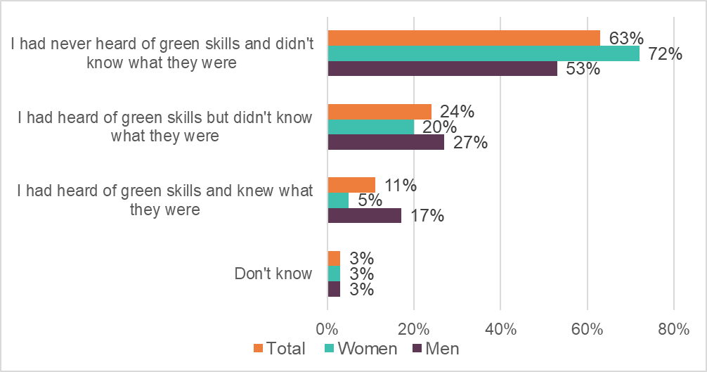
55% of young people feel inspired to pursue a green career – despite low awareness and understanding of green skills and green jobs

Slide 7
Workshop 4 | Skills for a net zero economy
Chair: Naomi Clayton, Deputy Director, Learning and Work Institute
Emily Jones, Deputy Director, Learning and Work Institute
Louise Murphy, Economist, Young people and skills, Resolution Foundation
Gudrun Cartwright, Climate Action Director, Business in the Community
Sarah Maguire, Social Value Manager, Fusion21

Slide 8
Skills for a net zero economy
Louise Murphy, Economist, Resolution Foundation
@_louisemurphy
Thursday 17th November 2022

Slide 9
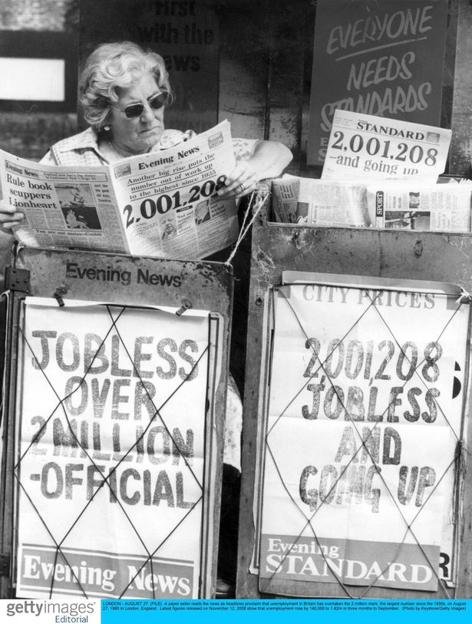
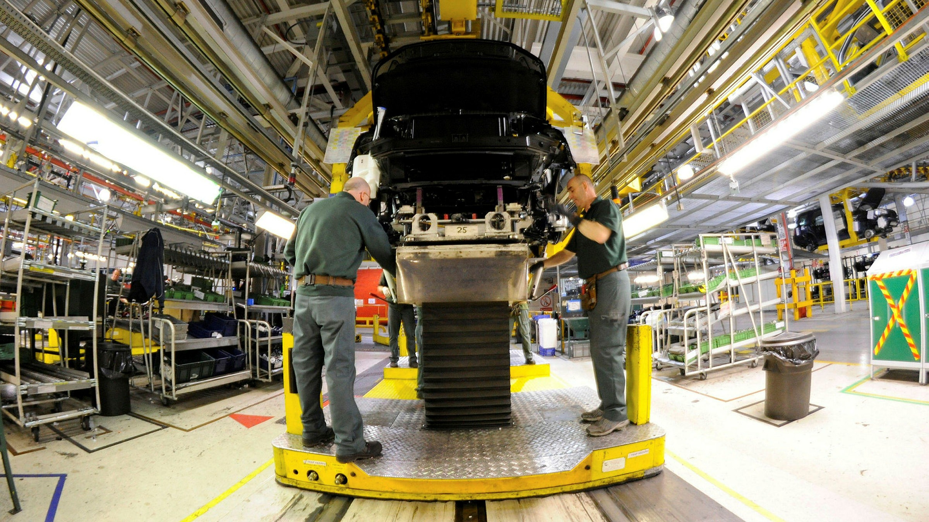
Some fear the net zero transition will be a repeat of 1980s deindustrialisation; others see it as a win for left-behind regions
Notes:
Now some think the transition will bring with it significant amounts of job destruction – rehashing the 1980s, and the trauma that deindustrialisation and unemployment brought to specific groups of people and places.
For others, the net zero transition is the next great hope: with the promise of green job growth revitalising left-behind places, and indeed many left-behind workers.

Slide 10
The transition won’t be a repeat of the 1980s, but it will bring change to many workers’ tasks and the technologies they use
Brown jobs
A small number of occupations representing a very small share of employment will see a decline in demand (e.g. coal mining);
A much larger share, by contrast, will need to adapt new technologies (e.g. LGV drivers), or indeed new tasks and technologies (ship builders);
Green jobs
Growing demand (alongside technology development and task change) in relatively new green jobs, like wind turbine engineers & heat pump installers;
Widescale, pre-existing occupations will see changes in skill or task requirements over time (e.g. operations managers will need to take on the environmental sustainability portfolio).
Reaching net zero by 2050 will require accelerated action
For example, we will need 44,000 more workers in the offshore wind industry by 2026, 60,000 more heat pump installers in under a decade, and 260,000 additional energy workers by 2050.
Notes:
When thinking about brown jobs, we find a small number of occupations – representing a small share of employment – at risk of decline
However, we find that the large majority of ‘brown’ jobs will still be needed in future; but they will need to change the technologies and/or tasks that they deploy – so for example lorry drivers and ship builders
When it comes to green jobs, we find that some relatively new occupations, for example wind turbine engineers and heat pump installers will need to grow in numbers
But also that a wide range of pre-existing occupations will see some change in the types of work they do – for example operations managers taking on environmental sustainability work

Slide 11
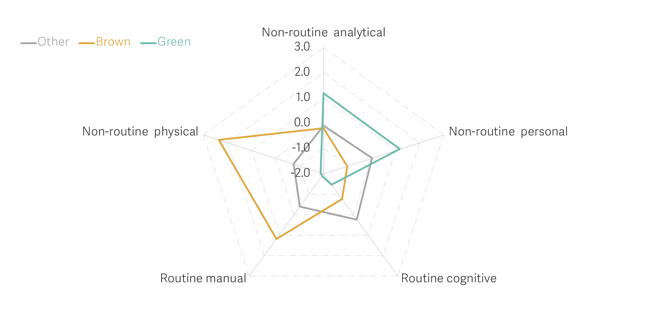
Brown and green jobs tend to require very different types of skills and tasks
Relative intensity of different types of tasks across types of occupations: UK, 2019
Source: Analysis of O*NET and ONS, Labour Force Survey.
Notes:
To understand how workers and firms will experience change, we take stock of the core differences between green and brown jobs
Green jobs are concentrated among workers who are male, White, graduates and highly paid.
Brown jobs are also concentrated among men, but tend to be prominent among those at low-to-mid pay levels, and with low-to-mid-level qualifications.
On geography, we find that green jobs are for the most part overrepresented in London and the South East, whereas brown jobs are concentrated in specific parts of the north of England (16 per cent of all employment in Barrow in Furness, compared to 4% in the UK overall) as well as in Newport in Wales (10 per cent of employment) and Aberdeen (9 p recent).
And finally, green and brown jobs tend to centre on very different types of tasks. Non-routine analytical and personal tasks are more commonly performed in green jobs. Non-routine physical, and routine-manual tasks are more prevalent in brown jobs.

Slide 12
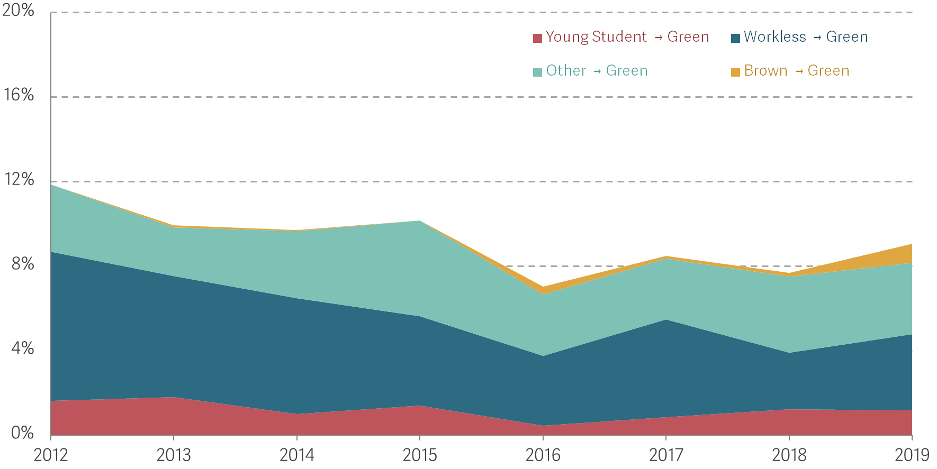
Occupational moves have been the main driver in the (limited) expansion of the green workforce
Percentage of workers moving into green jobs (as a proportion of green employment in previous year) by their origin: UK, 2012-2019
NOTES: These measures pertain to workers who are observed employed in a green occupation in year T and that, one year prior to that (T-1), were observed as workless (including unemployed or inactive, but not in education), studying (defined here as being less than 25 years old and enrolled in some course) or as being employed in a different job in a brown or ‘other’ occupation.
SOURCE: Analysis of ONS, Five-quarter longitudinal Labour Force Survey.
Notes:
Workers moving from non-green, and to a lesser extent brown occupations, have represented a growing proportion of those starting green jobs.
This need not be bad news: if green jobs are accessible and attractive to non-green workers, despite their different task content, we might expect that over the coming years, the existing workforce will be able to fill in gaps in the demand for green workers more rapidly than new cohorts of young people can do (as they represent a bigger pool).
But – workers will need support and training. the distance between the tasks required in green jobs vs brown jobs is higher than average, making natural job moves less likely.
At the same time, stagnating job mobility, an ageing workforce and potential skill gaps among current workers may stifle the growth of green sectors and hamper their future productivity, meaning that firms in green sectors may need to do more to attract younger workers just leaving education and/or to train their existing workforce.

Slide 13
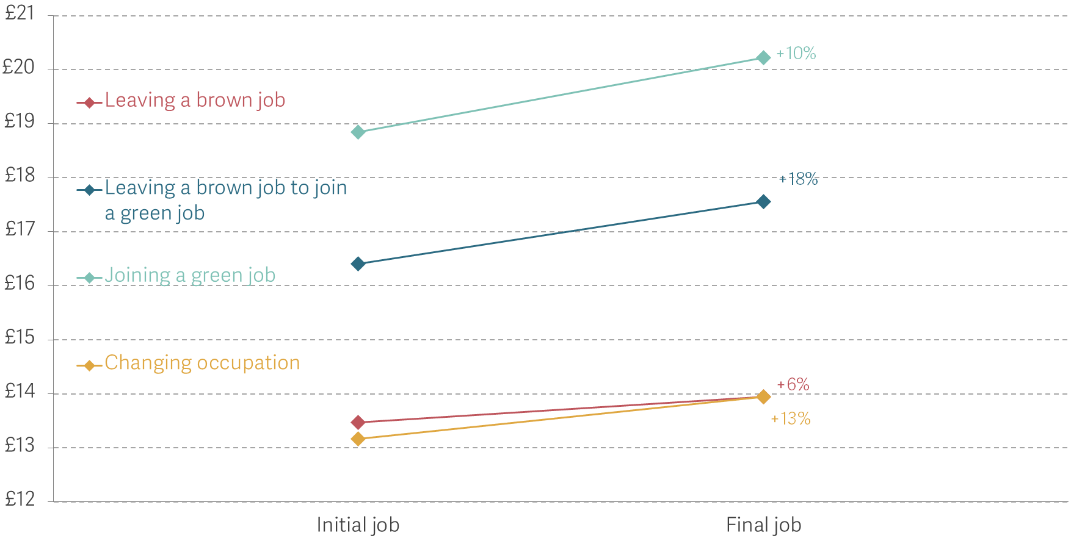
Moving into green jobs is associated with an increase in wages
Average hourly wage (in GBP) in workers’ initial and final jobs when they change jobs: UK, 2012-2020
NOTES: The chart shows the average hourly wage (in GBP) earned by workers changing occupation in their job in year T and in year T+1 by the type of occupation they move from and into. The percentages refer to the average percentage change in hourly pay across workers experiencing these occupational transitions. SOURCE: Analysis of ONS, Five-quarter longitudinal Labour Force Survey.
Notes:
On average, moving from a non-green to a green job is associated with a wage boost of around £1.40 an hour, much larger, in absolute terms, than the one experienced by occupational changers overall.
The few workers who move from a brown to a green job experience the largest wage increase in relative terms (18 per cent on average).
These workers are typically more highly educated and are employed in occupations with more emphasis on non-routine analytical and personal tasks, and their starting hourly wages were considerably higher than the wages received by an average brown job worker

Slide 14
Successfully meeting the transition to net zero will require a range of policies to support workers and firms
Learn from the past: success of transitioning Germany’s Ruhr out of coal mining was due to better coordination between national and local policy, skills investments, and a focus on good jobs and environmental activities;
Targeted workforce training programmes can help firms and workers to more easily adopt new technologies and tasks within occupations; and,
Greater collaboration between businesses, universities and colleges can help train up workers of all ages – including education leavers – for new and emerging green occupations that are in high demand, and ensure they’re accessible to a wider range of workers.
Notes:
On the first of these, we could do worse than look to the past: several case studies have shown that transitions out of industry were most successful when done via coordinated policy initiatives, significant skills investments and an unrelenting focus on good jobs
On the second, there’s much that can be done to help firms access new technology and train their staff to adapt new tech and indeed new tasks
And on the third, we know there’s much we can do to train up people for new jobs via better coordinated collaboration between educators, government and businesses – indeed coordinating policy at both the national and local levels as well as harnessing the power of apprenticeships.

Slide 15
Skills for a net zero economy
Louise Murphy, Economist, Resolution Foundation
@_louisemurphy
Thursday 17th November 2022

Slide 16
Workshop 4 | Skills for a net zero economy
Chair: Naomi Clayton, Deputy Director, Learning and Work Institute
Emily Jones, Deputy Director, Learning and Work Institute
Louise Murphy, Economist, Young people and skills, Resolution Foundation
Gudrun Cartwright, Climate Action Director, Business in the Community
Sarah Maguire, Social Value Manager, Fusion21

Slide 17
learningandwork.org.uk
@LearnWorkUK
#EmpSkills22

