Slide 2
@LearnWorkUK
#EmpSkills23
KEYNOTE
Naomi Clayton
Deputy Director
Learning and Work Institute
Led by
Sponsored by

Slide 3
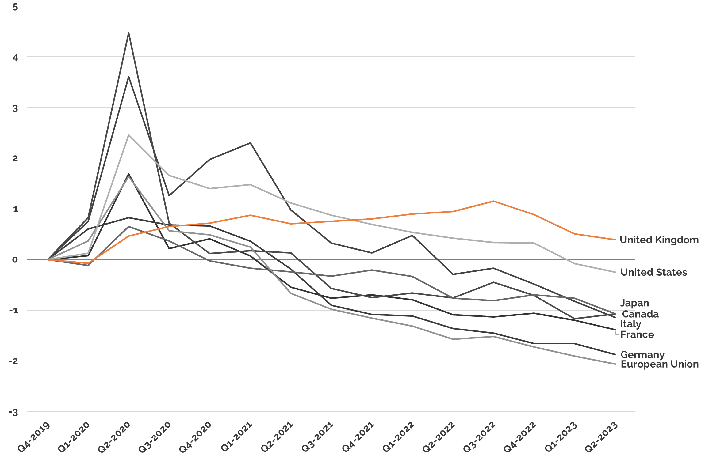
@LearnWorkUK
#EmpSkills23
UK employment recovery has been weaker than other G7 countries
Percentage point change in economic inactivity (cumulative) since Q4 2019

Slide 4
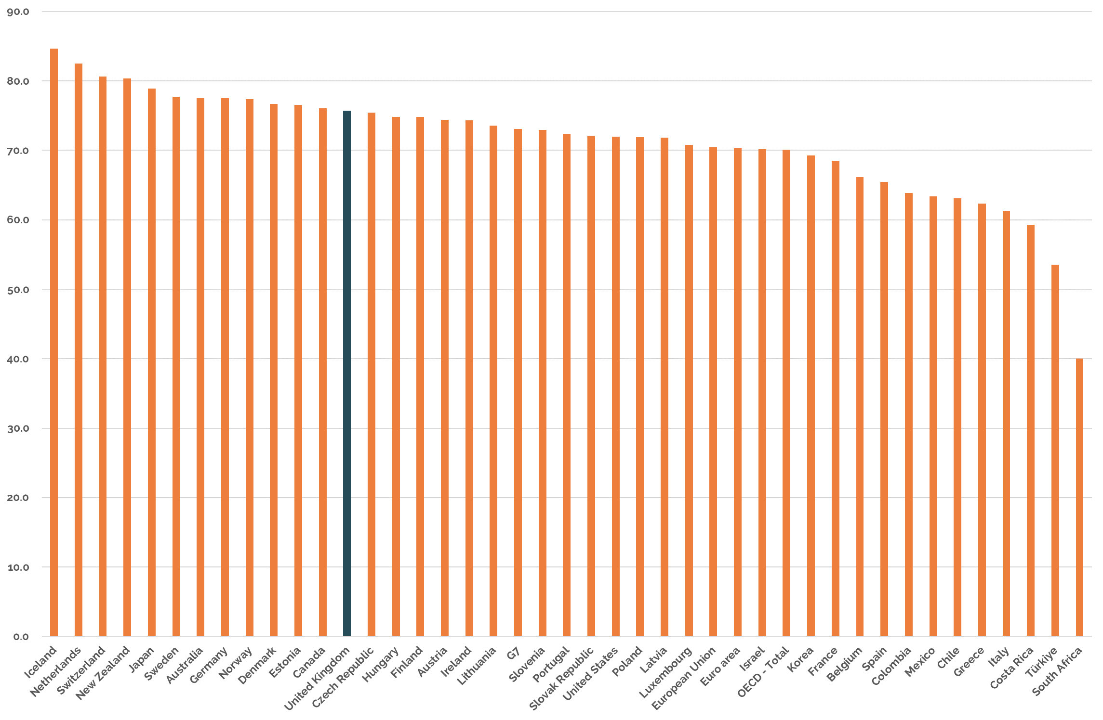
@LearnWorkUK
#EmpSkills23
Matching high performing countries’ employment rates would mean 1.2 million more people in work
Employment rate, Q2 2023

Slide 5
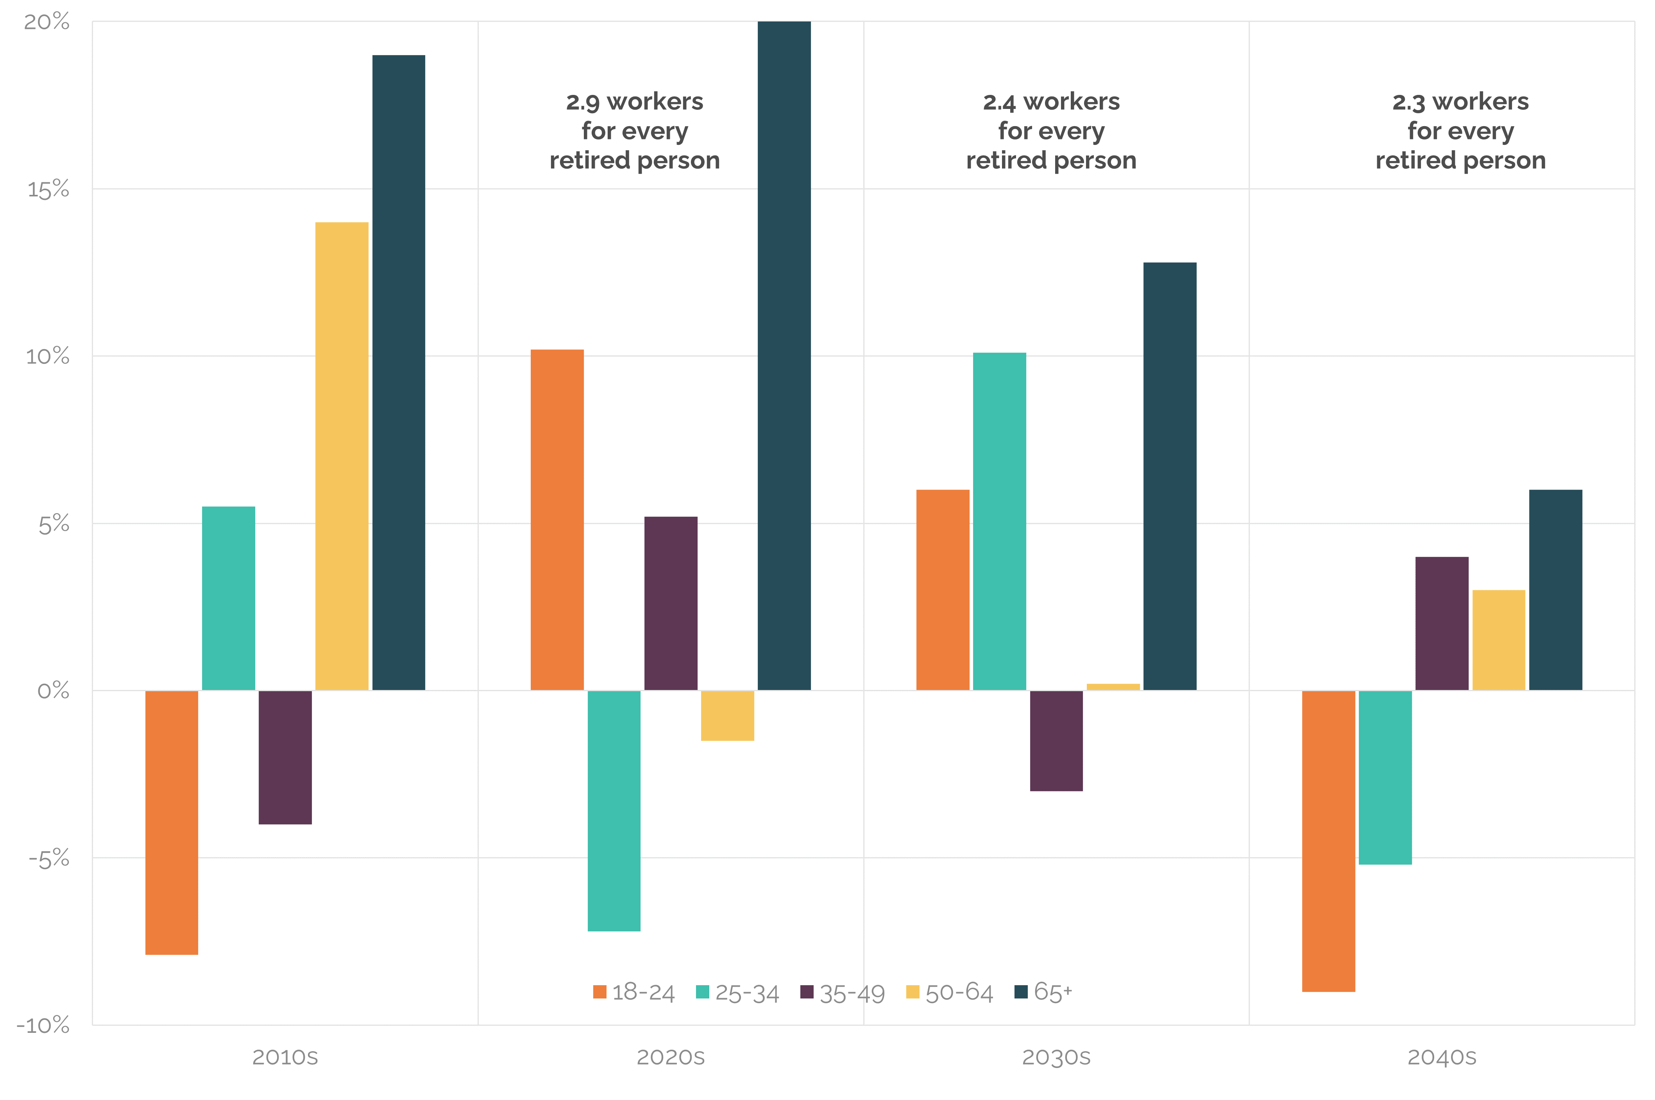
@LearnWorkUK
#EmpSkills23
Supporting more people to find and stay in work is key to avoiding labour shortages in decades ahead
Projected population by age, UK

Slide 6
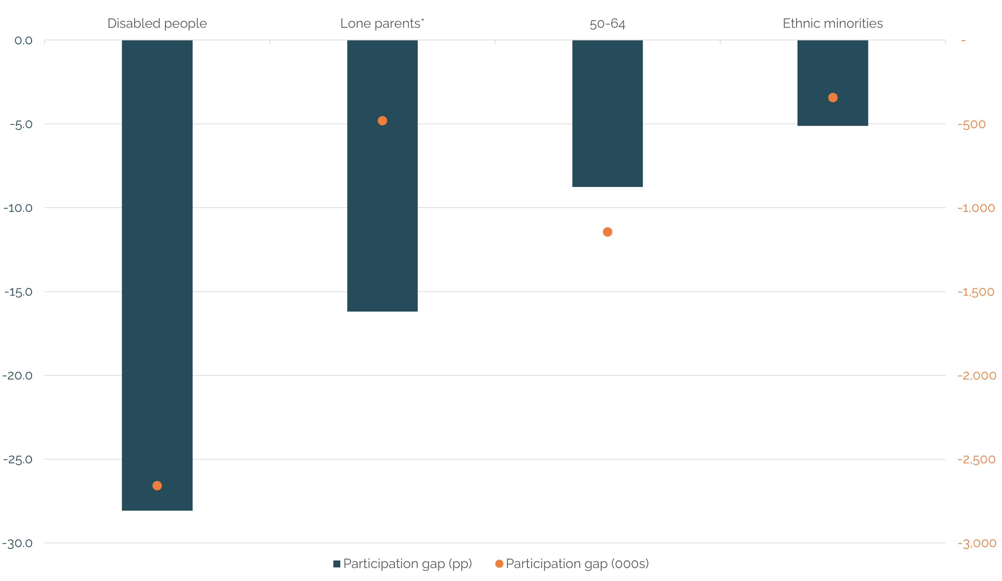
@LearnWorkUK
#EmpSkills23
Need to address longer term gaps, as well as more recent rises in economic inactivity
Economic activity rate and level gaps by group

Slide 7
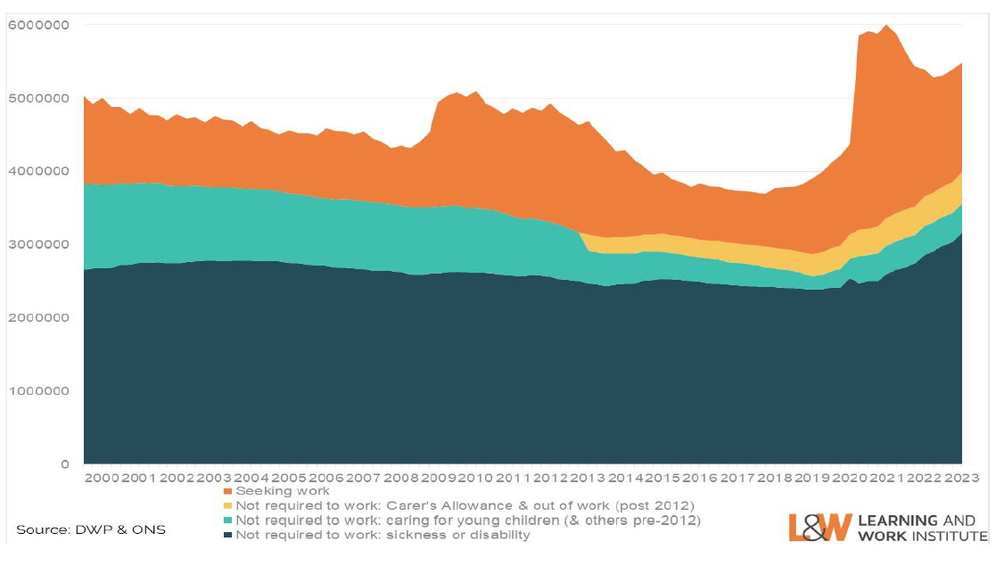
@LearnWorkUK
#EmpSkills23
An estimated 5.5m are in receipt of out-of-work benefits – over half due to LT sickness and disability
Out-of-work benefit receipt by main reason

Slide 8
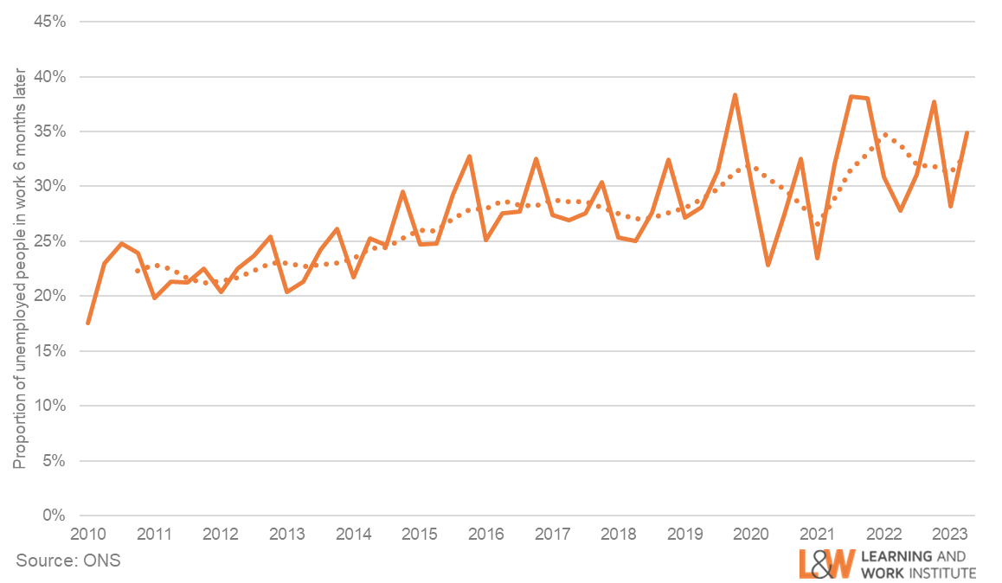
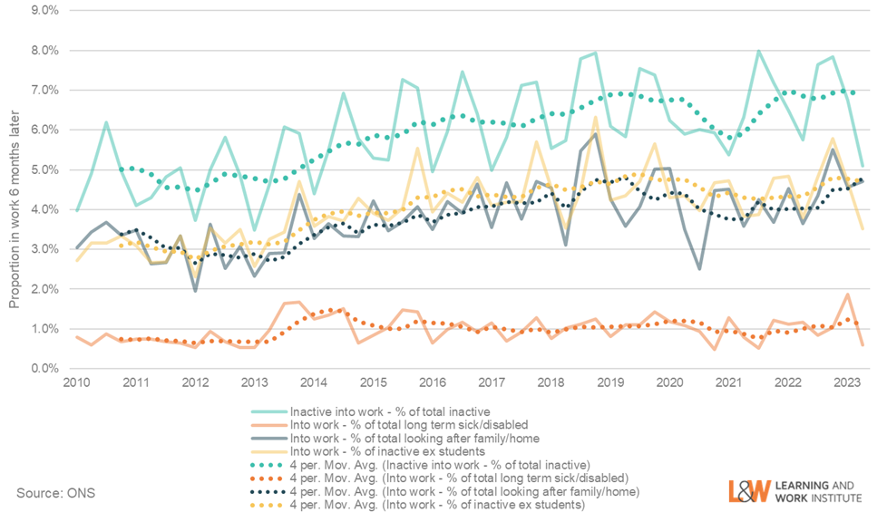
A
@LearnWorkUK
#EmpSkills23
After 6 months, unemployed people are 10 times more likely to be in work than economically inactive people
B
Proportion of A) unemployed people and B) economically inactive who are in work two quarters later

Slide 9
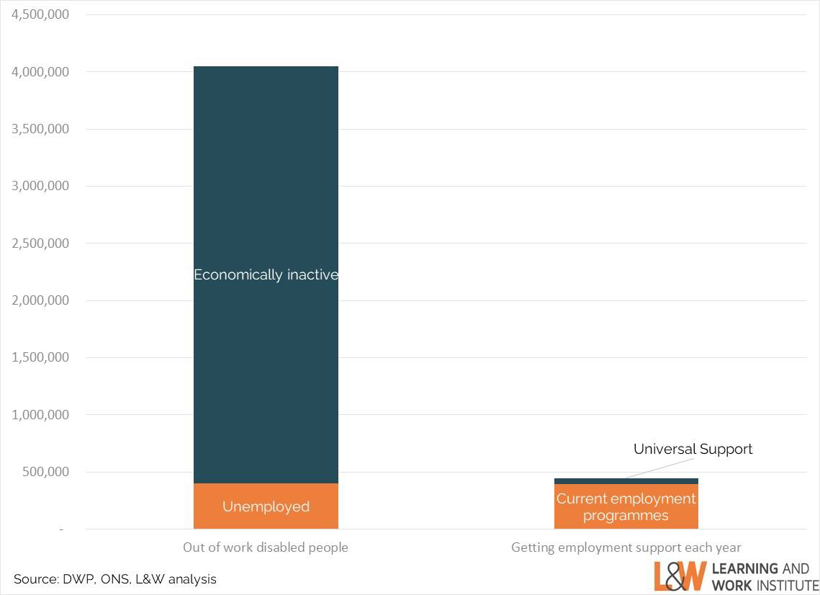
@LearnWorkUK
#EmpSkills23
Just 1 in 10 out of work disabled people get support to find work each year
Numbers of disabled people out of work and numbers engaged in employment support annually

Slide 10
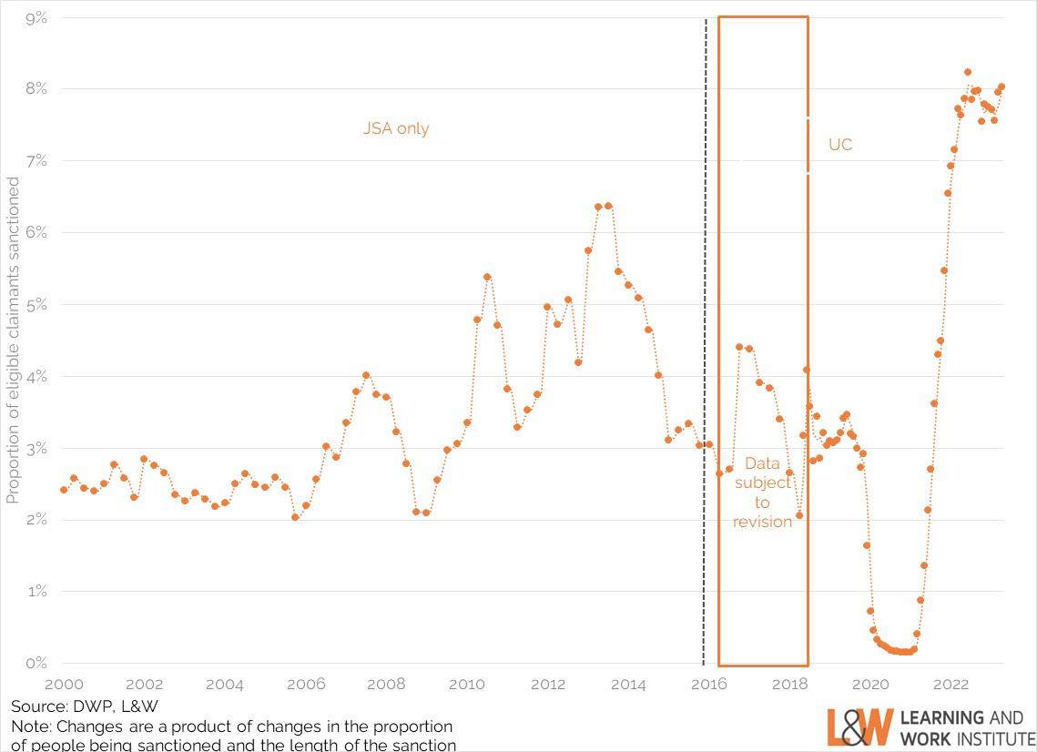
@LearnWorkUK
#EmpSkills23
Evidence on effectiveness of sanctions is limited and mixed
Numbers of disabled people out of work and numbers engaged in employment support annually

