Slide 1











#EmpSkills25
@learnworkuk.bsky.social
Tuesday 1 July | 8am–4.20pm
The path to productive, inclusive and sustainable growth
Led by
Lead sponsor
Sponsors

Slide 2
#EmpSkills25
@learnworkuk.bsky.social
WORKSHOP 1
A Youth Guarantee for England
Led by
Lead sponsor
Sponsors

Slide 3
#EmpSkills25
@learnworkuk.bsky.social
Chair: Barry Fletcher, Youth Futures Foundation
Nicola Aylward, Learning and Work Institute
Helene Dearn OBE, West Midlands Combined Authority
Farzana and Jayden, Youth Delegates
Led by
Lead sponsor
Sponsors

Slide 4
#EmpSkills25
@learnworkuk.bsky.social
Barry Fletcher
CEO, Youth Futures Foundation
Led by
Lead sponsor
Sponsors

Slide 5
#EmpSkills25
@learnworkuk.bsky.social
Nicola Aylward
Head of Learning for Young People
Learning and Work Institute
Led by
Lead sponsor
Sponsors

Slide 6

Programme of work
Young people who are NEET – what does the data tell us?
Youth Opportunity Index 2025 - Learning and Work Institute
Transforming opportunity: Learning and Work Institute's vision for a Youth Guarantee
The Youth Guarantee and the benefits system: Challenges, opportunities, and changes needed (Upcoming, July 2025)
Notes:
Methods included data analysis, consultation with stakeholders, young people, and

Slide 7
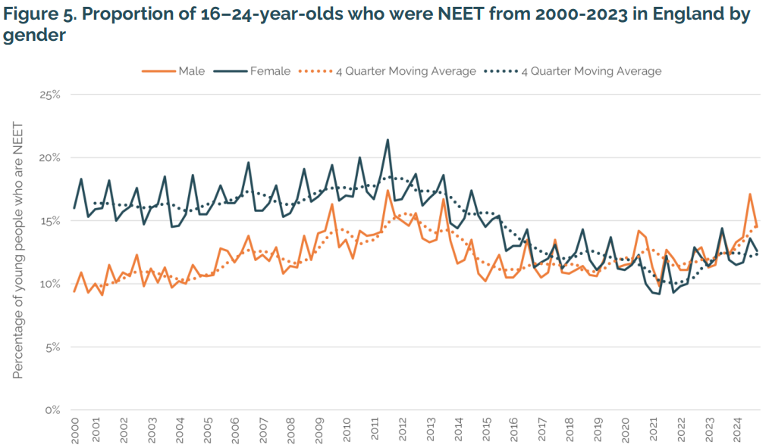
Almost one million young people are NEET…

Slide 8
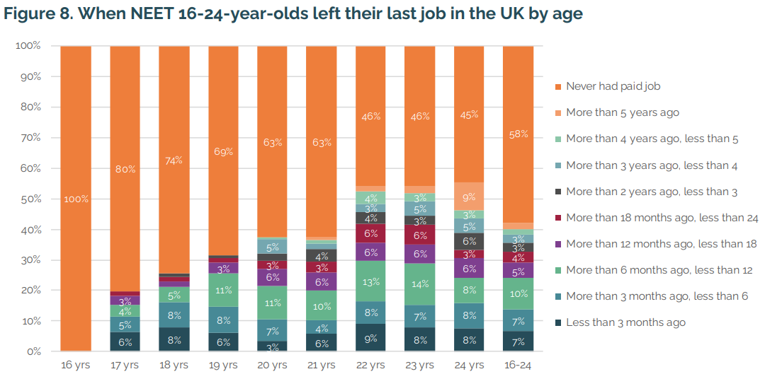
…and over half have never had a paid job
Notes:
Many young people will experience a period of time out of education, employment or training. For some, this will be short lived; one in three young people move back into education, employment or training within the first six months of becoming NEET. Being out of education, employment or training for a short period of time is unlikely to have a significant impact on a young person’s life. However, many young people are NEET for a sustained period of time. In fact, in the UK nearly half (48%) of young people are still not in education, employment or training a year after becoming NEET, equating to more than 360,000 young people.

Slide 9
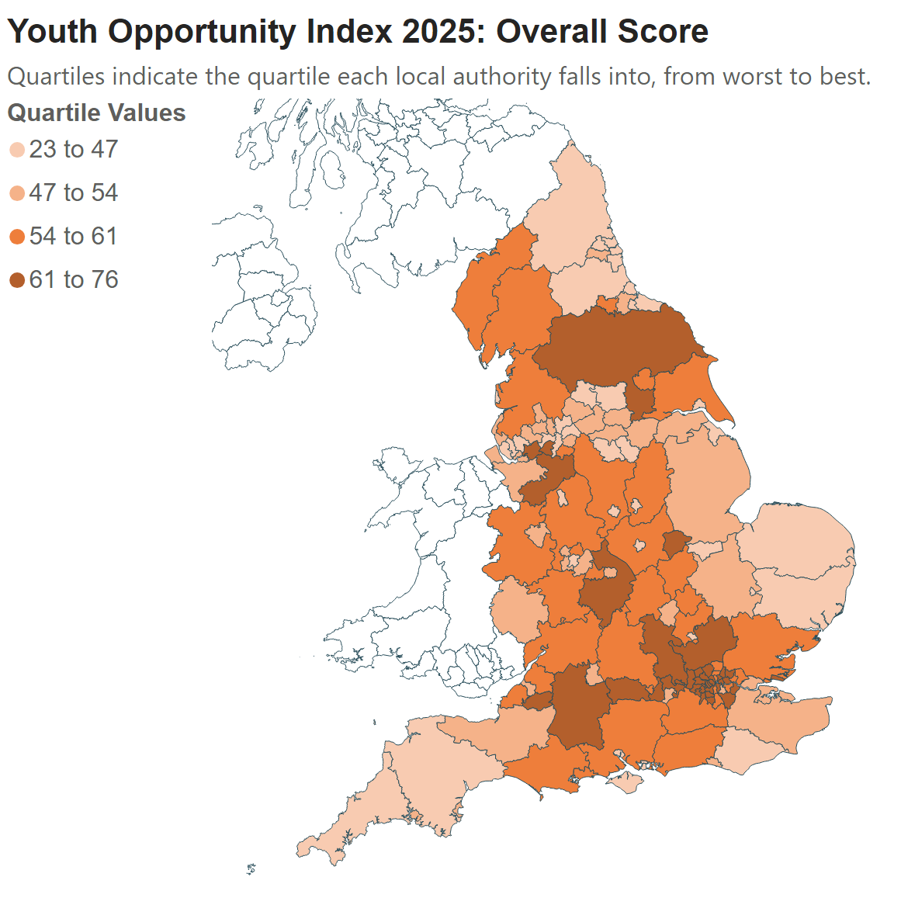
Education and employment opportunities are not evenly spread across England
Notes:
The best-ranking local authorities are mostly in London, with Sutton coming out on top, while young people in Knowsley have the worst access to opportunities in the country. Poverty and worse opportunities for young people generally go hand in hand but some areas don’t follow this trend; Hackney is ranked among the most deprived places in England but ranks 17th for youth opportunity.
Explore further with our interactive maps and tables: https://learningandwork.org.uk/resources/research-and-reports/youth-opportunity-index-2025/

Slide 10
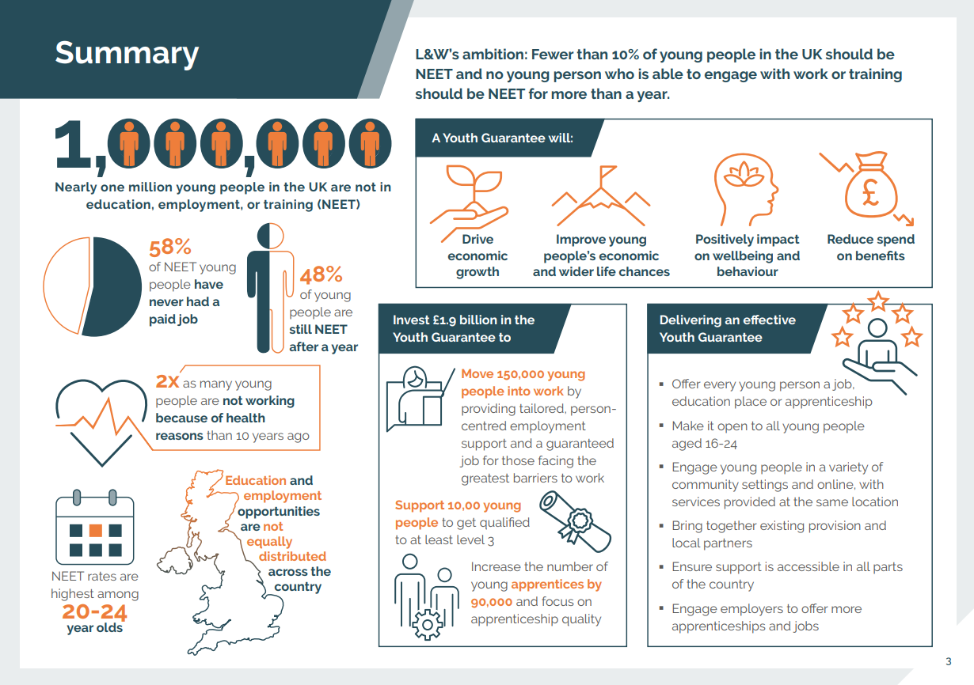

Slide 11
#EmpSkills25
@learnworkuk.bsky.social
Farzana and Jayden
Youth delegates
Led by
Lead sponsor
Sponsors

Slide 12
#EmpSkills25
@learnworkuk.bsky.social
Helene Dearn OBE
Interim Executive Director for Employment, Skills, Health and Communities, West Midlands Combined Authority
Led by
Lead sponsor
Sponsors

Slide 13
#EmpSkills25
@learnworkuk.bsky.social
What does a successful youth guarantee look like?
What should national government learn from the trailblazers?
What is needed to scale and sustain success?
Sponsors
Led by
Sponsors
Led by
Lead sponsor
Lead sponsor

Slide 14

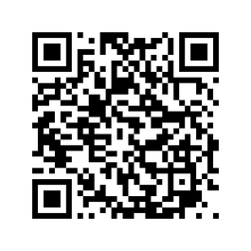
Stay informed. Be involved. Keep engaged.
learningandwork.org.uk/supporter-network

Slide 15
#EmpSkills25
@learnworkuk.bsky.social
Thank you for joining us
Catch you in the Exhibition Hall for a short break before our next plenary panel in the Wren Hall at 3pm
Led by
Lead sponsor
Sponsors

