Slide 1











#EmpSkills25
@learnworkuk.bsky.social
Tuesday 1 July | 8am–4.20pm
The path to productive, inclusive and sustainable growth
Led by
Lead sponsor
Sponsors

Slide 2
#EmpSkills25
@learnworkuk.bsky.social
BREAKFAST SESSION
Drive to revive – tackling skills
shortages in motorsport
Led by
Lead sponsor
Sponsors

Slide 3
#EmpSkills25
@learnworkuk.bsky.social
Chair: Olly Newton, Edge Foundation
Beatrice Barleon, Engineering UK
Owen Carless, Red Bull Ford Powertrains and Oracle Red Bull Racing
Anna Clarke, Milton Keynes College Group
Ann Watson, Enginuity
Led by
Lead sponsor
Sponsors

Slide 4
#EmpSkills25
@learnworkuk.bsky.social
Olly Newton
Edge Foundation
Led by
Lead sponsor
Sponsors

Slide 5
#EmpSkills25
@learnworkuk.bsky.social
Beatrice Barleon
Head of Policy and Public Affairs
Engineering UK
Led by
Lead sponsor
Sponsors

Slide 6
#EmpSkills25
@learnworkuk.bsky.social
Owen Carless
Head of Mechanical Simulation &
Red Bull Engineering Academy Mentor
Red Bull Powertrains and Oracle Red Bull Racing
Led by
Lead sponsor
Sponsors

Slide 7
#EmpSkills25
@learnworkuk.bsky.social
Anna Clarke
Group Director: Employer Engagement and Partnerships
Milton Keynes College Group
Led by
Lead sponsor
Sponsors

Slide 8
#EmpSkills25
@learnworkuk.bsky.social
Ann Watson
CEO, Enginuity
Led by
Lead sponsor
Sponsors

Slide 9
#EmpSkills25
@learnworkuk.bsky.social
Chair: Olly Newton, Edge Foundation
Beatrice Barleon, Engineering UK
Owen Carless, Red Bull Ford Powertrains and Oracle Red Bull Racing
Anna Clarke, Milton Keynes College Group
Ann Watson, Enginuity
Led by
Lead sponsor
Sponsors

Slide 10

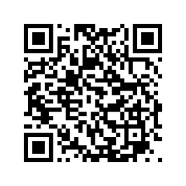
Stay informed. Be involved. Keep engaged.
learningandwork.org.uk/supporter-network

Slide 11
#EmpSkills25
@learnworkuk.bsky.social
Tuesday 1 July | 8am–4.20pm
The path to productive, inclusive and sustainable growth
Led by
Lead sponsor
Sponsors

Slide 12
#EmpSkills25
@learnworkuk.bsky.social
WELCOME
Stephen Evans
Chief Executive, Learning and Work Institute
Led by
Lead sponsor
Sponsors

Slide 13
#EmpSkills25
@learnworkuk.bsky.social
Thank you to our sponsors
Led by
Lead sponsor
Sponsors

Slide 14
#EmpSkills25
@learnworkuk.bsky.social
Q&A
Work and Health Programme
Led by
Lead sponsor
Sponsors

Slide 15
#EmpSkills25
@learnworkuk.bsky.social
Brought to you by
Led by
Lead sponsor
Sponsors

Slide 16
#EmpSkills25
@learnworkuk.bsky.social
Gareth Parry
Managing Director, Maximus
Led by
Lead sponsor
Sponsors

Slide 17
#EmpSkills25
@learnworkuk.bsky.social
Naureen Reza, Employment Adviser, Maximus
Coleen Rayney, Teacher
Led by
Lead sponsor
Sponsors

Slide 18
#EmpSkills25
@learnworkuk.bsky.social
Tuesday 1 July | 8am–4.20pm
The path to productive, inclusive and sustainable growth
Led by
Lead sponsor
Sponsors

Slide 19
#EmpSkills25
@learnworkuk.bsky.social
PANEL 1
Closing the disability employment gap: how can we make a step change in opportunity?
Led by
Lead sponsor
Sponsors

Slide 20
#EmpSkills25
@learnworkuk.bsky.social
Chair: Chris Smyth, The Times
Fazilet Hadi MBE, Disability Rights UK
Dr Nancy Doyle, Genius Within
Gareth Parry, Maximus
Deven Ghelani, Policy in Practice
Led by
Lead sponsor
Sponsors

Slide 21
#EmpSkills25
@learnworkuk.bsky.social
Chris Smyth
Whitehall Editor, The Times
Led by
Lead sponsor
Sponsors

Slide 22
#EmpSkills25
@learnworkuk.bsky.social
Fazilet Hadi MBE
Head of Policy, Disability Rights UK
Led by
Lead sponsor
Sponsors

Slide 23
#EmpSkills25
@learnworkuk.bsky.social
Dr Nancy Doyle
Founder and Chief Science Officer, Genius Within
Led by
Lead sponsor
Sponsors

Slide 24
#EmpSkills25
@learnworkuk.bsky.social
Gareth Parry
Managing Director, Maximus
Led by
Lead sponsor
Sponsors

Slide 25
#EmpSkills25
@learnworkuk.bsky.social
Deven Ghelani
Founder and Director, Policy in Practice
Led by
Lead sponsor
Sponsors

Slide 26
#EmpSkills25
@learnworkuk.bsky.social
Chair: Chris Smyth, The Times
Fazilet Hadi MBE, Disability Rights UK
Dr Nancy Doyle, Genius Within
Gareth Parry, Maximus
Deven Ghelani, Policy in Practice
Led by
Lead sponsor
Sponsors

Slide 27
#EmpSkills25
@learnworkuk.bsky.social
Break
Head to the Exhibition Hall for tea and coffee before our next plenary panel here at 11.50am
Led by
Lead sponsor
Sponsors

Slide 28
#EmpSkills25
@learnworkuk.bsky.social
PANEL 2
Powering inclusive growth: perspectives from mayoral combined authorities
Led by
Lead sponsor
Sponsors

Slide 29
#EmpSkills25
@learnworkuk.bsky.social
Chair: Heather Stewart, The Guardian
Adam Swersky, East Midlands Combined County Authority
Ann-Marie Soyinka, Greater London Authority
Helene Dearn OBE, West Midlands Combined Authority
Nic Witton-Dowd, Greater Manchester Combined Authority
Led by
Lead sponsor
Sponsors

Slide 30
#EmpSkills25
@learnworkuk.bsky.social
Adam Swersky
Interim Director of Skills and Employment
East Midlands Combined County Authority
Led by
Lead sponsor
Sponsors

Slide 31
#EmpSkills25
@learnworkuk.bsky.social
Ann-Marie Soyinka
Assistant Director for Skills and Employment
Greater London Authority
Led by
Lead sponsor
Sponsors

Slide 32
#EmpSkills25
@learnworkuk.bsky.social
Helene Dearn OBE
Interim Executive Director for Employment,
Skills, Health and Communities
West Midlands Combined Authority
Led by
Lead sponsor
Sponsors

Slide 33
#EmpSkills25
@learnworkuk.bsky.social
Nic Witton-Dowd
Assistant Director
Greater Manchester Combined Authority
Led by
Lead sponsor
Sponsors

Slide 34
#EmpSkills25
@learnworkuk.bsky.social
Chair: Heather Stewart, The Guardian
Adam Swersky, East Midlands Combined County Authority
Ann-Marie Soyinka, Greater London Authority
Helene Dearn OBE, West Midlands Combined Authority
Nic Witton-Dowd, Greater Manchester Combined Authority
Led by
Lead sponsor
Sponsors

Slide 35
#EmpSkills25
@learnworkuk.bsky.social
Lunch
Head to the Exhibition Hall for lunch before our breakout sessions at 1.30pm
Led by
Lead sponsor
Sponsors

Slide 36
#EmpSkills25
@learnworkuk.bsky.social
Workshop 1: A Youth Guarantee for England (Lutyens)
Workshop 2: Top tips for local approaches to employment support (Donne)
Workshop 3: Opening up opportunities through devolution (Wren)
Workshop 4: More workforce training for more of the workforce: how do we ramp up employer investment in skills? (Kitchener)
Led by
Lead sponsor
Sponsors

Slide 37
#EmpSkills25
@learnworkuk.bsky.social
WORKSHOP 3
Opening up opportunities
through devolution
Led by
Lead sponsor
Sponsors

Slide 38
#EmpSkills25
@learnworkuk.bsky.social
Chair: Alex Stevenson, Learning and Work Institute
Megan Cooper, Serco
Nic Witton-Dowd, Greater Manchester Combined Authority
Emma Grigson, PeoplePlus
Adam Swersky, East Midlands Combined County Authority
Lindsey Daniels, West Yorkshire Combined Authority
Led by
Lead sponsor
Sponsors

Slide 39
#EmpSkills25
@learnworkuk.bsky.social
Alex Stevenson
Deputy Director, Learning and Work Institute
Led by
Lead sponsor
Sponsors

Slide 40
#EmpSkills25
@learnworkuk.bsky.social
Megan Cooper
Sales Director for Employment and Skills
Serco
Led by
Lead sponsor
Sponsors

Slide 41
#EmpSkills25
@learnworkuk.bsky.social
Nic Witton-Dowd
Assistant Director
Greater Manchester Combined Authority
Led by
Lead sponsor
Sponsors

Slide 42
#EmpSkills25
@learnworkuk.bsky.social
Emma Grigson
Partnerships & Social Value Solutions Director
PeoplePlus
Led by
Lead sponsor
Sponsors

Slide 43
#EmpSkills25
@learnworkuk.bsky.social
Adam Swersky
Interim Director of Skills and Employment
East Midlands Combined County Authority
Led by
Lead sponsor
Sponsors

Slide 44
#EmpSkills25
@learnworkuk.bsky.social
Lindsey Daniels
Inclusive Economy Lead - Adult Skills
West Yorkshire Combined County Authority
Led by
Lead sponsor
Sponsors

Slide 45
#EmpSkills25
@learnworkuk.bsky.social
How can providers and commissioners work together to ensure effective local commissioning, and to support local integration and delivery against Strategic Authorities’ priorities?
Sponsors
Led by
Sponsors
Led by
Lead sponsor
Lead sponsor

Slide 46
Stay informed. Be involved. Keep engaged.
learningandwork.org.uk/supporter-network

Slide 47
#EmpSkills25
@learnworkuk.bsky.social
Thank you for joining us
Head to the Exhibition Hall for a short break before our next plenary panel in the Wren Hall at 3pm
Led by
Lead sponsor
Sponsors

Slide 48
#EmpSkills25
@learnworkuk.bsky.social
PANEL 3
Better work: moving on from
‘employers vs workers’
Led by
Lead sponsor
Sponsors

Slide 49
#EmpSkills25
@learnworkuk.bsky.social
Chair: Dr Jo Bibby, The Health Foundation
Katia Bazar-Rosen, Department for Business and Trade
Kate Nicholls OBE, UKHospitality
Kirsty Watt, Acas
Shaun Lowthian, Greater London Authority
Dr Emily Andrews, Centre for Ageing Better
Led by
Lead sponsor
Sponsors

Slide 50
#EmpSkills25
@learnworkuk.bsky.social
Dr Jo Bibby
Director of Health, The Health Foundation
Led by
Lead sponsor
Sponsors

Slide 51
#EmpSkills25
@learnworkuk.bsky.social
Katia Bazar-Rosen
Deputy Director for Strategy and International,
Employment Rights Directorate, Department for Business and Trade
Led by
Lead sponsor
Sponsors

Slide 52
#EmpSkills25
@learnworkuk.bsky.social
Kate Nicholls OBE
CEO, UKHospitality
Led by
Lead sponsor
Sponsors

Slide 53
#EmpSkills25
@learnworkuk.bsky.social
Kirsty Watt
Director of Strategy and External Affairs
Acas
Led by
Lead sponsor
Sponsors

Slide 54
#EmpSkills25
@learnworkuk.bsky.social
Shaun Lowthian
Principal Policy Officer, Greater London Authority
Led by
Lead sponsor
Sponsors

Slide 55
#EmpSkills25
@learnworkuk.bsky.social
Dr Emily Andrews
Deputy Director for Work, Centre for Ageing Better, and
Learning and Work Institute’s incoming Director for Policy and Research
Led by
Lead sponsor
Sponsors

Slide 56
#EmpSkills25
@learnworkuk.bsky.social
Chair: Dr Jo Bibby, The Health Foundation
Katia Bazar-Rosen, Department for Business and Trade
Kate Nicholls OBE, UKHospitality
Kirsty Watt, Acas
Shaun Lowthian, Greater London Authority
Dr Emily Andrews, Centre for Ageing Better
Led by
Lead sponsor
Sponsors

Slide 57
#EmpSkills25
@learnworkuk.bsky.social
Tuesday 1 July | 8am–4.20pm
The path to productive, inclusive and sustainable growth
Led by
Lead sponsor
Sponsors

Slide 58
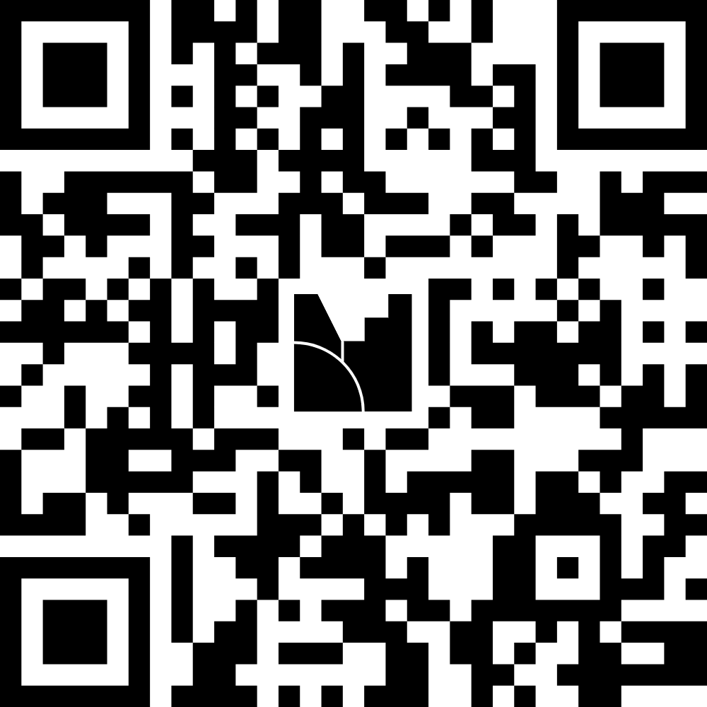
#EmpSkills25
@learnworkuk.bsky.social
AND NOW...
Join at menti.com
1113 4117
Top of the Policies
Led by
Lead sponsor
Sponsors

Slide 59
#EmpSkills25
@learnworkuk.bsky.social
Chair: Stephen Evans, Learning and Work Institute
Ben Rowland, AELP
Elizabeth Taylor, ERSA
David Pierpoint, The Retrofit Academy
Lynsey Sweeney, Communities that Work
Led by
Lead sponsor
Sponsors

Slide 60
#EmpSkills25
@learnworkuk.bsky.social
Ben Rowland
CEO, Association of Employment and Learning Providers (AELP)
Led by
Lead sponsor
Sponsors

Slide 61
#EmpSkills25
@learnworkuk.bsky.social
Elizabeth Taylor
CEO, Employment Related Services Association (ERSA)
Led by
Lead sponsor
Sponsors

Slide 62
#EmpSkills25
@learnworkuk.bsky.social
Lynsey Sweeney
Managing Director, Communities that Work
Led by
Lead sponsor
Sponsors

Slide 63
#EmpSkills25
@learnworkuk.bsky.social
David Pierpoint
CEO, The Retrofit Academy
Led by
Lead sponsor
Sponsors

Slide 64
#EmpSkills25
@learnworkuk.bsky.social
TIME TO VOTE
Top of the Policies
Led by
Lead sponsor
Sponsors

Slide 65
#EmpSkills25
@learnworkuk.bsky.social
RESULTS ARE IN
Top of the Policies
Led by
Lead sponsor
Sponsors

Slide 66
#EmpSkills25
@learnworkuk.bsky.social
Tuesday 1 July | 8am–4.20pm
The path to productive, inclusive and sustainable growth
Led by
Lead sponsor
Sponsors

Slide 67
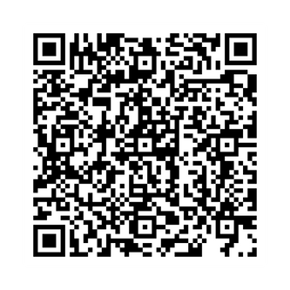

#EmpSkills25
@learnworkuk.bsky.social
How did we do?
And where should we
go next year?
Led by
Lead sponsor
Sponsors

