Slide 1








2026
#EmpSkills26
Learning and Work Institute
@learnworkuk.bsky.social
Led by
Lead sponsor
Sponsors

Slide 2
#EmpSkills26
2026
WELCOME
Stephen Evans
Chief Executive
Learning and Work Institute
Led by
Lead sponsor
Sponsors

Slide 3
#EmpSkills26
2026
Thank you to our sponsors!
Led by
Lead sponsor
Sponsors

Slide 4
#EmpSkills26
2026
Led by
Lead sponsor
Sponsors

Slide 5
#EmpSkills26
2026
Guy Venables
Regional Director
Maximus
Led by
Lead sponsor
Sponsors

Slide 6
#EmpSkills26
2026
Stephen Evans
Chief Executive
Learning and Work Institute
Led by
Lead sponsor
Sponsors

Slide 7
#EmpSkills26
2026
Lots of steps forward, time for a giant leap
Led by
Lead sponsor
Sponsors

Slide 8
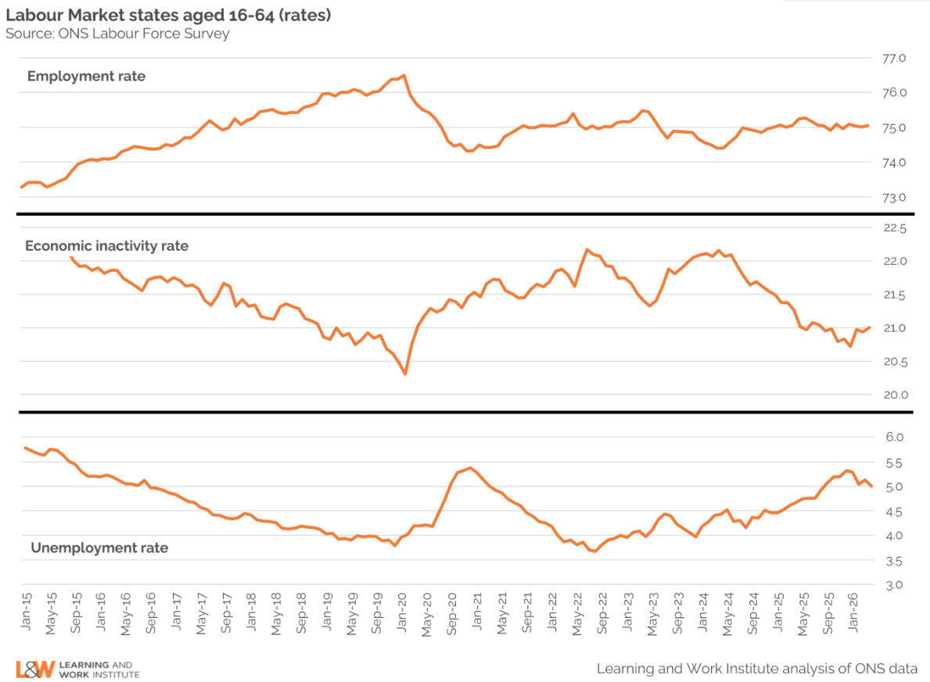

Employment rate is flat…

Slide 9
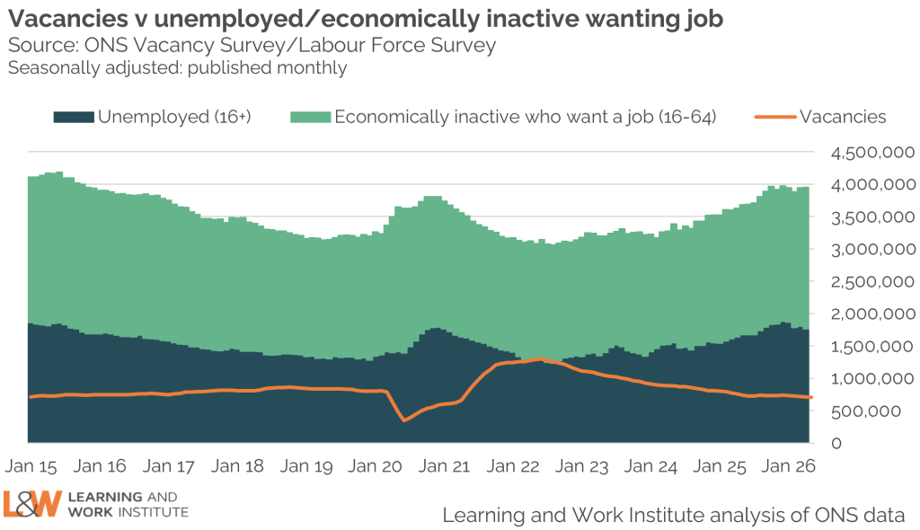
…and the labour market’s getting tougher…

Slide 10
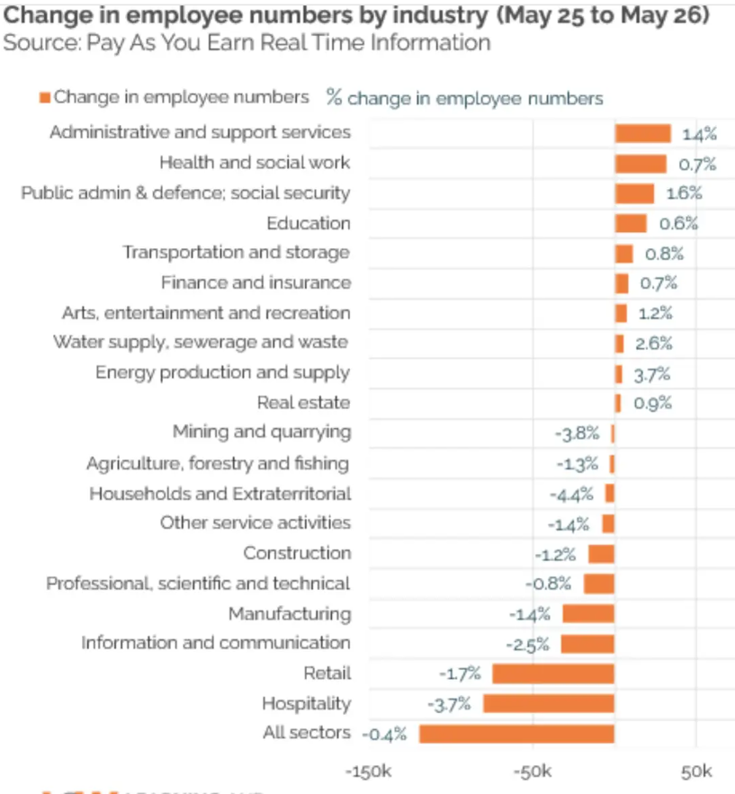
…and the labour market’s getting tougher…

Slide 11
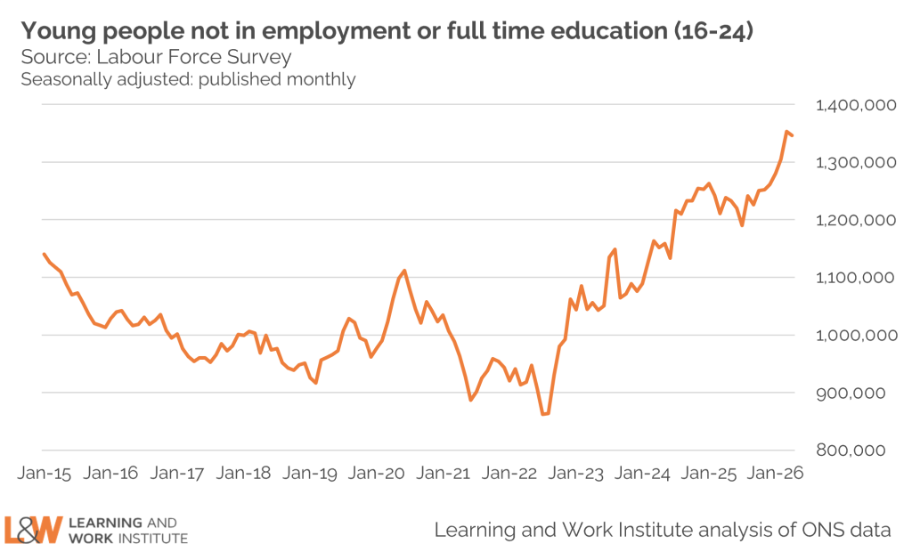
…particularly for young people…

Slide 12
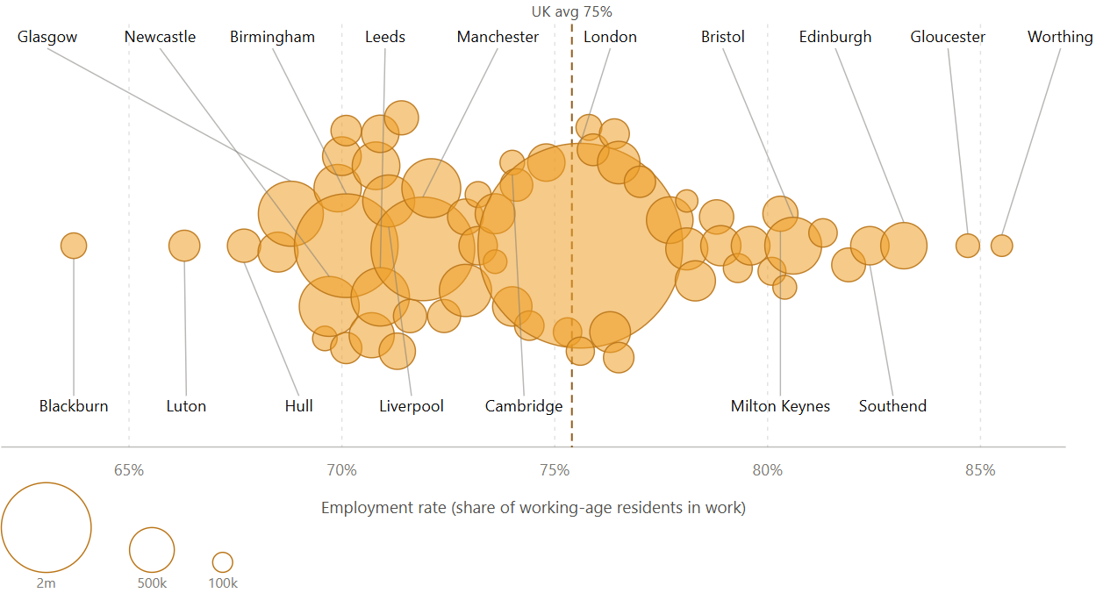
…and varies across the country…

Slide 13
…while technology & demography drive change
Anything present when you’re born feels normal and natural.
2. Innovations between ages 15 and 35 are exciting and revolutionary.
3. Anything invented after 35 seems unnatural or disruptive.

Slide 14
What can we do?

Slide 15
There’s lots of policy…
Employment. Connect to Work, WorkWell, economic inactivity trailblazers, JobsPlus
Skills. Apprenticeship grants, pivot to young people, more devolution
Young people. Trailblazers, Job Guarantee, apprenticeships
BUT not enough & not about the system as a whole or starting with the person.

Slide 16
…but we need long-term transformation...
Only 1 in 10 out-of-work disabled people get help to find work each year. Yet 2 in 10 say they want to work.
Only 1 in 4 NEETs is on unemployment-related benefits. Yet that’s where most help is targeted.
5% of 18-21s are on an apprenticeship. Yet it’s about double that in Germany.
C25,000 young people colleges are teaching but not funded for

Slide 17

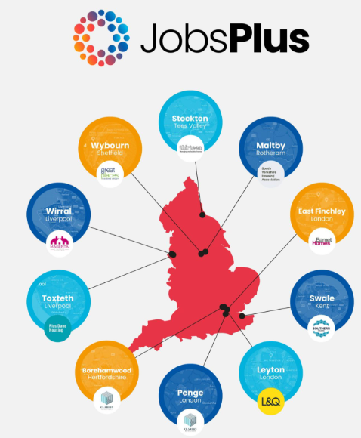

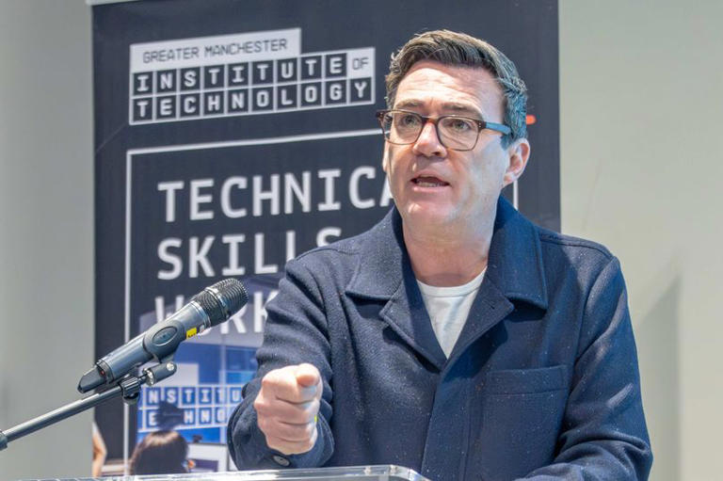
…to a people-led, locally delivered system
Joined up, long-term funded, locally delivered support.

Slide 18
#EmpSkills26
2026
KEYNOTE
The Rt Hon Lord Willetts
President
Resolution Foundation
Led by
Lead sponsor
Sponsors

Slide 19
#EmpSkills26
2026
PANEL
Growing opportunity: young people, real jobs
Led by
Lead sponsor
Sponsors

Slide 20
#EmpSkills26
2026
Chair: Dr Emily Andrews, Director of Policy and Research, Learning and Work Institute
Alex Fitzpatrick, Director for Joint Skills Strategy and Young People, Department for Work and Pensions
Sarah Yong, Deputy CEO, Youth Futures Foundation
Luiza Paludo Gomes, Employment Policy Lead, British Retail Consortium
Subrahmaniam Krishnan-Harihara, Director of Business Policy and Research, Greater Manchester Chambers of Commerce
Jemma Johnstone, Operations Director, Maximus
Led by
Lead sponsor
Sponsors

Slide 21
#EmpSkills26
2026
Dr Emily Andrews
Director of Policy and Research
Learning and Work Institute
Led by
Lead sponsor
Sponsors

Slide 22
#EmpSkills26
2026
Alex Fitzpatrick
Director for Joint Skills Strategy and Young People
Department of Work and Pensions
Led by
Lead sponsor
Sponsors

Slide 23
#EmpSkills26
2026
Sarah Yong
Deputy CEO
Youth Futures Foundation
Led by
Lead sponsor
Sponsors

Slide 24
#EmpSkills26
2026
Luiza Paludo Gomes
Employment Policy Lead
British Retail Consortium
Led by
Lead sponsor
Sponsors

Slide 25
#EmpSkills26
2026
Subrahmaniam Krishnan-Harihara
Director of Business Policy and Research Greater Manchester Chambers of Commerce
Led by
Lead sponsor
Sponsors

Slide 26
#EmpSkills26
2026
Jemma Johnstone
Operations Director
Maximus
Led by
Lead sponsor
Sponsors

Slide 27
#EmpSkills26
2026
Chair: Dr Emily Andrews, Director of Policy and Research, Learning and Work Institute
Alex Fitzpatrick, Director for Joint Skills Strategy and Young People, Department for Work and Pensions
Sarah Yong, Deputy CEO, Youth Futures Foundation
Luiza Paludo Gomes, Employment Policy Lead, British Retail Consortium
Subrahmaniam Krishnan-Harihara, Director of Business Policy and Research, Greater Manchester Chambers of Commerce
Jemma Johnstone, Operations Director, Maximus
Led by
Lead sponsor
Sponsors

Slide 28
#EmpSkills26
2026
WORKSHOPS
Small employers, big opportunities: apprenticeships for young people | Main Hall
Off the grid: reaching ‘hidden’ young people who are NEET | Breakout Room 1
AI in action: transforming employment support | Breakout Room 2
From evidence to delivery: what works in health and work support | Breakout Room 3
Led by
Lead sponsor
Sponsors

Slide 29
#EmpSkills26
2026
LUNCH AND EXHIBITION
Workshops at 1.30pm!
Led by
Lead sponsor
Sponsors

Slide 30
2026
#EmpSkills26
Learning and Work Institute
@learnworkuk.bsky.social
Led by
Lead sponsor
Sponsors

Slide 31
#EmpSkills26
2026
WORKSHOP
Small employers, big opportunities: apprenticeships for young people
Led by
Lead sponsor
Sponsors

Slide 32
#EmpSkills26
2026
Chair: Olly Newton, Executive Director, Edge Foundation
Laura Hawksworth, Associate Director, Policy and Impact, Careers & Enterprise Company
Kate Carr, Senior Employer Engagement & Partnerships Manager, Youth Futures Foundation
Dr Anna Morrison, Founder and Director, Amazing Apprenticeships
Chris Mayne, Managing Director, Forsberg Services and Board Member, Electech Innovation Cluster
Led by
Lead sponsor
Sponsors

Slide 33
#EmpSkills26
2026
Olly Newton
Executive Director
Edge Foundation
Led by
Lead sponsor
Sponsors

Slide 34
#EmpSkills26
2026
Laura Hawksworth
Head of Policy and Impact Careers & Enterprise Company
Led by
Lead sponsor
Sponsors

Slide 35
Small employers, big opportunities
Laura Hawksworth
2nd July 2026

Slide 36
The Careers & Enterprise Company is the independent national body preparing young people for their futures.
We have a regional network of 44 Careers Hubs covering 96% of schools and colleges, in partnership with Mayoral Strategic and Local Authorities, to connect with employers and local skills needs.

Slide 37
Our mission
To help every young person find their best next step.

Slide 38
More young people know
DfE parent, pupil and learner voice shows 100% awareness.
CEC data consistently shows a doubling of understanding between years 7 and 11.
CEC analysis shows career readiness (includes pathway understanding) improves faster where careers education is highest quality.
Disadvantage, health and place continue to shape young people's access to opportunities and progression.
  ATE Framework evidence suggests awareness does not always translate into apprenticeship take-up.
...about apprenticeships
DWP & Rt Hon Alan Milburn (May 2026). Young people and work: interim report.

Slide 39
…but FSM eligibility is associated with a gap in pathway understanding
Understanding of pathways after Year 11 by FSM status, 2024/25
Learners not eligible for FSM consistently report higher understanding of both pathways than FSM-eligible learners.
The gap is relatively small for Apprenticeships (4%pts: 80% vs 76%), suggesting similar levels of awareness, but a larger gap for A-Levels (11%pts: 86% vs 75%)
Source: Future Skills Questionnaire, 2024/25 academic year-end data (Year 11, N=31,015)

Slide 40
The Boosting Skills Pathways programme uses the ATE Framework and employer-led outreach in growth sectors to increase awareness and uptake.
Repeated, meaningful encounters with employers, FE colleges and training providers improve understanding of ATE pathways and support progression decisions.
But: awareness alone if not enough. Careers Hub coordination is needed to:
    Boost the opportunities available to young people
    Increase enthusiasm for occupations with opportunities
    Improve the conversion of interest to uptake of opportunities
DFAF is applying the ATE Framework to identify and overcome barriers to digital apprenticeship take-up in disadvantaged communities.
Boosting Skills Pathways and Digital Futures Accelerator Funds
…what works

Slide 41
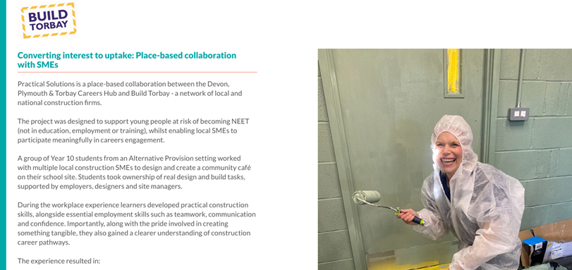
Case study:
Converting interest to uptake in Devon, Plymouth & Torbay
Devon, Plymouth & Torbay Careers Hub and Build Torbay worked with Year 10 students in Alternative Provision to design and build a community café.
  Young people gained hands-on experience with employers while developing practical, teamwork and communication skills.
  The project increased understanding of construction careers and apprenticeship pathways.
Demonstrates how place-based SME collaboration can convert interest into progression opportunities for young people at risk of becoming NEET.

Slide 42
More we need to do
There is more to do:
Updated Gatsby Benchmarks – meaningful encounters for all young people
Sector approaches (e.g., Home building) that enable SME engagement and more structured pathways, starting early
Localised approaches, based on evidence-based assessments (ATE Transitions Framework)
…to enable SME engagement

Slide 43
#EmpSkills26
2026
Kate Carr
Senior Employer Engagement & Partnerships Manager
Youth Futures Foundation UK
Led by
Lead sponsor
Sponsors

Slide 44
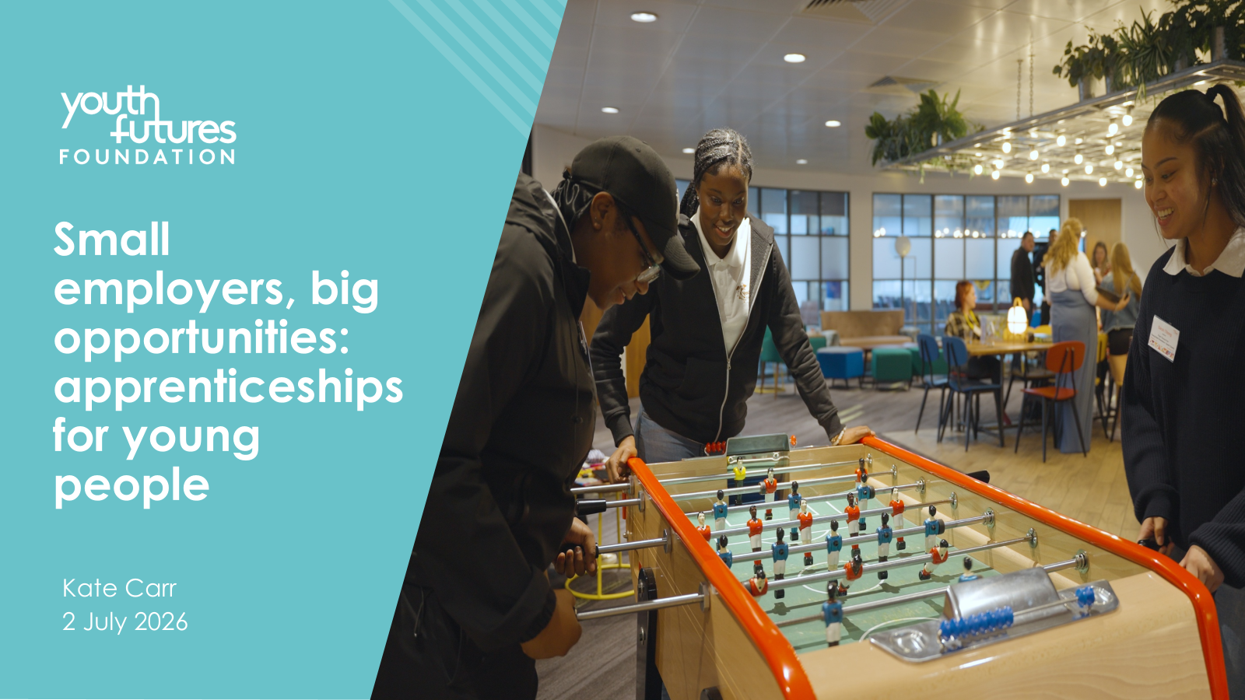

Slide 45


Slide 46
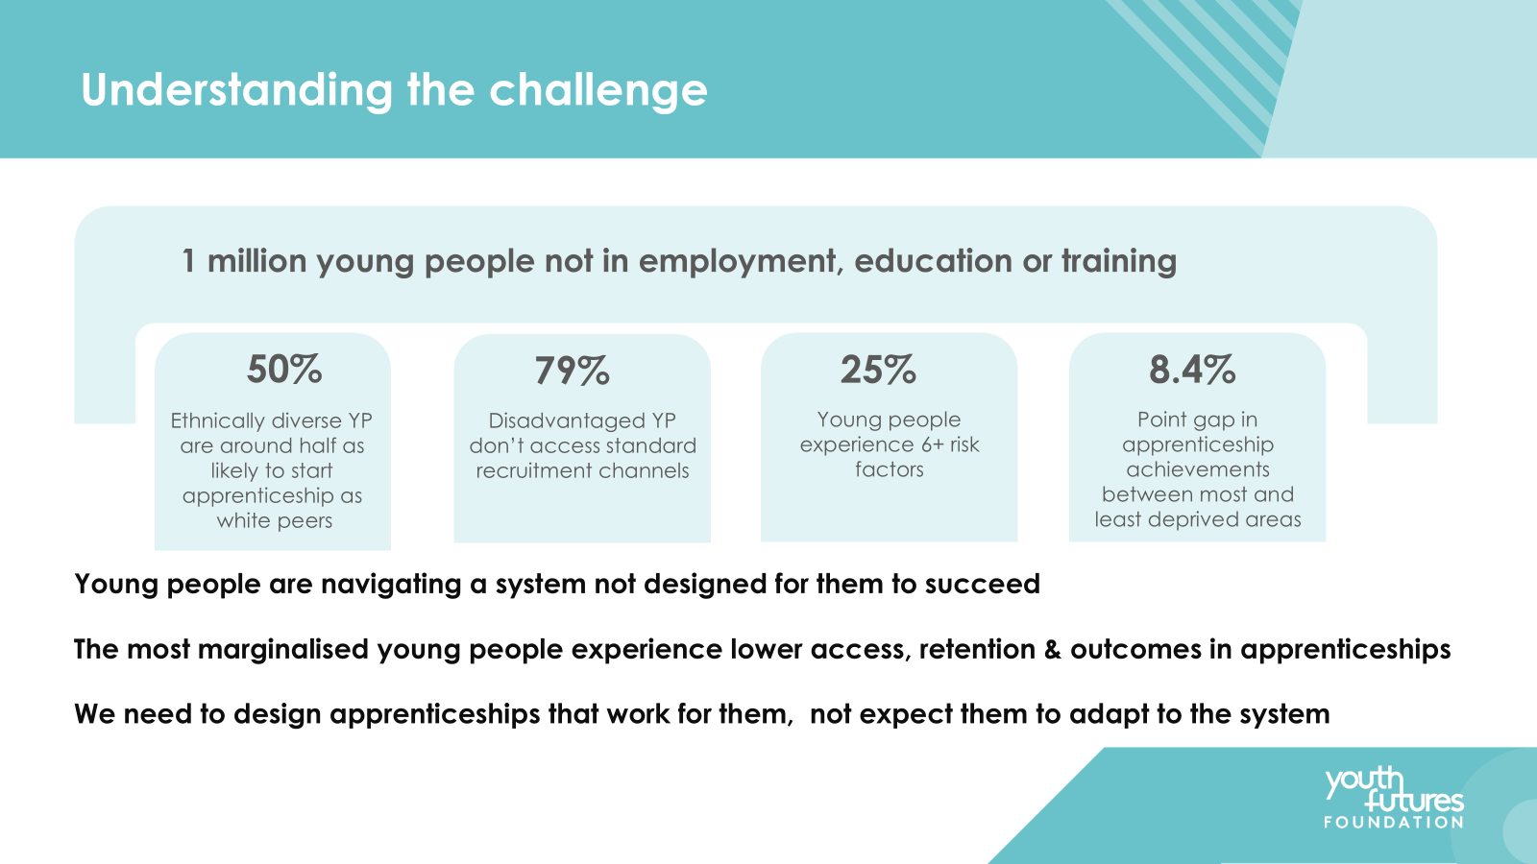

Slide 47
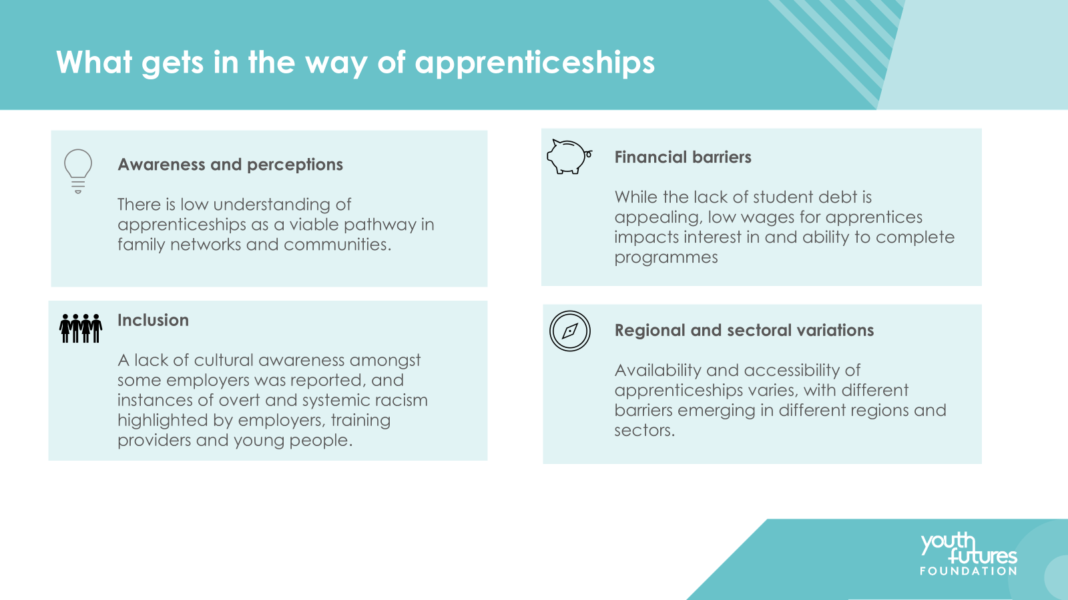

Slide 48
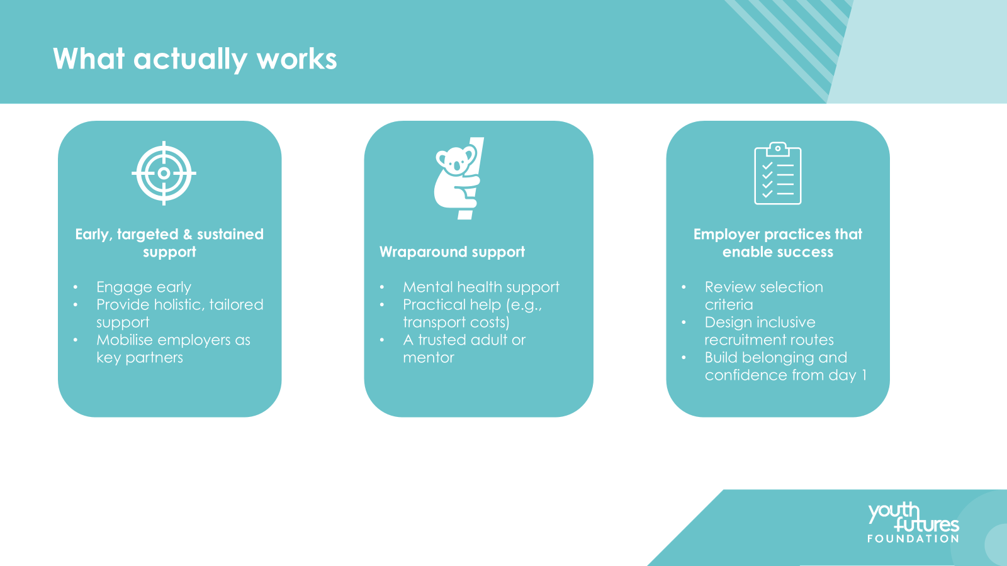

Slide 49
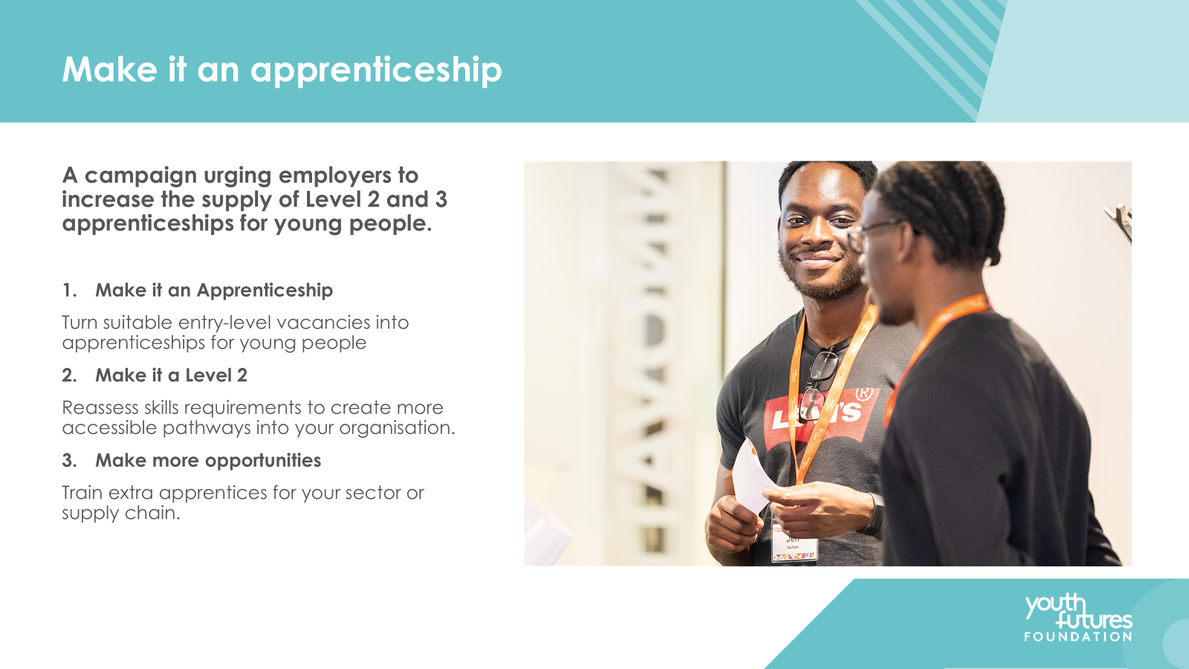

Slide 50


Slide 51
#EmpSkills26
2026
Dr Anna Morrison
Founder and Director
Amazing Apprenticeships
Led by
Lead sponsor
Sponsors

Slide 52
#EmpSkills26
2026
Chris Mayne
Managing Director, Forsberg Services and
Board Member, Electech Innovation Cluster
Led by
Lead sponsor
Sponsors

Slide 53
#EmpSkills26
2026
Chair: Olly Newton, Executive Director, Edge Foundation
Laura Hawksworth, Associate Director, Policy and Impact, Careers & Enterprise Company
Kate Carr, Senior Employer Engagement & Partnerships Manager, Youth Futures Foundation
Dr Anna Morrison, Founder and Director, Amazing Apprenticeships
Chris Mayne, Managing Director, Forsberg Services and Board Member, Electech Innovation Cluster
Led by
Lead sponsor
Sponsors

Slide 54
#EmpSkills26
2026
BREAK AND EXHIBITION
Back at 3pm!
Led by
Lead sponsor
Sponsors

Slide 55
2026
#EmpSkills26
Learning and Work Institute
@learnworkuk.bsky.social
Led by
Lead sponsor
Sponsors

Slide 56
#EmpSkills26
2026
SPOTLIGHT SESSION
Powering opportunity through devolution in the North West
Led by
Lead sponsor
Sponsors

Slide 57
#EmpSkills26
2026
Chair: Dr Emily Andrews, Director of Policy and Research, Learning and Work Institute
Nicola McLeod, Director for Education, Work and Skills, Greater Manchester Combined Authority
Matthew Ainsworth, Director of Skills, Work & Inclusive Economy, Salford City Council
Simon Joos, Work and Skills Specialist, Manchester City Council
Led by
Lead sponsor
Sponsors

Slide 58
#EmpSkills26
2026
Dr Emily Andrews
Director of Policy and Research Learning and Work Institute
Led by
Lead sponsor
Sponsors

Slide 59
#EmpSkills26
2026
Nicola McLeod
Director – Education, Work and Skills, Greater Manchester Combined Authority
Led by
Lead sponsor
Sponsors

Slide 60
#EmpSkills26
2026
Matthew Ainsworth
Director – Skills, Work & Inclusive Economy, Salford City Council
Led by
Lead sponsor
Sponsors

Slide 61
#EmpSkills26
2026
Simon Joos
Work and Skills Specialist
Manchester City Council
Led by
Lead sponsor
Sponsors

Slide 62
#EmpSkills26
2026
Chair: Dr Emily Andrews, Director of Policy and Research, Learning and Work Institute
Nicola McLeod, Director for Education, Work and Skills, Greater Manchester Combined Authority
Matthew Ainsworth, Director of Skills, Work & Inclusive Economy, Salford City Council
Simon Joos, Work and Skills Specialist, Manchester City Council
Led by
Lead sponsor
Sponsors

Slide 63
#EmpSkills26
2026
PANEL
Unlocking potential: skills for a changing workforce
Led by
Lead sponsor
Sponsors

Slide 64
#EmpSkills26
2026
Stephen Evans, Chief Executive, Learning and Work Institute (Chair)
Oliver Nash, Director of Innovation, Institute for the Future of Work
Dr Fiona Aldridge, Chief Executive, Skills Federation and Board Member, Skills England
Kate Bell, Assistant General Secretary, TUC
Nimmi Patel, Associate Director, techUK
Patrick Craven, Public Affairs, Partnership & Engagement Director, City & Guilds
Led by
Lead sponsor
Sponsors

Slide 65
#EmpSkills26
2026
Stephen Evans
Chief Executive
Learning and Work Institute
Led by
Lead sponsor
Sponsors

Slide 66
#EmpSkills26
2026
Oliver Nash
Director of Innovation
Institute for the Future of Work
Led by
Lead sponsor
Sponsors

Slide 67
#EmpSkills26
2026
Dr Fiona Aldridge
Chief Executive, Skills Federation and Board Member, Skills England
Led by
Lead sponsor
Sponsors

Slide 68
#EmpSkills26
2026
Kate Bell
Assistant General Secretary
TUC
Led by
Lead sponsor
Sponsors

Slide 69
#EmpSkills26
2026
Nimmi Patel
Associate Director
techUK
Led by
Lead sponsor
Sponsors

Slide 70
#EmpSkills26
2026
Patrick Craven
Public Affairs, Partnership & Engagement Director
City & Guilds
Led by
Lead sponsor
Sponsors

Slide 71
#EmpSkills26
2026
Stephen Evans, Chief Executive, Learning and Work Institute (Chair)
Oliver Nash, Director of Innovation, Institute for the Future of Work
Dr Fiona Aldridge, Chief Executive, Skills Federation and Board Member, Skills England
Kate Bell, Assistant General Secretary, TUC
Nimmi Patel, Associate Director, techUK
Patrick Craven, Public Affairs, Partnership & Engagement Director, City & Guilds
Led by
Lead sponsor
Sponsors

Slide 72
#EmpSkills26
2026
CLOSING REMARKS
Stephen Evans
Chief Executive
Learning and Work Institute
Led by
Lead sponsor
Sponsors

Slide 73
#EmpSkills26
2026
Thank you to our sponsors!
Led by
Lead sponsor
Sponsors

Slide 74
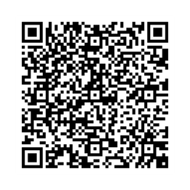
#EmpSkills26
2026
HOW DID WE DO?
Led by
Lead sponsor
Sponsors

Slide 75

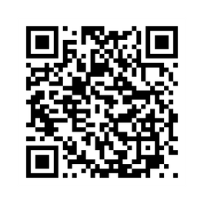
Stay informed. Be involved. Keep engaged.
learningandwork.org.uk/supporter-network

