Slide 1
Addressing challenges in the UK workforce
David Willetts, President, Resolution Foundation
Employment and Skills Convention, 2nd July 2026

Slide 2
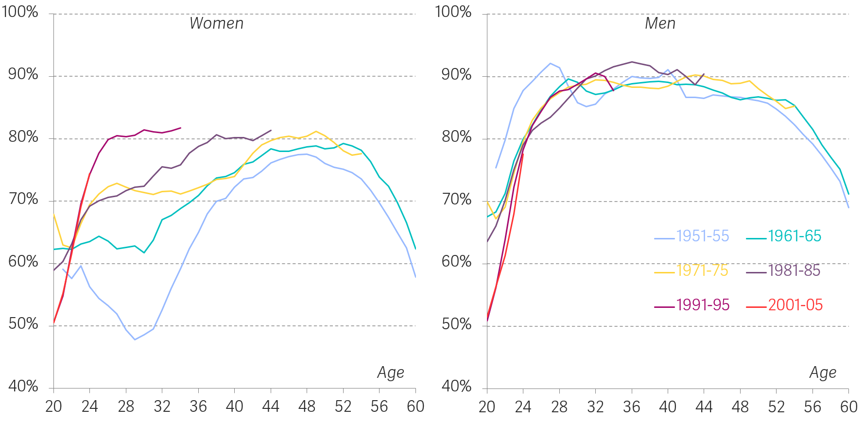
Successive generations, especially women, have benefited from strong employment
Employment rate, by age and cohort, women (left panel) and men (right panel): UK, 1975 to 2025
Notes: Figures for each cohort are derived from a weighted average of estimates by single year of age; cohorts are included if at least five birth years are present in the data.
​Source: RF analysis of ONS, Annual Labour Force Survey (1975–91); ONS, Quarterly Labour Force Survey (1992–2025).

Slide 3
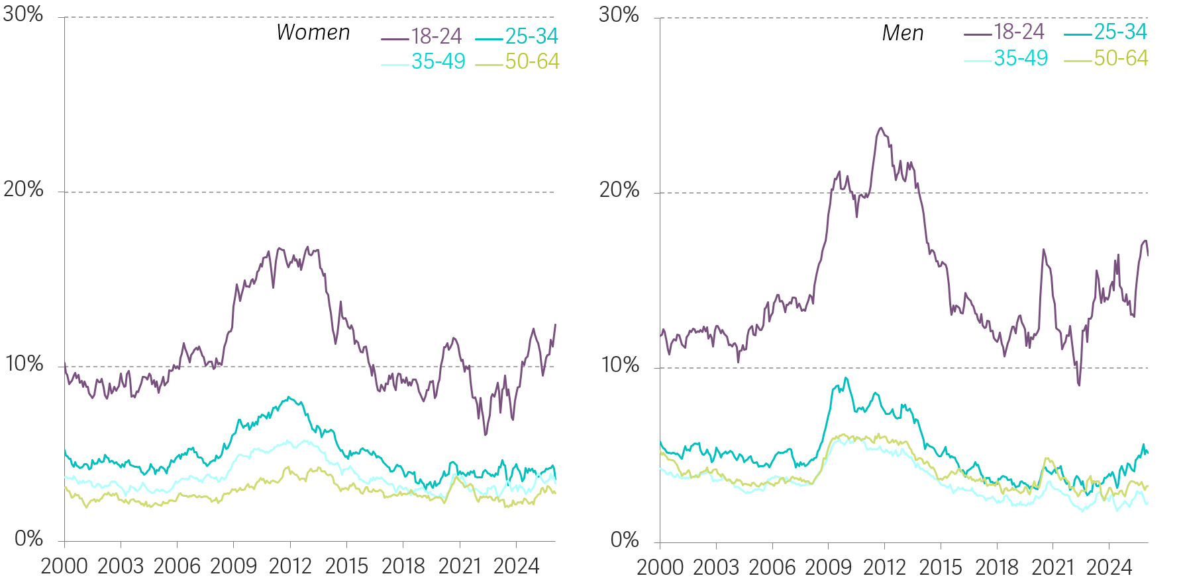
Compared to other age groups, younger people face higher unemployment compared to pre–Financial Crisis
Proportion who are unemployed, by age, women (left panel) and men (right panel): UK, February 2000 to March 2026
Source: RF analysis of ONS, Labour Force Survey.

Slide 4
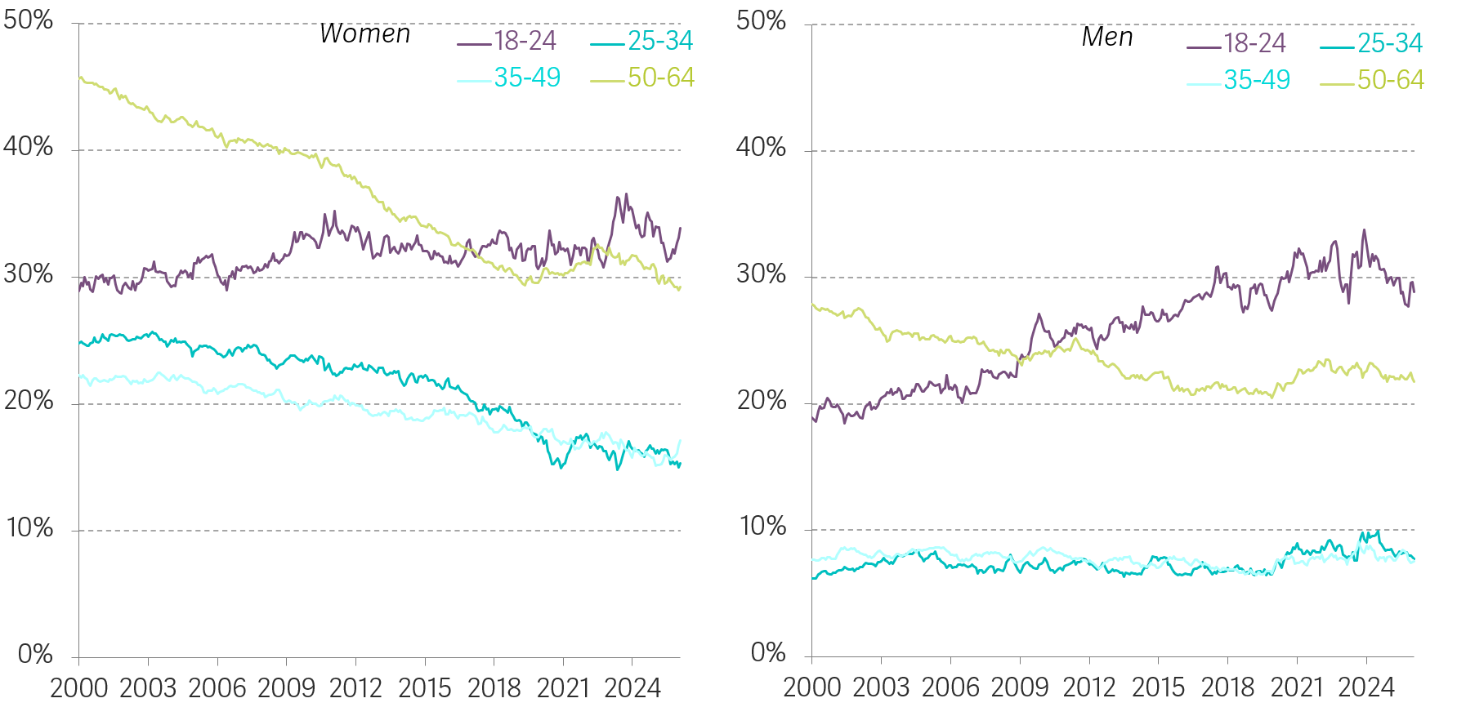
Economic inactivity has risen for 18-24-year-olds, especially men
Proportion who are economically inactive, by age, women (left panel) and men (right panel): UK, February 2000 to March 2026
Source: RF analysis of ONS, Labour Force Survey.

Slide 5
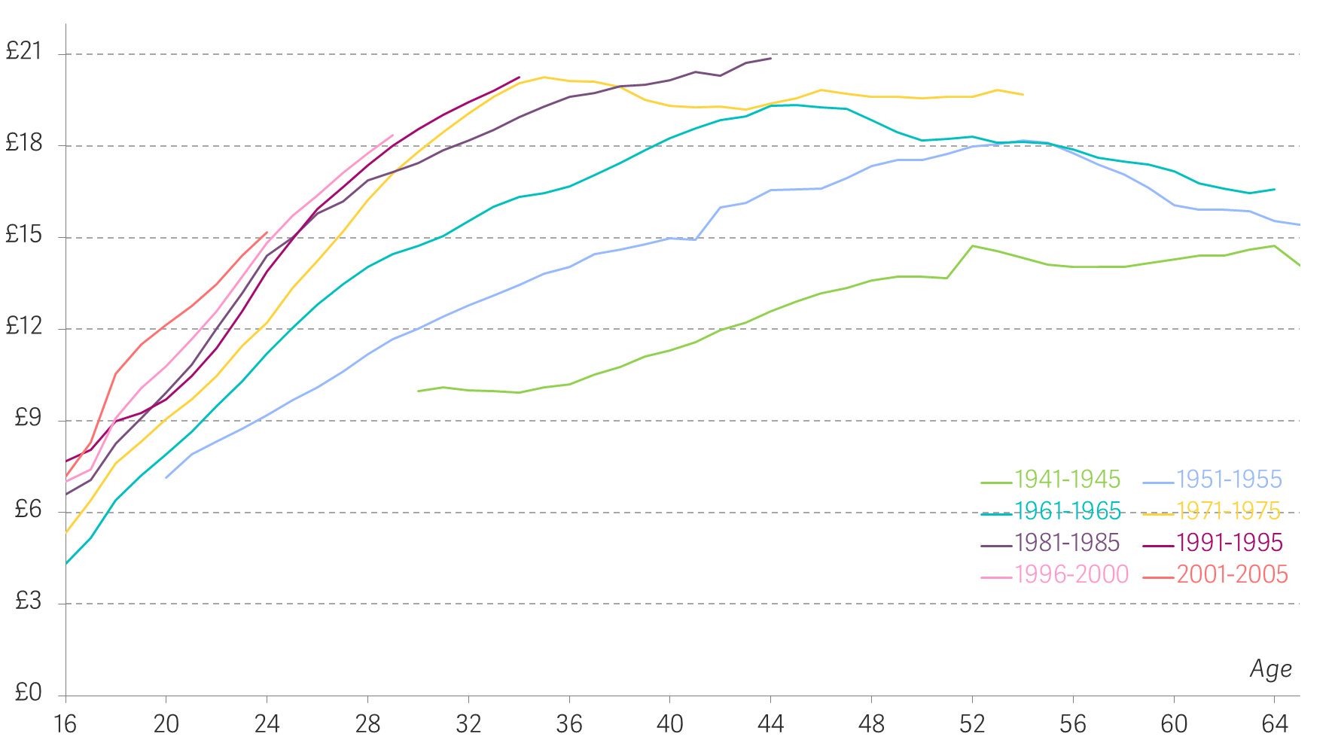
Earnings gains of successive cohorts are not what they once were
Median real hourly employee pay, by cohort: UK, 1975 to 2025
Notes: Adjusted to 2026 prices using CPI.
Source: RF analysis of ONS, New Earnings Survey (1975-97); ONS, Annual Survey of Hours and Earnings (1997-latest); ONS, CPI inflation series.

Slide 6
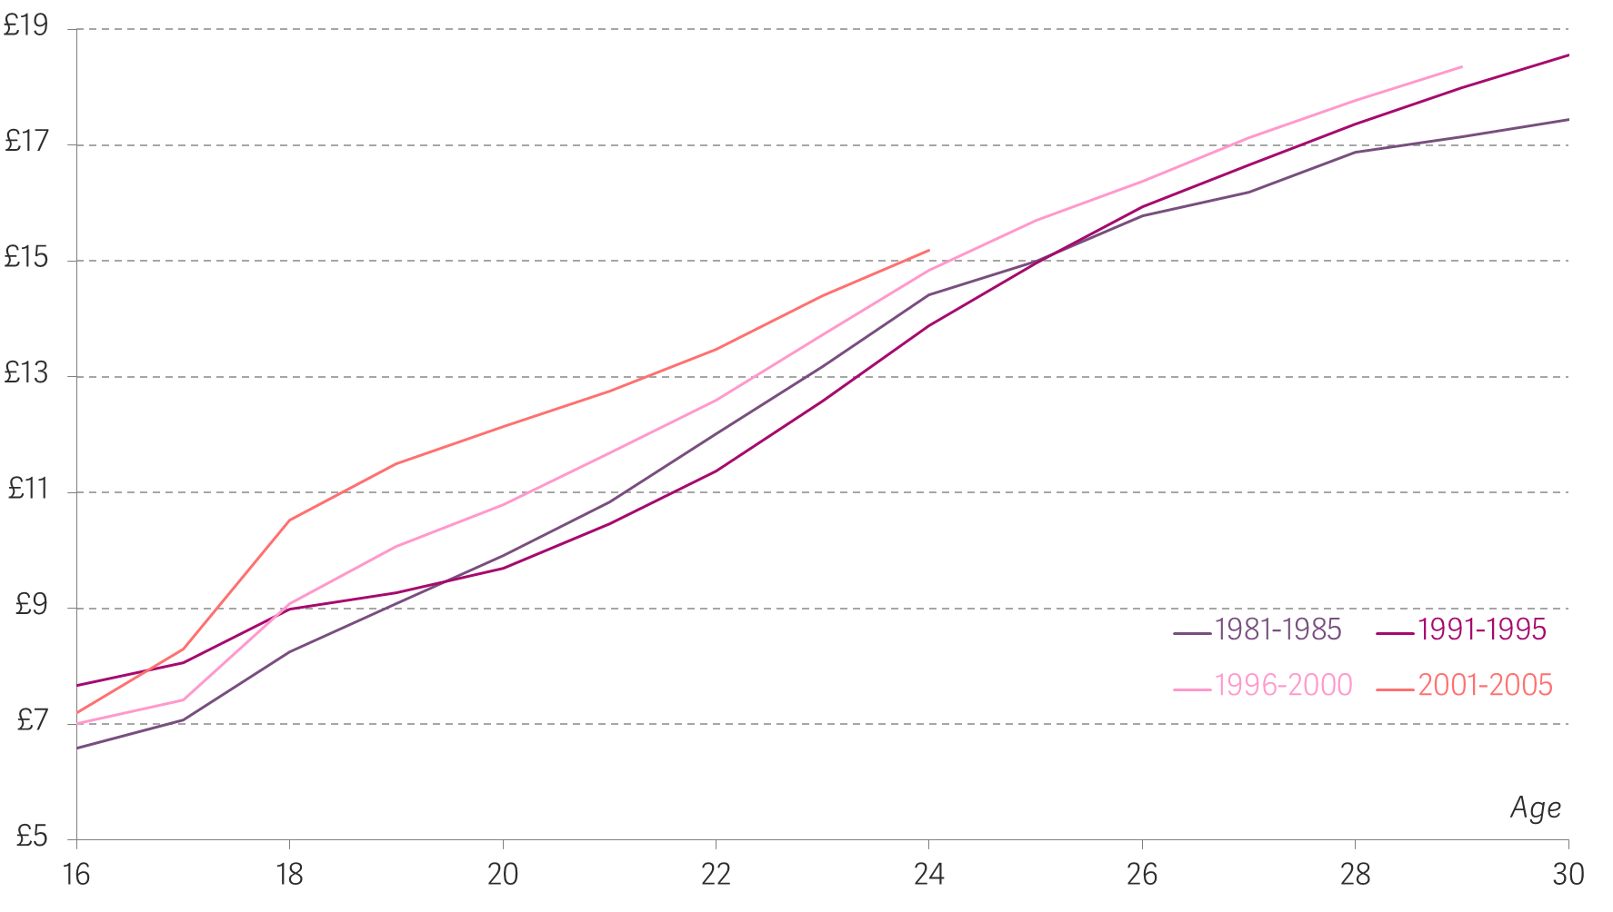
A fast-rising minimum wage has benefited younger ages
Median real hourly employee pay, by cohort: UK, 1975 to 2025
Notes: Adjusted to 2026 prices using CPI.
Source: RF analysis of ONS, New Earnings Survey (1975-97); ONS, Annual Survey of Hours and Earnings (1997-latest); ONS, CPI inflation series.

Slide 7
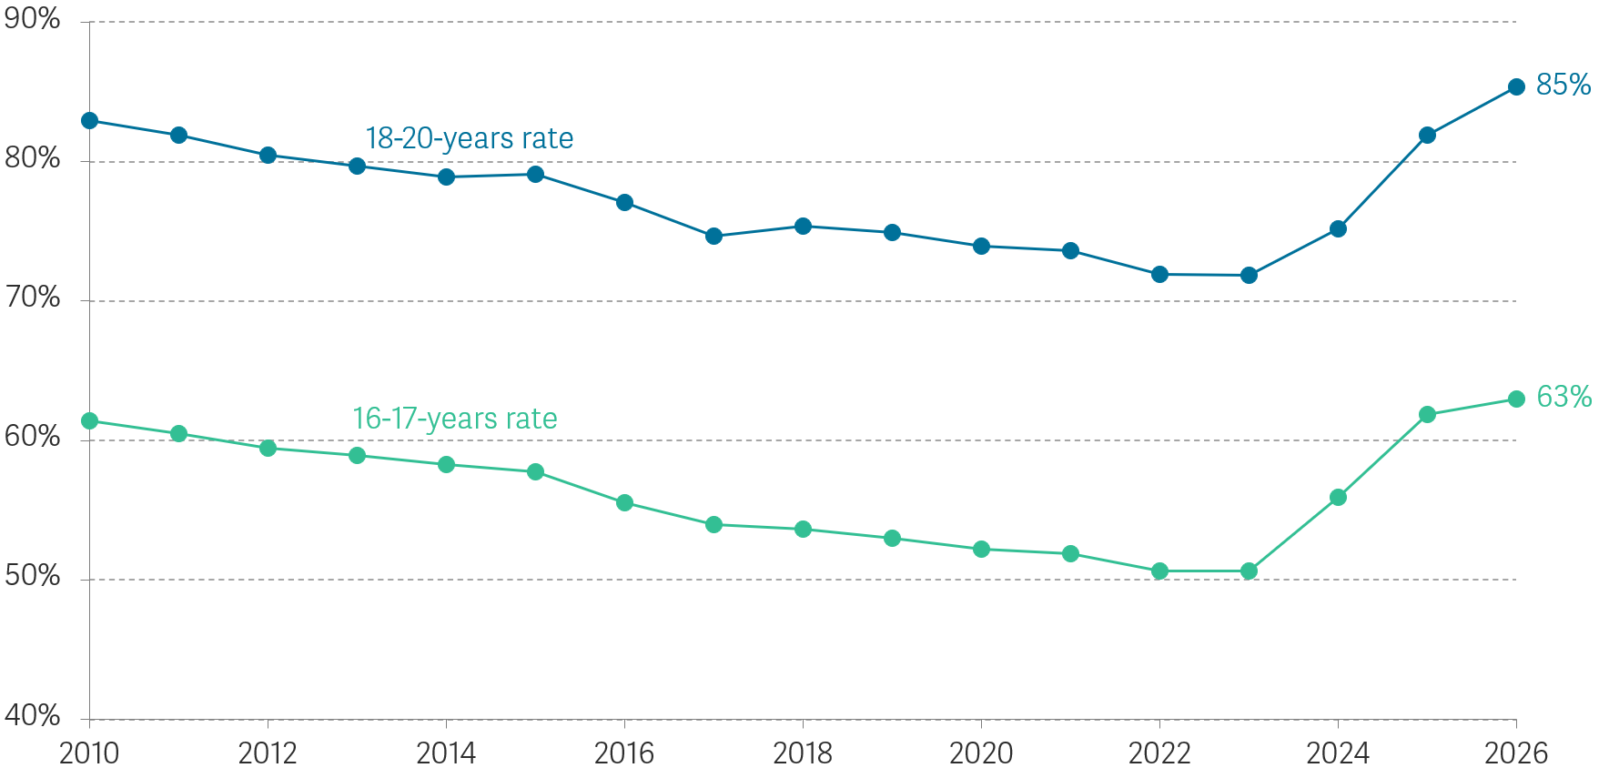
The value of the minimum wage youth rates relative to the adult rate has been increasing rapidly
Minimum wage youth rates as a proportion of the rate for over 25s: UK
Source: RF analysis of Low Pay Commission, Uprating Report 2025; Low Pay Commission, Main Report 2026.

Slide 8
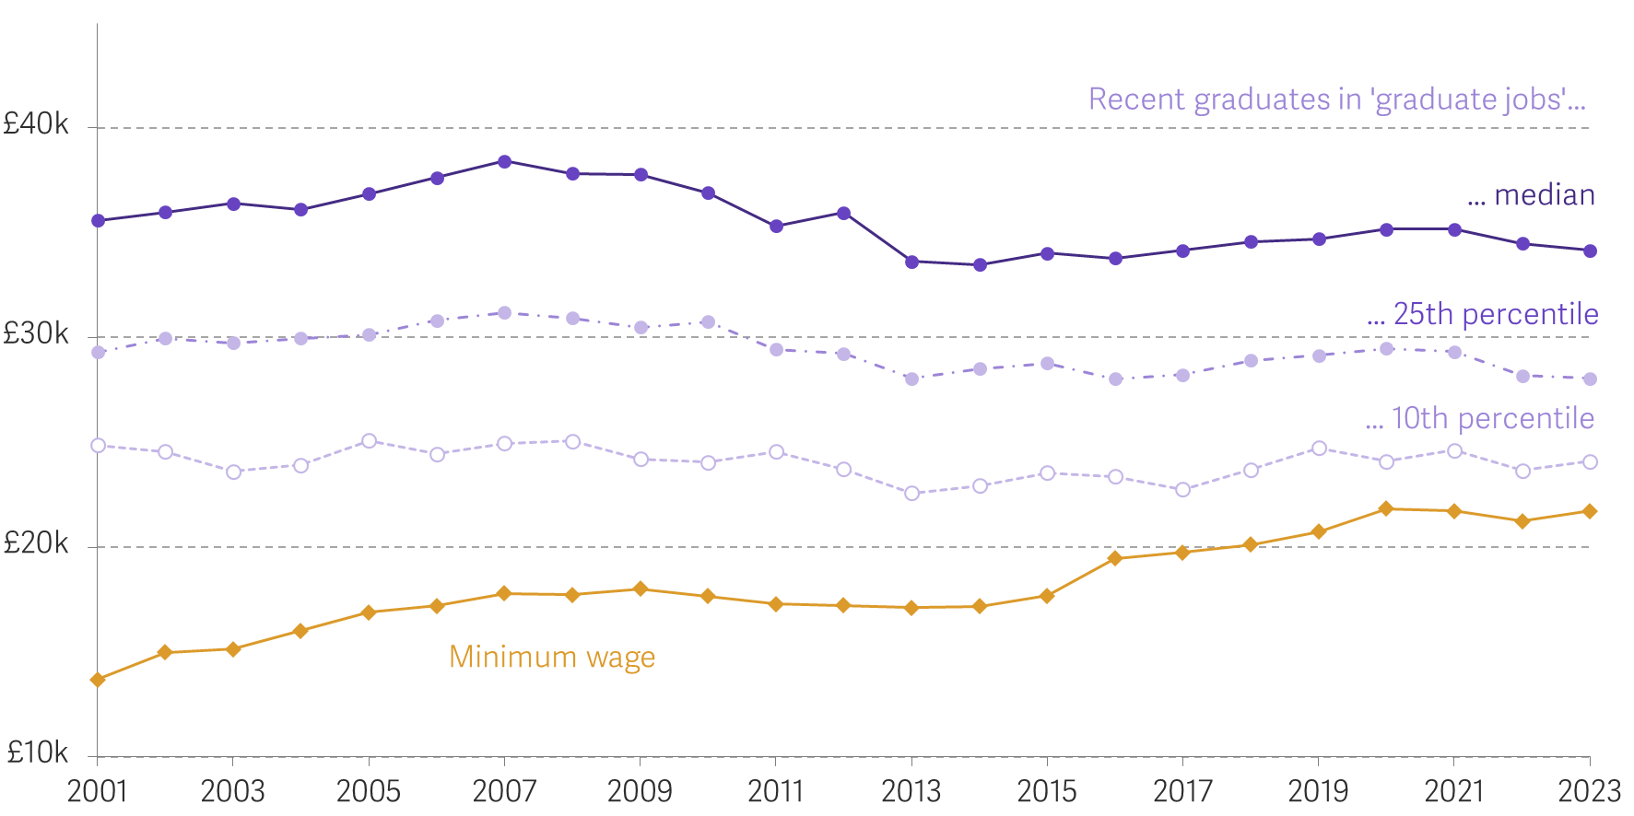
The minimum wage is closing the pay gap with recent graduates
Real full-time annual earnings for someone on the minimum wage and different categories of graduates: UK
Notes: Adjusted for CPI inflation. Recent graduates defined as those with a qualification at Level 4 or above and who have left education in the last five years. Graduate jobs defined using four-digit occupation codes set out in: P Elias & K Purcell, Classifying graduate occupations for the knowledge society, Institute for Employment Research Working Paper 5, February 2013. Full-time minimum wage equivalent assumes 40 hours a week.
Source: RF analysis of ONS, Labour Force Survey.

Slide 9
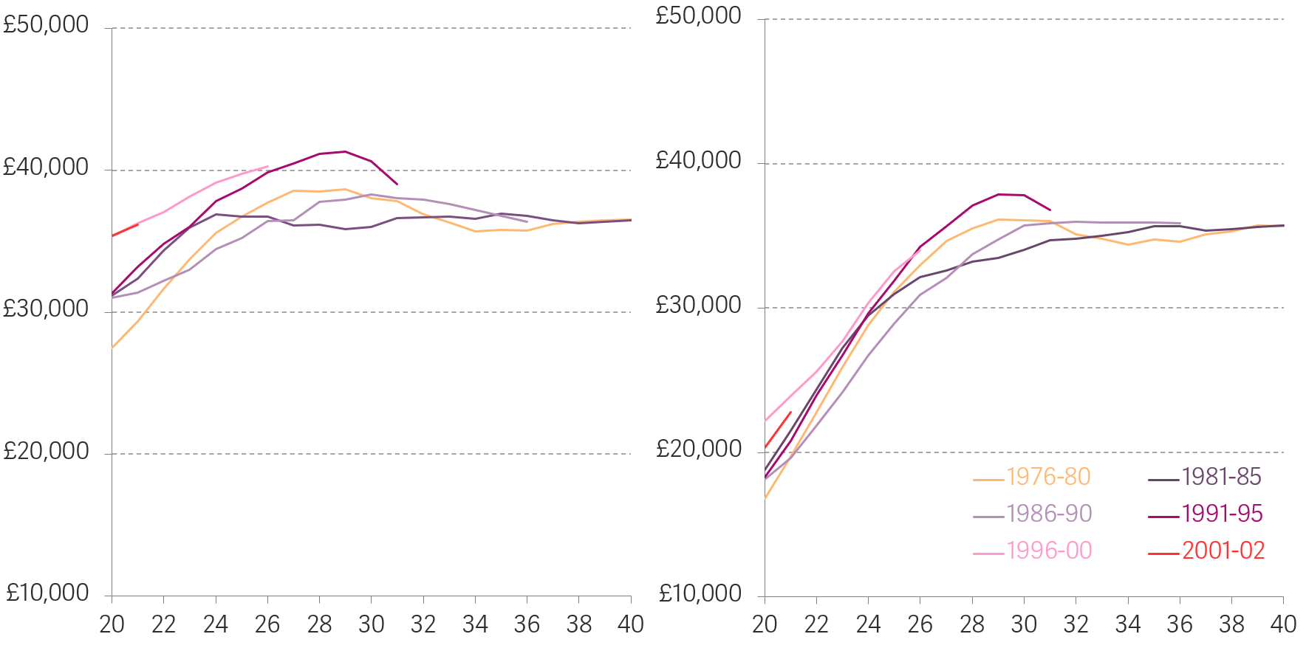
The youngest cohort are set to be on a lower income trajectory
Total real household disposable income (left panel) versus benefit unit disposable income (right panel) by age and birth cohort: UK, 1994-95 to 2023-24
A ‘benefit unit’ is defined as the young person, any co-resident partner, and dependent children.
Notes: Incomes here are net of direct taxes and benefits, ‘equivalised’ for household size, and measured before housing costs. Income values are on a three-year rolling average by age. For example, data shown at 25 years old in the chart averages data from 24-26.
Source: RF analysis of DWP, Households Below Average Income.

Slide 10
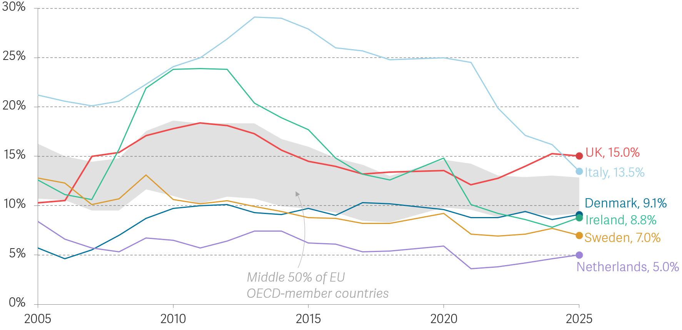
The UK has a NEETs problem
Proportion of young people aged 18-24-years-old that are not in employment, education or training (NEET): UK and selected EU OECD-member countries
Source: RF analysis of Eurostat, Young persons neither in employment nor in education and training (NEET rates); ONS, Young people not in education, employment or training (NEET).

Slide 11
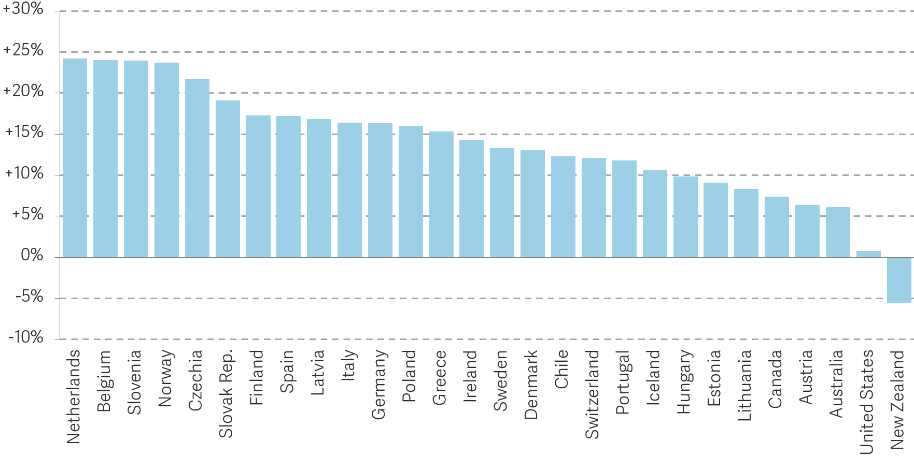
Education participation in the UK lags behind leading countries on NEETs
Proportion of 18-24-year-olds who are participating in education measured relative to the UK: OECD countries with a lower NEET rate than the UK, 2024
Source: OECD, Education at a Glance, 2025.

Slide 12
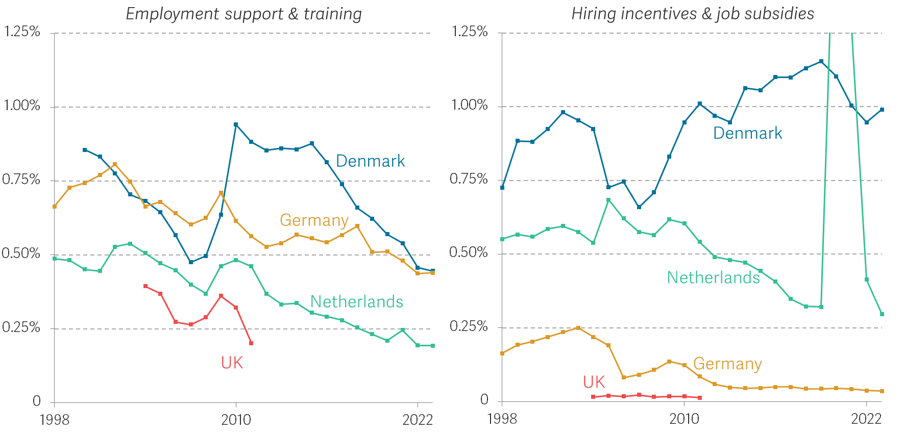
Low NEET countries spend more on labour market policies
Spending on different types of active labour market policies as a share of GDP: various countries
Source: RF analysis of Eurostat, LMP expenditure by type of action – summary tables.

Slide 13
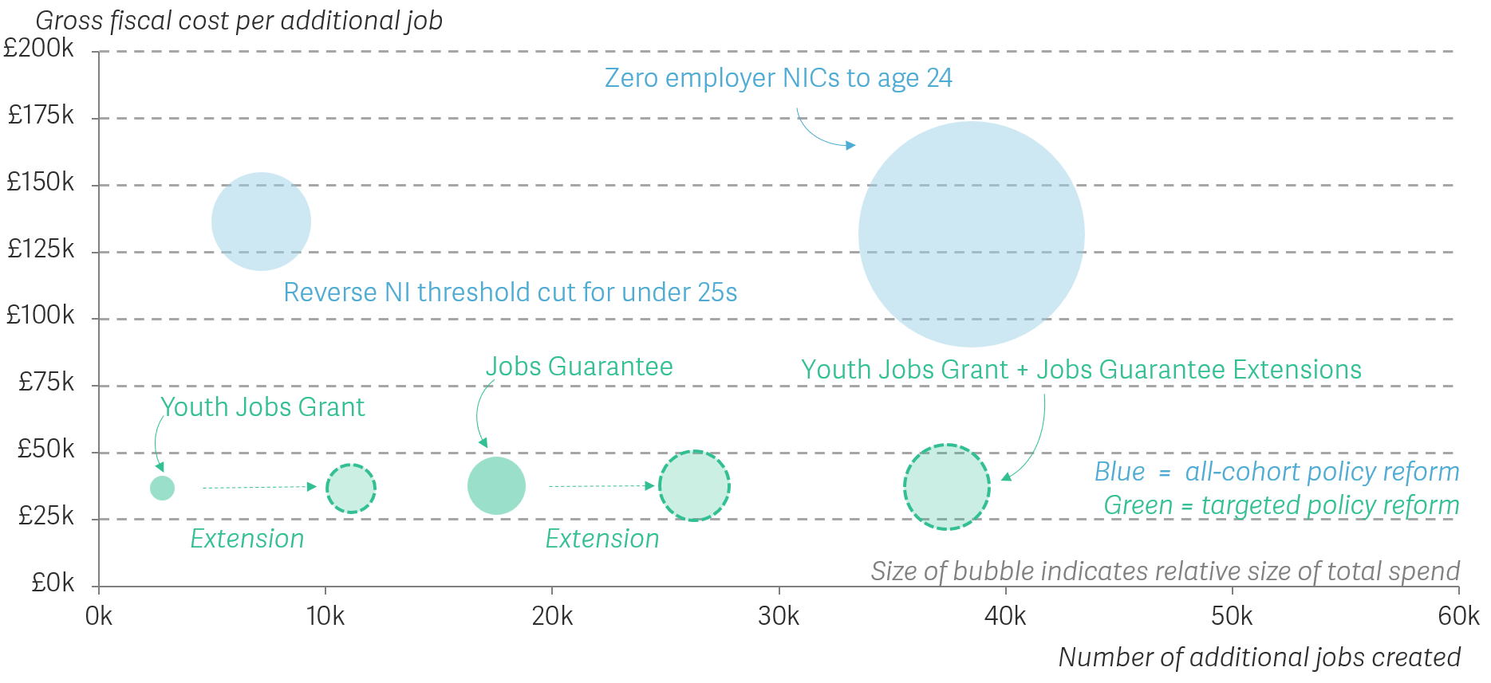
Scaling up targeted interventions is more cost-effective than tax reform
Estimated number of additional jobs created, and gross fiscal cost per additional job,
by demand-side scheme: 2025-26/2026-27, UK/GB
Notes: The Youth Jobs Grant and the Jobs Guarantee begin in 2026-27 so our calculations estimate the gross fiscal cost in 2026-27. The Youth Jobs Grant and the Jobs Guarantee are GB only. Youth Jobs Grant and Jobs Guarantee Extension uses the midpoint of their respective cost per additional job (£37,000 and £38,000).
Source: RF calculations.

Slide 14
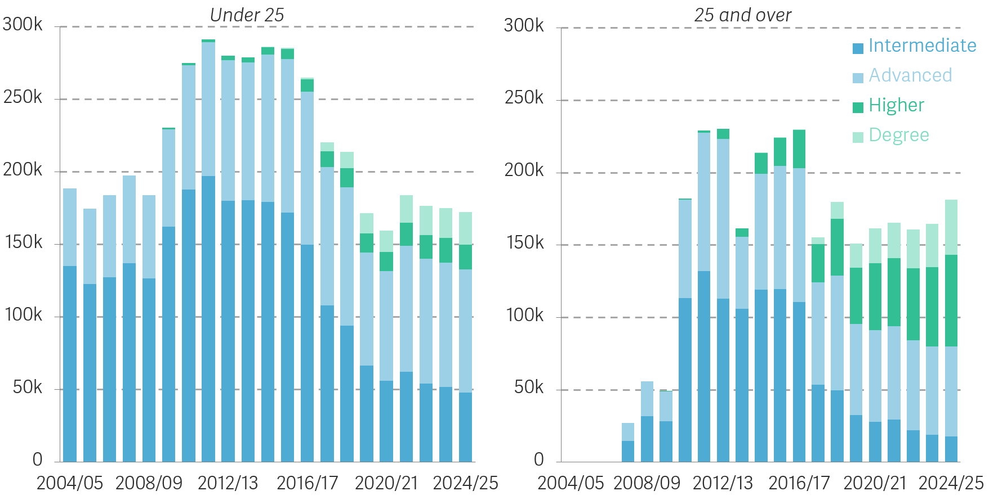
Younger apprenticeship numbers have fallen
Apprenticeship starts, by age group and level: England
Source: RF analysis of Department for Education, Apprenticeships.

Slide 15
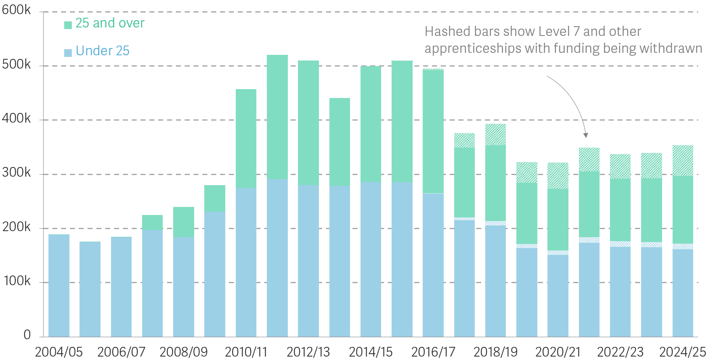
From 2026, the Government has withdrawn funding from the higher level apprenticeships
Apprenticeship starts, by age group: England
Notes: Apprenticeships starts refers to all starts, both those funded by the levy and otherwise.
Source: RF analysis of Department for Education, Apprenticeships.

Slide 16
Policy proposals
Enable more young people to enjoy the premium of higher education with a stronger maintenance loan and grants offer.
Extend the Youth Jobs Grant and reform the payment structure.
Extend the Jobs Guarantee scheme to young people on UC Health, those looking for work, and in receipt of UC for 12 months.
The Growth and Skills Levy should be ringfenced for under 25-year-olds (and use the extra funding to extend young apprenticeship payments to larger firms).
Abandon the commitment to ultimate convergence between the youth and adult minimum wage.

Slide 17
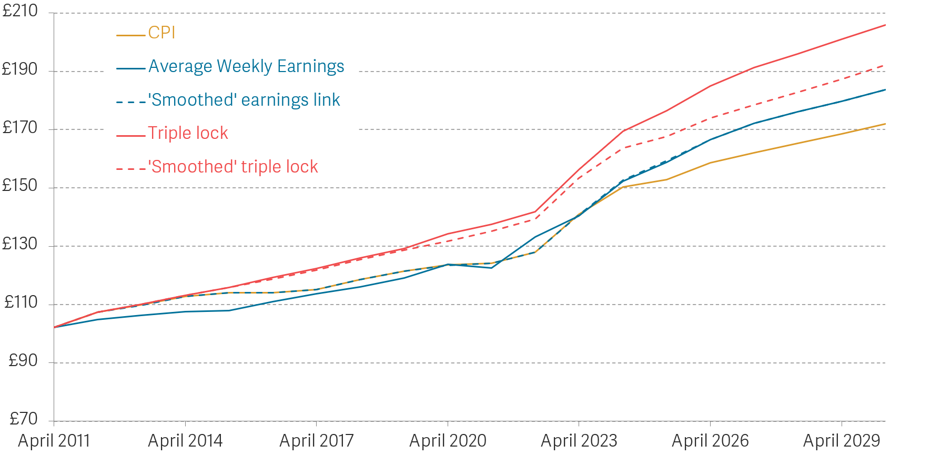
Alternative uprating mechanisms could lead to more sustainable State Pension uprating
Weekly value of the Basic State Pension under various uprating mechanisms since 2011-12: UK
Notes: In nominal prices. Includes the temporary suspension of triple lock uprating in 2022-23. CPI uprating uses the CPI rate from the previous September. Average Weekly Earnings uprating uses the 3-month average AWE growth from the previous July to September. ‘Smoothed’ triple lock uprates by 2.5 per cent annually as a minimum but tracks AWE growth in the long term.
Source: RF analysis of DWP, Benefit and Pension rates; OBR, Economic and Fiscal Outlook, Spring Forecast 2026.

Slide 18
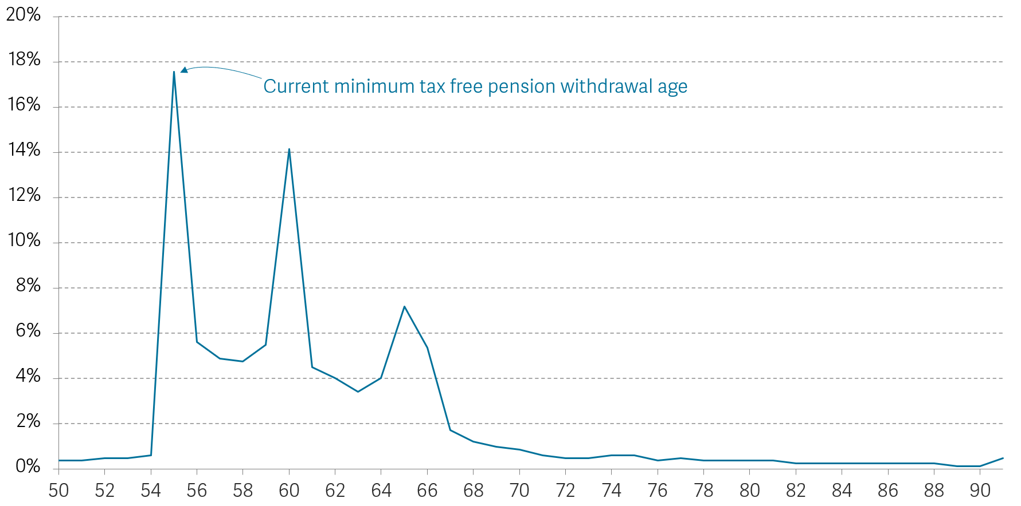
Current decumulation policy allows for early labour market exit
Share of individuals accessing private pension for the first time by age: UK, 2024-25
Source: RF analysis of DWP, Workplace pension participation and saving trends of eligible employees: 2009-2024

Slide 19
Policy proposals
Maintain and implement a rise in the State Pension age from 67 to 68 from 2037-2039.
UC could offer greater support for part-time work and those above a certain age.
Raise the age at which tax-relieved pensions can be accessed.
Replace the Triple Lock with a smoothed earnings link.
Earnings link for family benefits

Slide 20
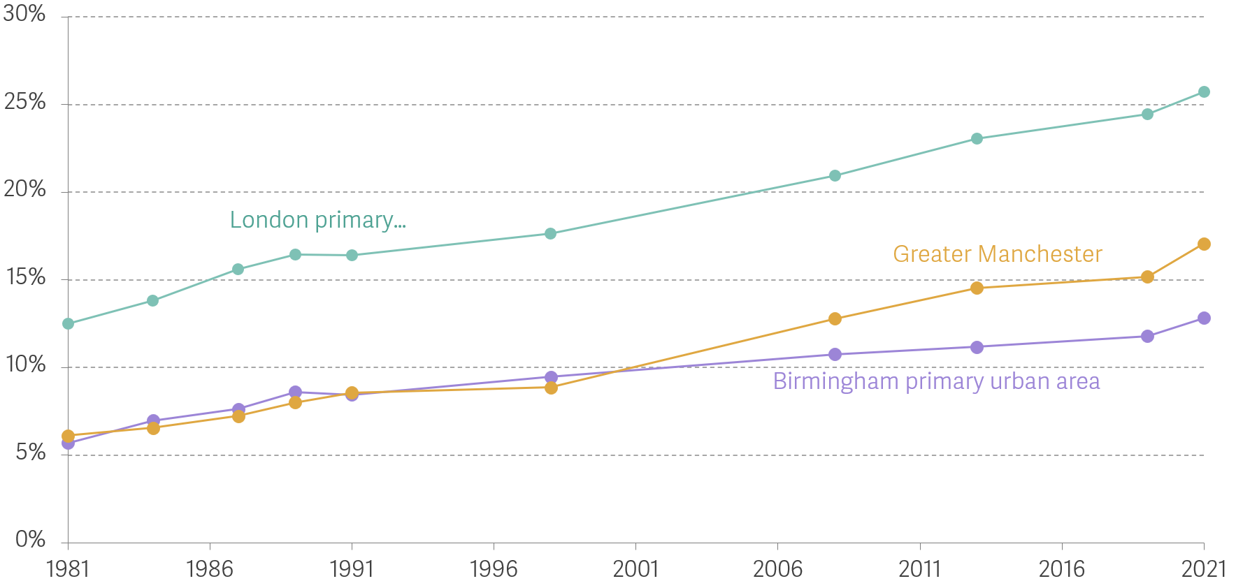
Greater Manchester has been relatively successful at transitioning to a high-value services economy
Proportion of employment in knowledge-intensive business services: Greater Manchester, and primary urban areas of Birmingham and London
Notes: Using primary urban areas for Birmingham and London for reasons of data availability.
Sources: Analysis of ONS, Census of Employment, Annual Business Inquiry, Business Register of Employment Survey.

Slide 21
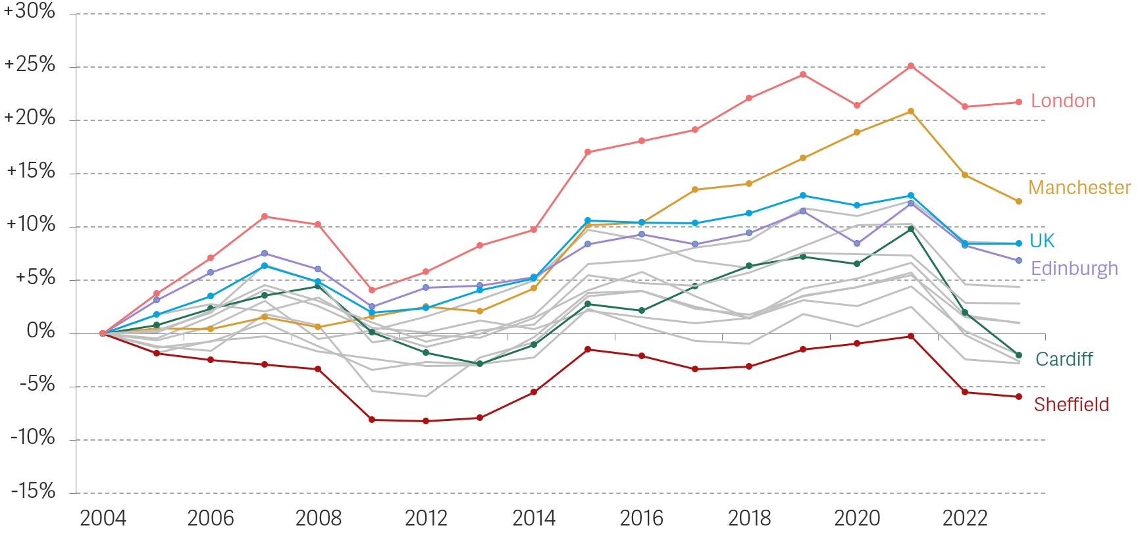
London pulls far ahead in disposable household income despite Manchester’s catch up
Change in real gross disposable household income per person: Core Cities, London, and the UK, 2004 to 2023
Notes: Figure is in Jan-Mar 2026 prices, deflated by CPI. Imputed rental income has been removed.
Source: RF analysis of ONS, Regional gross disposable household income; ONS, Consumer price inflation.

Slide 22
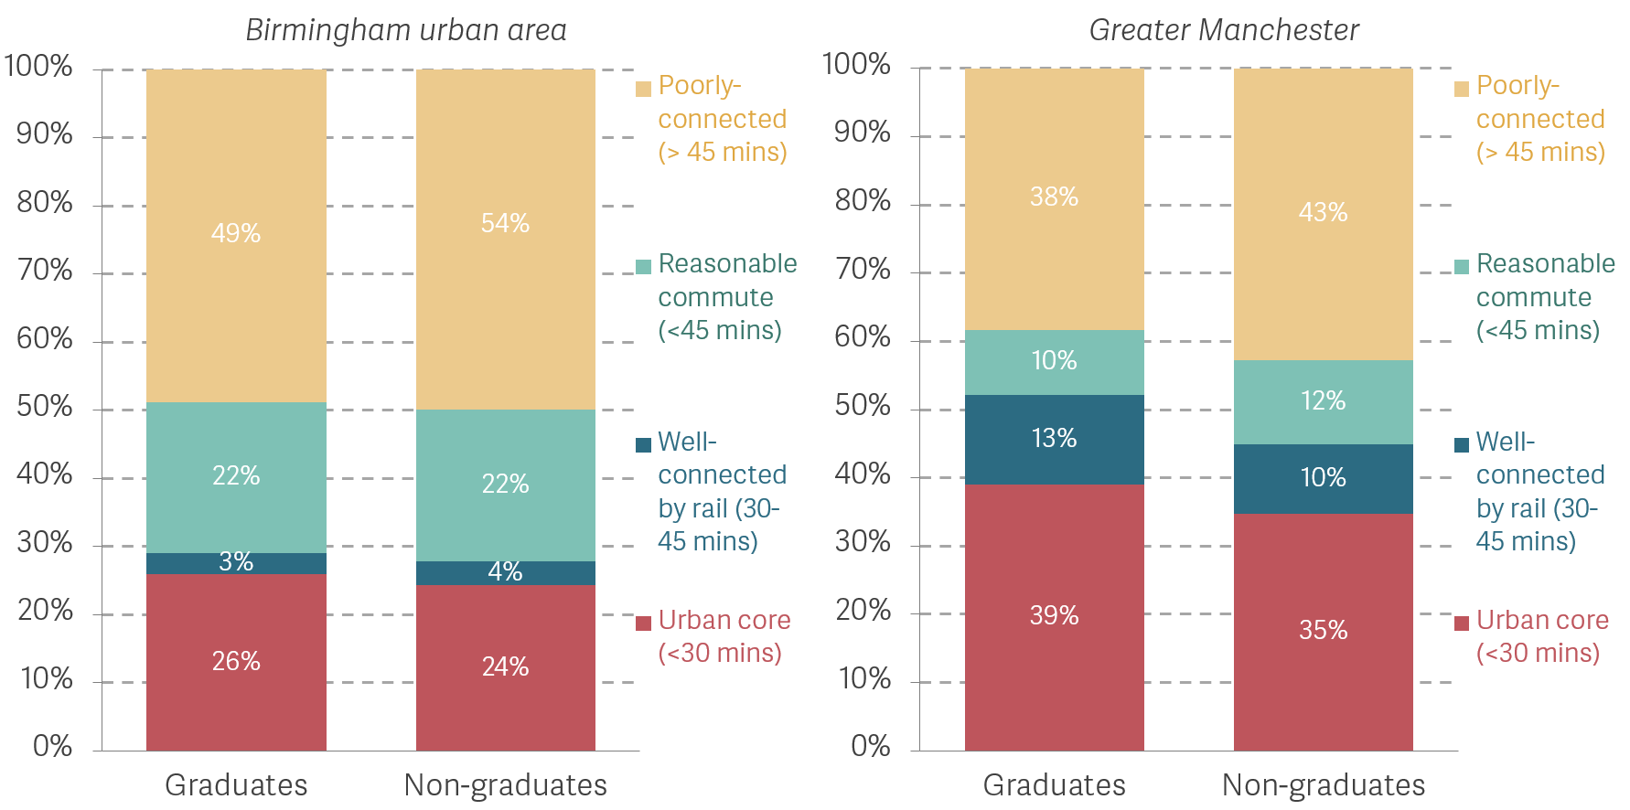
Around half of graduates in Birmingham are poorly connected, compared with a smaller share in GM
Proportion of working-age population, by qualification level and connectivity areas: Birmingham urban area (left hand panel) and Greater Manchester (right hand panel), 2021
Notes: Public transport catchment areas are measured using real-time bus data (DfT) and schedule rail data for light and heavy rail (TfWM and DfT, respectively). Estimates of the population are based on the public transport catchment areas and the numbers living in those Output Areas.
Source: Analysis of DfT, TfGM and ONS, Census 2021.

Slide 23
Policy proposals
A lot of public investment in major cities is required. We are still lagging behind second cities in Europe despite positive steps (mainly in Greater Manchester though).
Market-led commercial development in the city centre.
Expanding public transport to increase commuting size of productive (city) regions.
House building in the most productive local labour markets.
But these interventions will be most effective if accompanied by the arrival of higher-value corporate activity.

