Slide 1
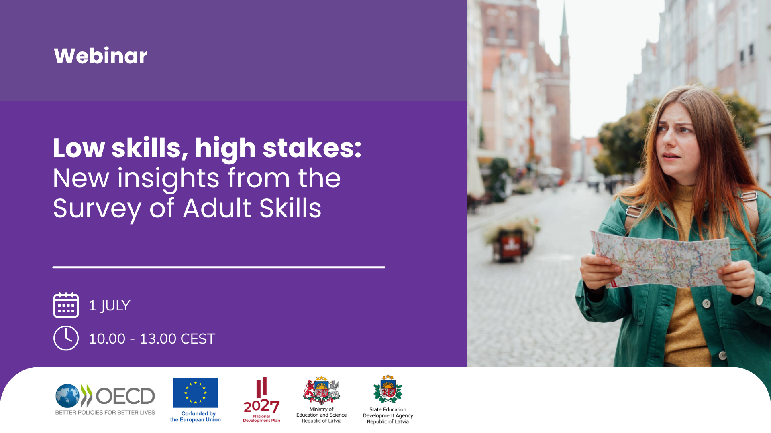

Anja Meierkord,
PIAAC Analyst, OECD
Insights into low literacy and numeracy from the Survey of Adult Skills (PIAAC)
What can Wales learn from international evidence on adult literacy and numeracy?
25 September 2026
Andreas Schleicher – Director for Education and Skills

Slide 2
Overview of this talk
1 What is PIAAC and what are its headline findings?
2 How many adults have low foundational skills and why does it matter?
3 Who has low foundational skills?
4 What direction for policy?

Slide 3
1
What is the Survey of Adult Skills
and
what are its headline findings?

Slide 4
What is the 2023 Survey of Adult Skills (PIAAC)?
adults tested
representing
673 million
16–65-year-olds
in 31 countries
domains assessed
literacy, numeracy and adaptive problem solving
variables collected
e.g. education, employment, skill use
cycle in 2022/2023
enabling trend comparison with Cycle 1 (2012-2018)
160 000
3
800
2nd
Notes:
Thirty-one countries and economies participated in Round 1 of the 2023 Survey of Adult Skills. 160,000 adults were interviewed, representing over 673 million adults worldwide. [click]
The survey measures proficiency in literacy, numeracy, and problem solving - the foundational skills individuals need to participate in society and that economies need to prosper. [click]
It also collects rich background data to support four analytical goals: describing proficiency across subgroups; identifying factors that shape skill development; and examining links between skills and economic and social outcomes. [click]
This is Cycle 2. Cycle 1 ran across three rounds between 2012 and 2018, giving us a basis for trend comparison.

Slide 5
Finland, Japan, the Netherlands, Norway and Sweden are the best-performing countries in all three domains
Comparison of countries’ and economies’ average proficiency in literacy and numeracy
Notes:
Finland, Japan, the Netherlands, Norway and Sweden are the best-performing countries in all three domains.
In 2023, adults in Finland display the highest level of proficiency in both literacy (296 points, against an average of 260 points across OECD countries) and numeracy (294 points, against an OECD average of 263). In adaptive problem solving, Finland and Japan have the highest average scores (276 points in both countries, against an OECD average of 251).
Eleven countries (Chile, Croatia, France, Hungary, Israel, Italy, Korea, Lithuania, Poland, Portugal and Spain) consistently perform below the OECD average in all skills domains.
This graphs shows what shares of adults achieve different levels of literacy proficiency from adults at or below Level 1, which can at most understand very simple texts, to adults at level 4 and 5, who have advanced literacy skills.
In France, 28% of adults are low-performers in literacy, at Level 1 and below; this is slightly more than the OECD average of 26%. Conversely, only 9%, compared to 12% on average, are high performers at Level 4 or above.

Slide 6
2
How many adults have low foundational skills and why does it matter?

Slide 7
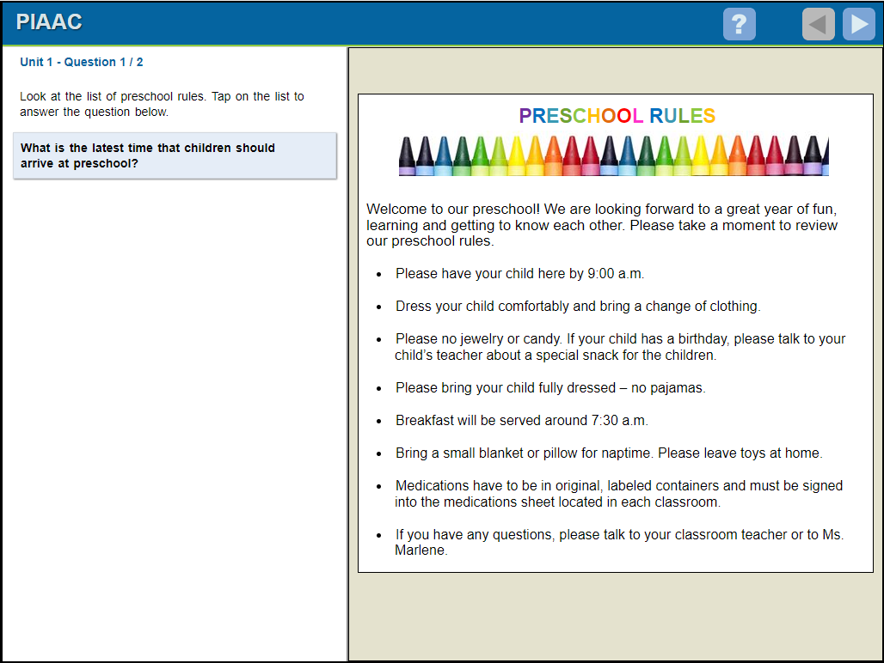
What are low foundational skills?
Literacy
Access, understand, evaluate and reflect on written texts
Low Literacy:
Achieve Level 1 or below
Numeracy
Access, use, reason critically with mathematical content, information and ideas
Low Numeracy:
Achieve Level 1 or below
Low Foundational Skills:
low literacy and / or numeracy
Notes:
Our new analysis focuses on adults with low foundational skills. [click]
We only look at literacy and numeracy – not adaptive problem solving - , because these are the two domains that allow for trend comparison across cycles.
Both are defined in ways appropriate for adults, not simply reading, writing, and arithmetic, but the ability to access, evaluate, and use written and mathematical information to function effectively in modern life.
[Click]
For this report, "low foundational skills" means performing at or below Level 1 in either literacy or numeracy on the PIAAC proficiency levels. Adults at this level typically struggle with tasks like locating a single piece of information in a short text, following simple instructions, or carrying out basic calculations. These are skills that underpin everyday workplace tasks and access to services.
[Click — present example item]

Slide 8
One in three adults lack foundational skills across the OECD
Percentage of adults scoring at or below Level 1 in literacy or numeracy, 2023

Slide 9
Accurate reading is common – fluent reading is not
Share of adults with low foundational skills by reader profile, by country, 2023
Notes:
There is often a misunderstanding that the data I just presented suggests that one in three adults across the OECD cannot read. With the analysis I present here, we show that the picture is much more nuanced.
[click]
Using data on speed and accuracy of responses in the sentence comprehension task of the literacy components, we create a typology of four types of readers:
Fluent readers – who read quickly and accurately
Effortful readers – who are slower, but still accurate
Surface readers – who are fast, but make errors
Struggling readers – who are both slow and inaccurate
Across the OECD, 54% of adults with low skills are either fluent or effortful readers. So, they can generally read simple sentences accurately, but their reading is not always fast and certainly not automatic.
What’s interesting is that in some Nordic countries, like Norway and Sweden, there is a much higher share of struggling readers among low-skilled adults. This is at least partly driven by the relatively large share of non-native speakers within this group.
So, the key takeaway is: Having low skills does not mean people cannot read. For many, it simply means that reading requires more effort and leaves less mental energy for actually decoding information.

Slide 10
These skills are the foundation of opportunity
Employment
Earnings
Well-being
Civic Life
3 in 10
adults with low foundational skills do not participate in the labour market
USD 5
lower hourly wages for adults with low vs. medium foundational skills
More than USD 10 in Singapore and Switzerland
Worse health outcomes,
lower life satisfaction
Lower trust in institutions, less likely to feel able to influence political processes (although not everywhere)
Notes:
The evidence is clear on the stakes of large populations of adults with low skills.
Adults with low foundational skills face significant disadvantages in employment, earnings, health, and civic engagement.
[Click]
3 in 10 adults with low foundational skills do not participate in the labour market.
[Click]
Among those who are in work, hourly earnings are around five dollars lower on average than for adults with medium levels of skills - and in countries like Singapore and Switzerland, that gap exceeds ten dollars.
[Click]
Adults with low foundational skills also report worse health, lower life satisfaction, and weaker trust in others and in institutions. – And I am sure Anke will tells us more about this in her presentation

Slide 11
3
Who has low foundational skills?

Slide 12
Low education is the strongest predictor of low skills
Relative importance of variables to predict low skills
Notes:
To understand who has low skills, we asked ourselves which factors are most useful for predicting whether an individual has low foundational skills.
We then use a machine learning model that ranks variables by predictive power.
[click]
Education comes out on top. In 25 of 31 countries, it is the single strongest predictor of having low skills. In most of the remaining countries, it ranks second.
[click]
The exceptions are informative. In Denmark, Norway, and Sweden, the strongest predictor is whether the respondent's native language differs from the language of assessment.
This reflects the fact that in those countries, the low-skilled population is predominantly foreign-born.
[click]
In Israel, parental education ranks first, highlighting the importance of inter-generational transmission of low skills.
[click]
In Estonia, age is the strongest predictor of low skills.

Slide 13
Adults with medium or high education levels can have low skills.
Share of adults with low foundational skills by education level, 2023

Slide 14
Older adults are more likely to have low skills nearly everywhere…
Share of adults with low foundational skills by age group, 2023

Slide 15
… and migrants are generally more likely to be low‑skilled.
Share of adults with low foundational skills by migration background, 2023

Slide 16
4
What direction for policy?

Slide 17
Rationale for intervention and key policy levers
Rationale for intervention
Reducing individual barriers to participation
Address under-provision by employers
Unlock wider economic and social returns
Policy Levers
Successful recruitment
Awareness raising and motivation
Active outreach
Successful policy design
Contextualised learning
Intensity, flexibility, stackability
Recognition of prior learning
Educator quality and professional development
Enabling conditions
Financial incentives and addressing cost
Addressing life barriers to learning
Workplaces as engines of skill development
Supporting skills in families and communities

Slide 18
Four country profiles, four policy logics
Near-threshold countries
Deep deficit countries
Canada, Czechia, Croatia, Estonia, Hungary, Ireland, Italy, Japan, Korea, Lithuania, Poland, Slovak Republic, Spain, Sweden
Population clustered just below medium proficiency and relatively homogenous. Well-targeted short-course upskilling is a viable policy lever.
Chile, Denmark, Finland, Flemish Region (BE), France, Germany, Israel, Netherlands, Portugal
Population further from medium proficiency and more internally diverse. Provision must be intensive, long-duration, and embedded in an educational equity agenda.
Literacy gap countries
Numeracy gap countries
Austria, Latvia, Norway, Singapore, Switzerland
Primarily a language integration challenge. Rapid, sustained language acquisition support for migrants and language minorities is the highest-return investment.
England (UK), New Zealand, United States
Challenge likely originates upstream in compulsory mathematics education. Adult provision helps at the margins, but high quality and equitable initial education is key.
Notes:
Only very briefly in the interest of time and I am sure we can discuss this further in the panel discussion.
In our report, we also convey the message that the right policy response is not the same everywhere. The composition of the low-skilled population varies fundamentally across countries, and so does the logic of intervention. Four country profiles emerge from the data.
[Click]
In near-threshold countries, most adults with low skills are clustered just below the threshold to medium proficiency. The way to medium proficiency for this population is short. The primary policy lever here is efficient, targeted upskilling - short, well-designed courses can move a significant share of adults across the threshold.
[Click]
In deep-deficit countries, the challenge is more fundamental. Provision must be intensive, long in duration, and differentiated. And it cannot be separated from a broader educational equity agenda. Short courses – at least those that do not form part of an upskilling pathway - will not be sufficient.
[Click]
In literacy gap countries, the low-skilled population is disproportionately composed of migrants or language minorities assessed in a non-native language. The central priority is rapid, high-quality language integration training.
[Click]
Numeracy gap countries point to a different problem: likely systematic weaknesses in initial mathematics education. Remediation is part of the answer, but so is prevention through stronger mathematics teaching in schools.
Across all profiles, prevention must be part of the long-term strategy. High-quality early childhood education - especially for children from disadvantaged families - and ensuring that skills acquired in adulthood are reinforced through use in work and everyday life.

