Slide 1

Adult Learning in Wales
Notes:
Welcome and intro:

Slide 2
Who delivers adult learning?
Adult Community Learning Partnerships
Local Authorities
FE colleges
Universities
Independent training providers
Community organisations
Welsh for adults
…..and more!
Notes:
Adult learning in its broadest sense takes place in various settings and through various providers across the tertiary sector. For the purposes of much of this I'm talking about adults aged 19+ but some providers such as FE colleges and others offer education across the post-16 spectrum.
There are 13 ALP in Wales that deliver adult community learning alongside Adult Learning Wales. Focus on essential skills, employability skills and ESOL but there is much more than this and the wider provision where it can be offered has huge potential to support health and well being and offer people a step into learning.
FE colleges deliver a significant amount of learning to adults through a range of provision from informal learning through to accredited provision, much of this is delivered through their Part time offer but adults may also be in full time FE too. Wayne – specific aspect of what CAVC do in the adult learning space.
Universities also have adult learning provision and the OU offers a flexible route into HE that Vicky will explain more about.
Community partners also have a key role to play as providers of learning who have access to and are trusted by people who may have had difficulties in traditional provision. Llamau.
Independent training providers deliver education and employment support programmes – some aimed at YP but many with a focus on adult learners. ACT.
And they don't work in isolation, the Partnerships have collaboration at their heart and many of these providers work together on pathways for learners to support their progression.
There is also of course adult learning delivered through Welsh for adults courses and this is certainly not a comprehensive list there is more including work based and employer learning and programmes delivered in partnership with Tradeons via WULF which is an important way of upskilling people in the workforce and accessing learners who may not otherwise consider adult education.

Slide 3
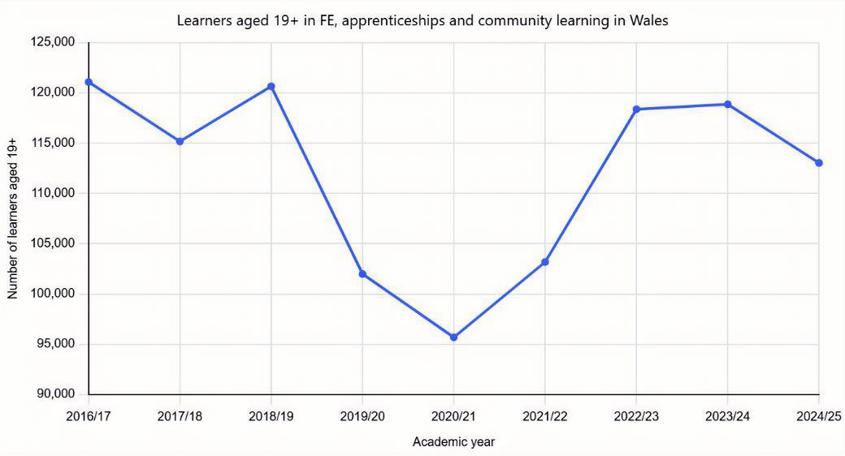
Number of learners
Stats Wales: Learners in further education, apprenticeships and community learning by provider, provision type and demographic information
Notes:
There were approximately 113,035 learners aged 19 and over participating in further education, apprenticeships or community learning in Wales in 2024/25.
That compares with 121,080 in 2016/17, meaning the number was 8,045 lower, or 6.6% lower, across the period.
Around seven in ten learners participating in FE, apprenticeships and community learning in Wales are aged 19 or over. Adult learning is a core part of the post-16 system.
Between 2023/24 and 2024/25, the 19+ population fell: 118,870 → 113,035 That's a reduction of 5,835 learners, or 4.9% in a single year.
Decline seems due to small decline in apprenticeships, decline in learners in PT FE and decline in numbers in ACL.
Why is this important – demographic change, workforce and skills need, importance of upskilling and reskilling, health impacts and number of adults who are econominically inactive as well as many of the alarming figures of YP not in education, employment or training, these are people who need to be able to come back into the education system.

Slide 4
Adult Participation in Learning Survey 2025
Annual survey of 5,000 people across the UK, boosted sample for Wales in 2025
Broad definition of learning – beyond government and employer funded education
The good news: More adults are participating in learning in Wales than in the UK as a whole
The challenge: Significant socio-demographic inequalities
Notes:
This is a survey that L&W runs each year, last year a boosted sample for Wales funded by Medr – 800 adults.
Purposefully broad definition of learning – formal and informal and self directed learning as well.
I will run through some of the findings for Wales, be interested to see if this reflects any of your experiences of working with learners but also where WULF provision may be addressing some of the barriers to learning that the survey highlights.

Slide 5
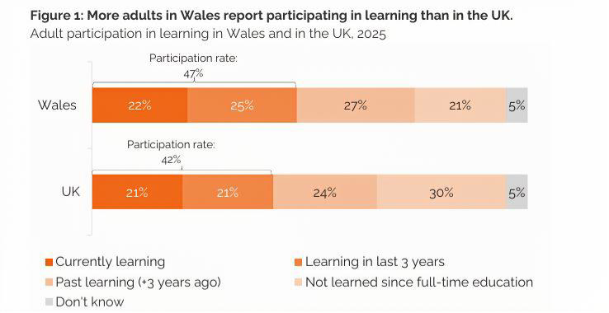
Learning participation is increasing
The figure for 2023 (when Wales sample was last boosted) was 41%
Notes:
47% of people in Wales are currently learning or have learnt in the last 3 years cf. 42% for UK as a whole. But still 1/5 of people have not learned since leaving full time education and this is with a wide definition of learning being asked for.
But figure is higher than last time survey was boosted for Wales so overall movement in the right direction.

Slide 6
But is learning reaching those who need it the most?
Social grade is a key predictor of participation in learning
The longer people stay in full-time education, the more likely they are to learn as an adult
People in work are more likely to participate in learning
Inequalities are at risk of becoming self-perpetuating: Just above nine in ten current learners (92%) and 78% of recent learners expect to take part in learning in the future.
Participation in learning decreases with age
Notes:
But…..
Drilling into the demographics of the respondents a picture emerges from the survey that suggests that those who are potentially the most likely to benefit from learning and least likely to access it. Inequalities by social grade and working status appear higher in Wales.
So…
55% of people in highest social grade have taken part in learning cf. 36% in lowest social grade
53% of people who left education aged 21 or over have reported learning cf. 34% who left aged 16 or under, but our figures for those who left at 16.17 or 18 are a lot higher than rest of UK
59% full time employees report learning cf. 28% economically inactive people
43% of learners report they did so at work
People aged 50-74 are half as likely to have taken part in learning as those aged 25-49
Only 14% learners who left FTE aged 16 expect to take part in learning in the future

Slide 7
Motivations for learning
In Wales, 58% of learners report their main motivation for learning is their work or career.
But broader motivations are varied, the top 6:
  To develop myself as a person
  To help me do my current job better
  To get a recognised qualification
  For the enjoyment of learning
  To improve my self-confidence
  To improve my health and well-being
Most commonly reported benefits are: self-confidence, moving towards personal goals, enjoying learning more, meeting new people, being better at current job or improving skills.

Slide 8
Benefits of learning
People who have engaged in learning in the last three years report a range of positive changes as a result - with 96% identifying at least one benefit.
My self-confidence has improved
I have achieved/moved towards my personal development goals
I enjoy learning more I have met new people
I am better at my current job/have improved my skills
I have got/expect to get a recognised qualification
My health and wellbeing have improved I have a greater understanding of other people and cultures
I am more engaged/involved in my local community
I have got/expect to get a new or different job
I have changed/expect to change the type of work I do/my career

Slide 9
Barriers to learning
More than four in five (84%) respondents who have not taken part in learning in the past three years identified at least one barrier that prevented them from doing so
Feeling too old (21% of those aged 25-49 and rising with age)
Cost
I don’t want to
Time pressures
Confidence
Notes:
Number of barriers – some real and some perceived. Importance of flexible provision and engagement activities that feel safe for people to try. But also importance of things like Adult Learners Week and the Inspire awards which show people what is out there offer inspiration and motivation.

Slide 10
learningandwork.wales | @LearnWorkCymru
Notes:
Now going to move on to hear from adult learning providers. I've asked each of them to speak for 5 mins and then we'll have a discussion at the end and there may be time for some audience questions.

