Slide 1

Apprenticeships: Upskilling Adults
for the Future of Work in Wales

Slide 2

Why adult learning matters?
Learning doesn’t stop after education.
Learning continues throughout a person's working life
Adults need opportunities to gain new skills and progress their careers
Many cannot afford to leave employment to study full-time
Lifelong learning is essential for a skilled and adaptable workforce
Apprenticeships make continuous professional development accessible while remaining in work.

Slide 3
The Apprenticeship Ladder
Degree Apprenticeship
(Level 6)
Higher Apprenticeship (Levels 4 / Level 5)
Apprenticeship (Level 3)
Foundation Apprenticeship (Level 2)

Slide 4
Changing the perception of apprenticeships
in Wales.
“Apprenticeships are only for young people”
The reality: Apprenticeships in Wales are available to people over the aged of 16 and specifically targets career changers or existing employees looking to increase their skills.
“Apprenticeships are only manual or trade jobs”
The reality: There are apprenticeships available in over 20 different sectors, including digital, business services, healthcare and more.
“You can’t do an apprenticeship if you’ve already got qualifications”
The reality: Eligibility and funding can depend on the particular qualification. Previous qualifications doesn’t always mean you can’t start an apprenticeship.

Slide 5

Benefits of
apprenticeships
Learning while earning.
Apprentices can:
Remain in employment while learning
Gain a recognised qualification
Apply learning directly in the workplace
Progress their career without leaving work

Slide 6
ACT can offer apprenticeships across a wide range of sectors
We support employers and employees through apprenticeships in:
Data Analyst
Project Management
Procurement & Supply
Accounting & Finance
HR Management
Leadership & Management
And other professional qualifications.

Slide 7

Why these skills matter now
Modern workplaces are becoming:
More digital
More data-driven
More complex
Employers now need people who can analyse information, manage projects, lead teams and adapt to change.

Slide 8
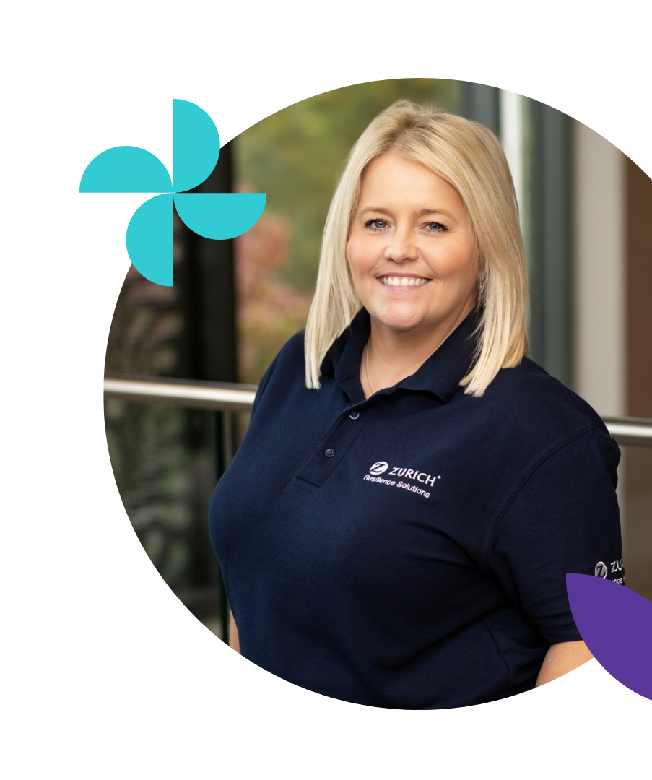
Lisa’s Learning Journey
Lisa Winter
Vice President, Dinner Secretary & CPD & Education Officer of The Insurance Institute of Cardiff

Slide 9

Apprenticeships develop careers
Apprenticeships,
Help adults gain new skills
Help employers develop their workforce
Help Wales meet changing economic demands
Support lifelong learning and career progression

Slide 10


