Slide 1
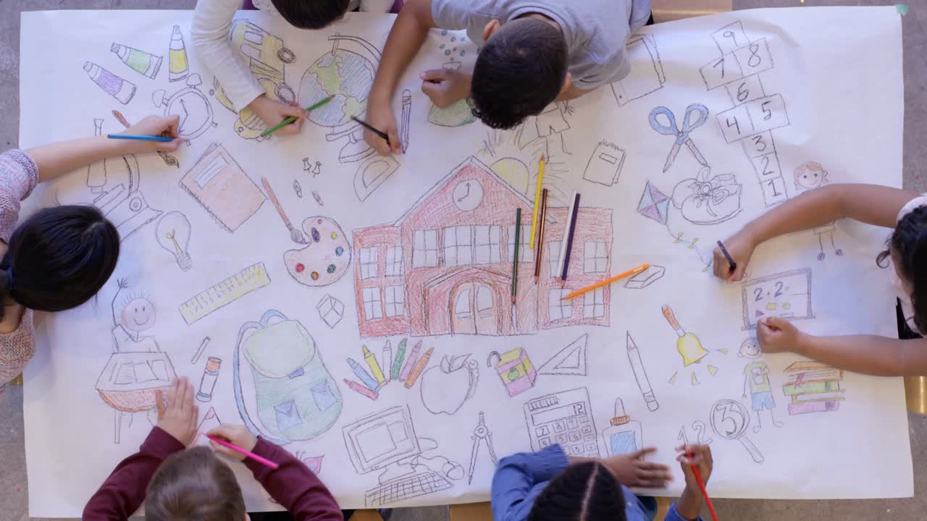

Family Learning
At Cardiff and Vale College

Slide 2

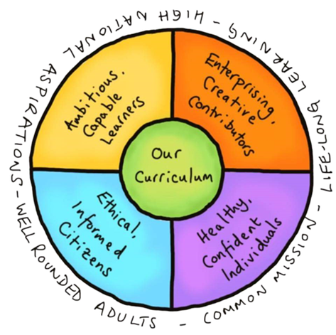
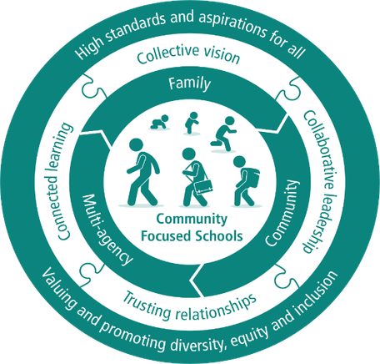
Family Learning at CAVC
How does it support children and families?
  Enhance language, literacy, and numeracy skills for parents and children. (linked to CfW)
  Support family learning programmes to boost confidence, life skills, community cohesion.
  Collaborate with schools and communities to engage families, remove barriers, fostering a positive views of education. (linked to CFS)
  Encourage effective and enjoyable home learning.
  Community to Campus - develop community links, opens doors to progression opportunities for further learning.
Curriculum for Wales
Community Focused Schools

Slide 3

What People Learn
  Numeracy
    Data Handling, Measure and Shape
    Develop Early Number Skills Play
    Developing a Childs Knowledge of Number
    Help a Child with Maths
    Mathematics and Multiplication
    Technology to Support a Child's Numeracy
  Literacy
    Learning to Read in the Foundation Phase
    Preparing a Child for Reading
    Recognising Words and Signs
    Using Poetry and Rhyme with a child
  STEM
    Teamwork: Building a model
    STEM Skills: Using eco-friendly materials to engineer a model
    Staying safe online
    Introduction to Artificial Intelligence
  Wellbeing
    The 6 Areas of wellbeing
    What can we do to support our children’s wellbeing?
  Welsh
    Assisting Children with their Welsh

Slide 4
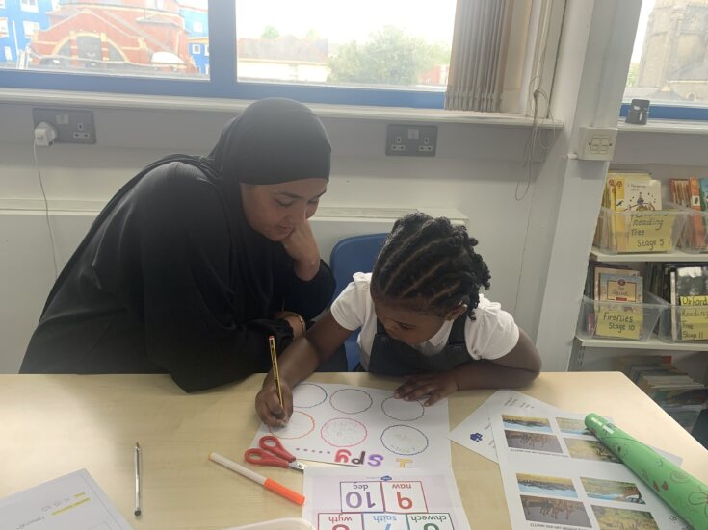
What is the delivery model?
  11 weeks x 3 hours accredited courses (Agored)
  Literacy, numeracy ,ESOL, Wellbeing or STEM– differentiated to meet needs
  Adult only + joint (in primary schools)
  Activity based provision (Fizzy Fun)
  Stand alone workshops (skills based)
  Bespoke courses to suit schools and/or parents
  Delivered within schools across Cardiff and Vale of Glamorgan
  Community based workshops
  Progression week
7

Slide 5
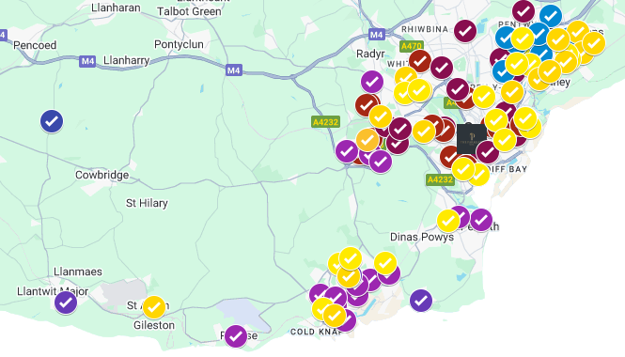
Partnership with Schools
  A large room to accommodate a minimum of 8 parents and 8 children
  Support in parental engagement (can by parental choice or targeted parents)
  Some schools like to provide refreshments(tea, coffee, biscuits)
  A link person from the school and collect children from class not leaving the parents unattended.
  The provision is free and funded by Cardiff and Vale College with the adults being the key learning focus.
Where we deliver!
88
schools across the region in areas of high deprivation (WIMD)

Slide 6
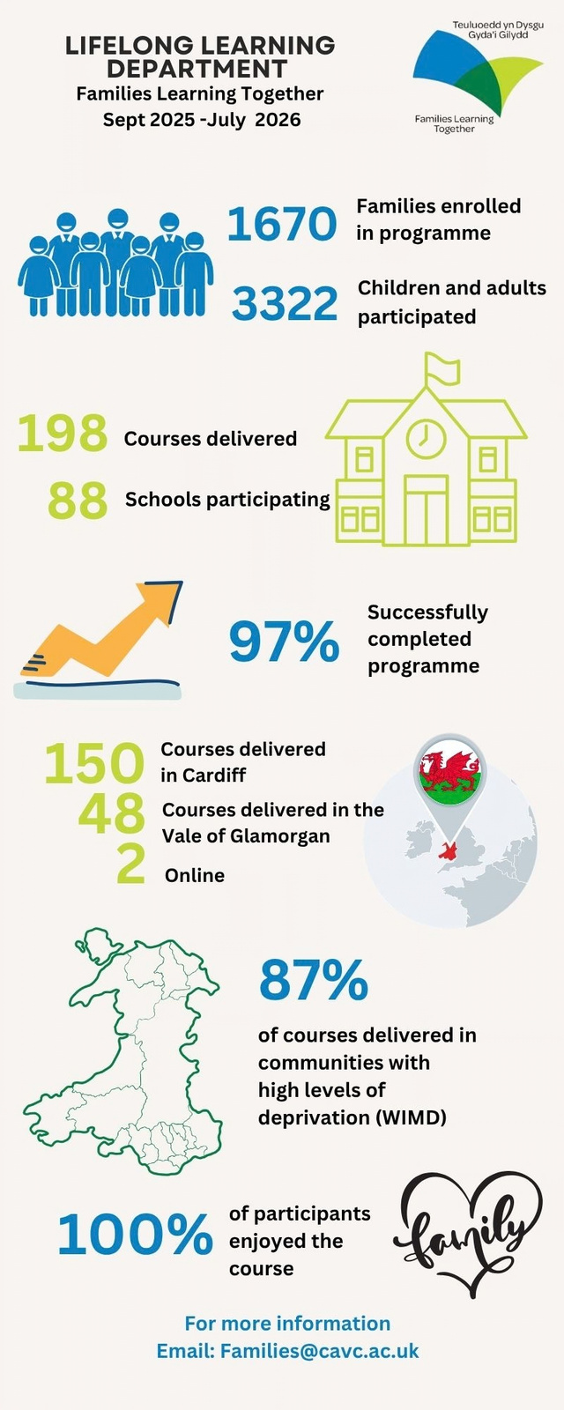

IMPACT!
84.5%
reported they are better at looking after their wellbeing.
reported increased confidence and feeling more outgoing.
reported becoming more active.
reported improved mental health.
reported improved confidence in supporting their childs learning at home.
of adult family learners are female
82%
82.2%
of adult family learners are between 50 - 79 yrs.
13.5%
73.6%
of adult family learners are between 26 - 49 yrs.
69.8%
74%
60%

Slide 7

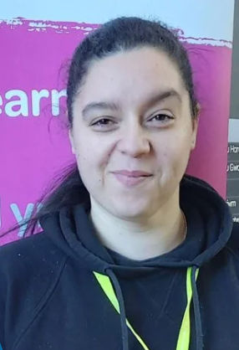
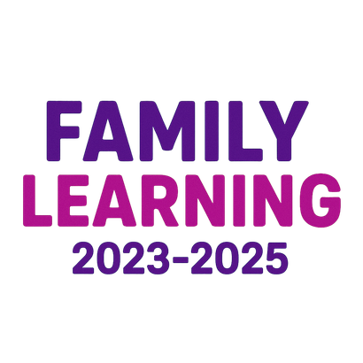





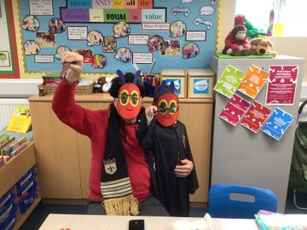
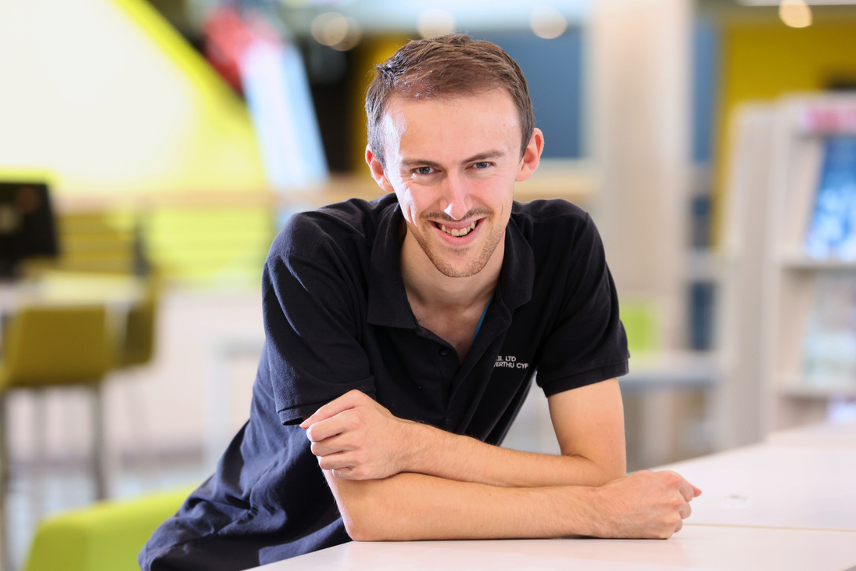
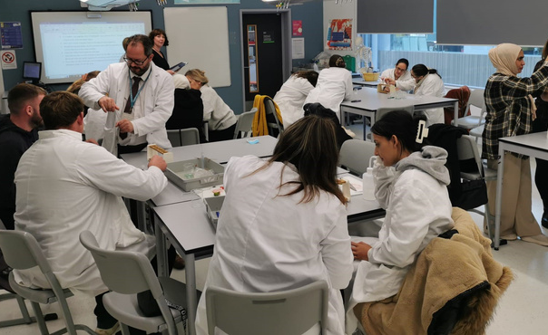
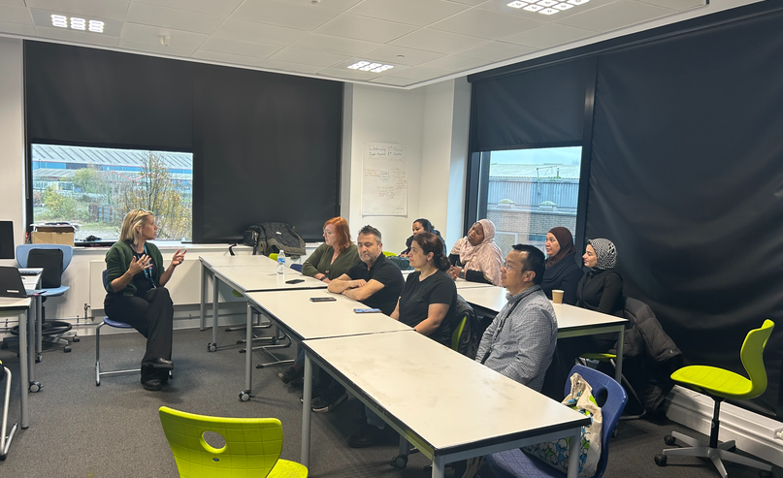
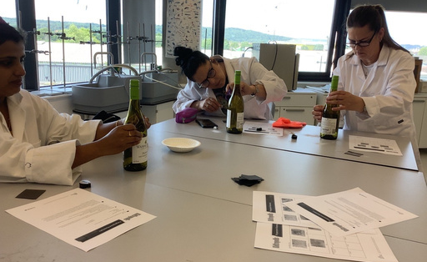
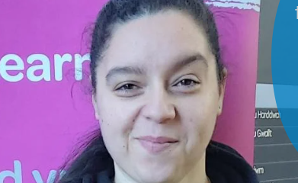
“I started with family learning, then did an Application of Number course at CAVC and then I progressed onto Access to Healthcare Science. I love learning at CAVC and I am know going tostudy an Open University course”
Community to Campus
28%
of adult family learners progress onto further study
Kimberley’s Journey

Slide 8

Community Voice
“Great ideas and advie on using leanring APPs.”
“It’ has made me able to help my children save and look at money differently for the first time.”
“I want to start an access course for Science.”
“I have enjoyed every part of this course. I have learnt many new skills and ways to budget...fun ways to save money.”
“This course has introduced to me new ways of involving my children in taking an interest in money, the role it plays in life and how to manage it. “
“It’s given me ideas on how to start my own business.”
“It has helped my maths skills and understanding of money.It has been nice to make new friends and get me on to course that can help me in the future.”
I’ve made new friends and now we share a whatsapp group so we can meet up
“It has given me confidence to be around people again.”

Slide 9
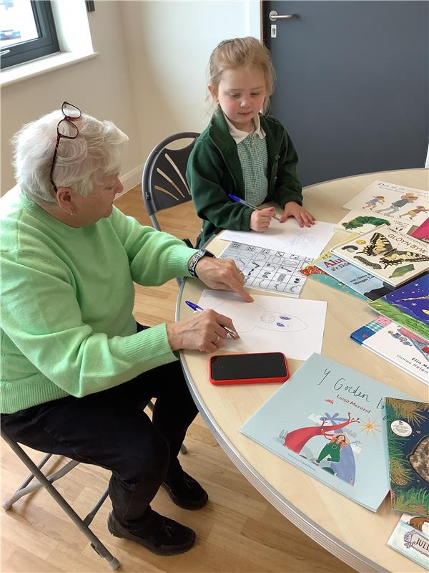
Takeaways
  Accessible in the community
  Fosters Lifelong Learning within the family
  Bridges Generational Gaps
  Improves health and wellbeing
  Prepares for Future (Second Chance) Careers
  Encourages Inclusivity
  Improves community cohesion

